Slide 1
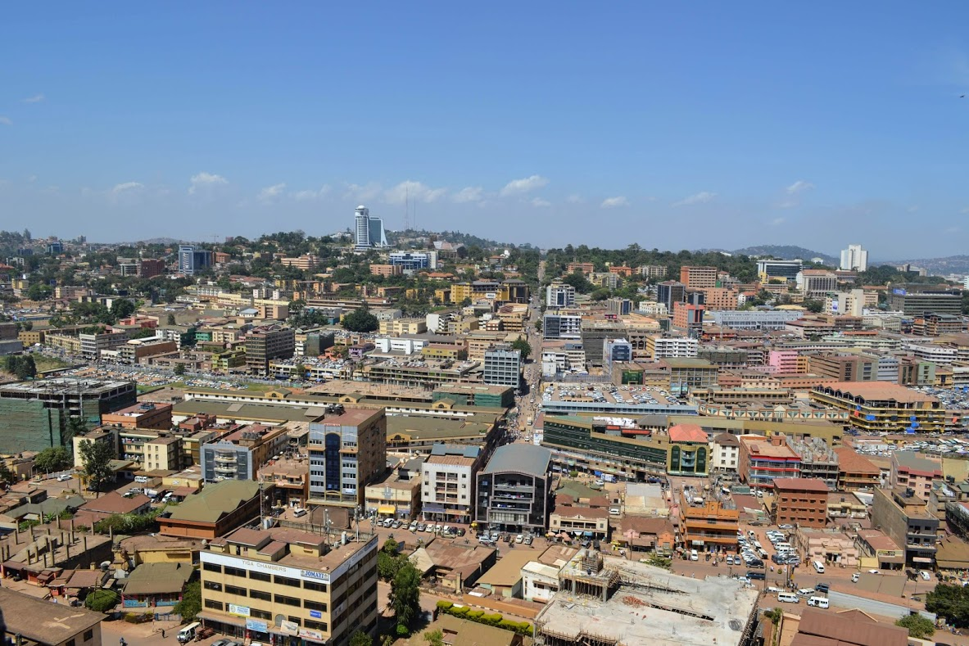
Uganda: A Paradoxical Paradise?
Elena Habersky
Center for Migration and Refugee Studies, AUC
Wednesday, December 4, 2019

Slide 2
Presentation outline
Background
Uganda Refugee Policy
Theoretical Framework
Ethnographic Fieldwork
Conclusion

Slide 3
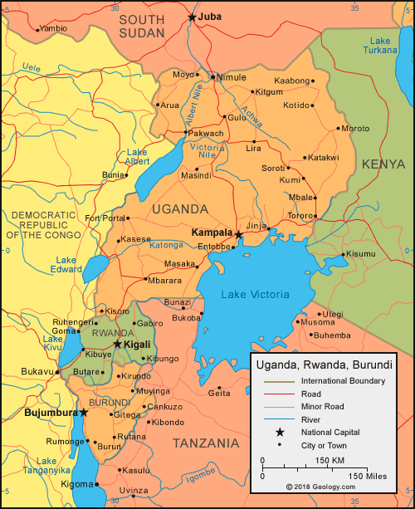
Uganda, officially the Republic of Uganda, is a landlocked country (except for its borders with Lake Victoria and Lake Albert) in East-Central Africa. It is bordered to the east by Kenya, to the north by South Sudan, to the west by the Democratic Republic of the Congo, to the south-west by Rwanda, and to the south by Tanzania.

Slide 4
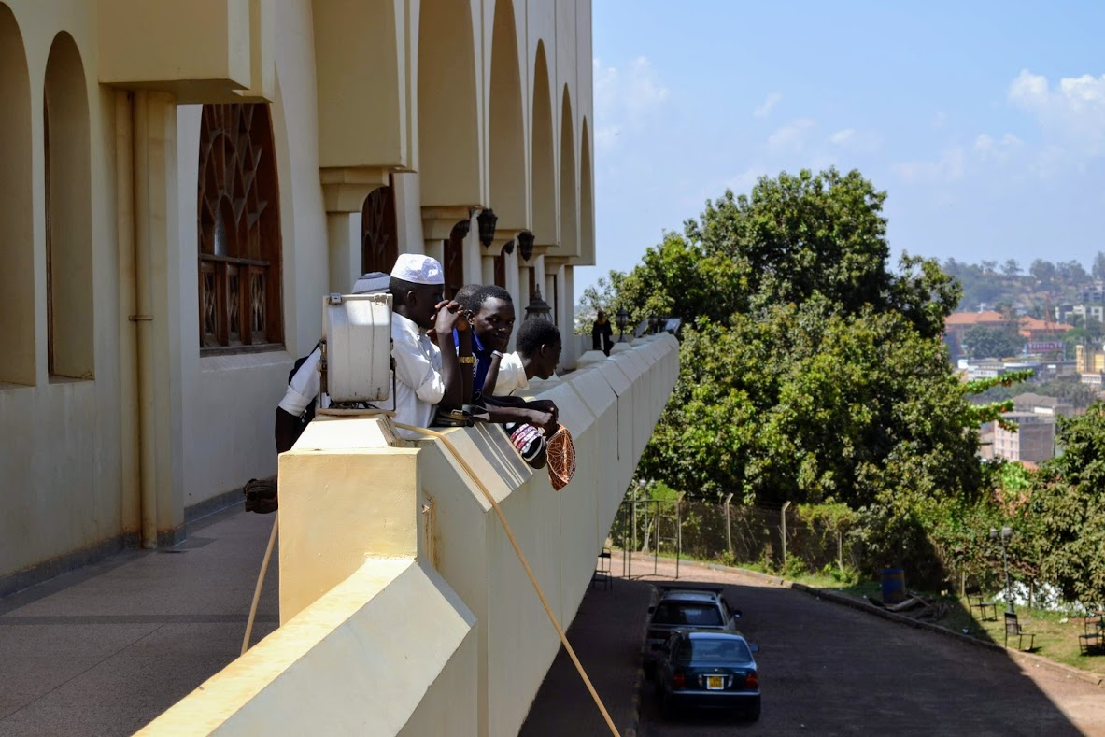
Background
Uganda currently hosts the most refugees in Africa: 1,362,269 (31/10/19) https://data2.unhcr.org/en/country/uga
27.6% of these refugees live in the Kampala district
Billed as a “Paradise for Refugees”: https://www.equaltimes.org/starting-over-in-in-the-most?lang=en#.XdUaS-gzaM8

Slide 5
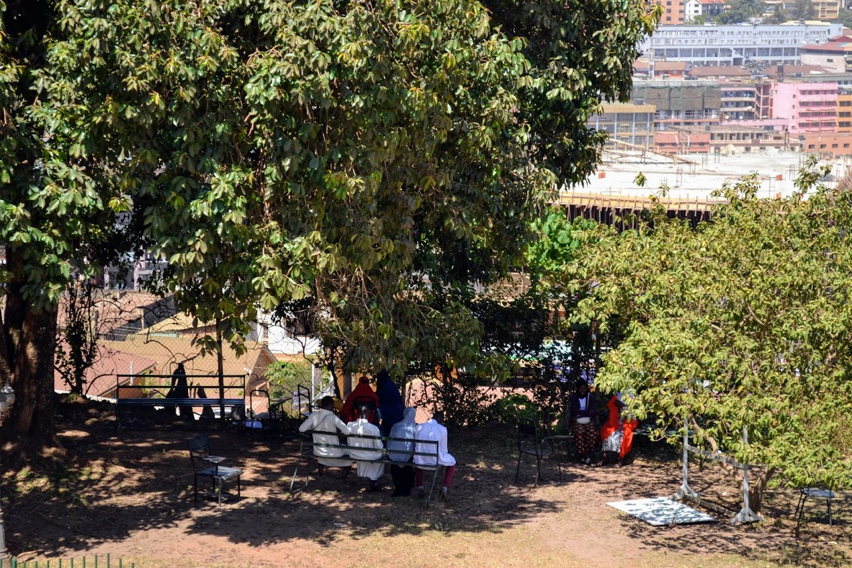
Uganda Refugee Policy
Economically, Uganda is considered a low-income country
The 2006 ‘Refugees Act’ and 2010 ‘Refugees Regulations’ laws allows asylum-seekers and refugees to access services, like healthcare and education, on par with services provided to nationals

Slide 6
Theoretical framework
Bakewell, Oliver. "'Keeping them in their Place': The Ambivalent Relationship between Development and Migration in Africa." Third World Quarterly 29, no. 7 (2008): 1341-1358.
Chimni, B. S. "Aid, Relief, and Containment: The First Asylum Country and Beyond." International Migration 40, no. 5 (2002): 75-94.
Chimni, B. S. "The Geopolitics of Refugee Studies: A View from the South." Journal of Refugee Studies 11, no. 4 (1998): 350-374.
Ilcan, S., M. Oliver, and L. Connoy. "Humanitarian Assistance, Refugee Management, and Self-Reliance Schemes: Nakivale Refugee Settlement". Luann Good-Gingrich and Stefan Köngeter, eds., Transnational social policy – Social support in a world on the move. London and New York: Routledge. (2017): 152-177.

Slide 7
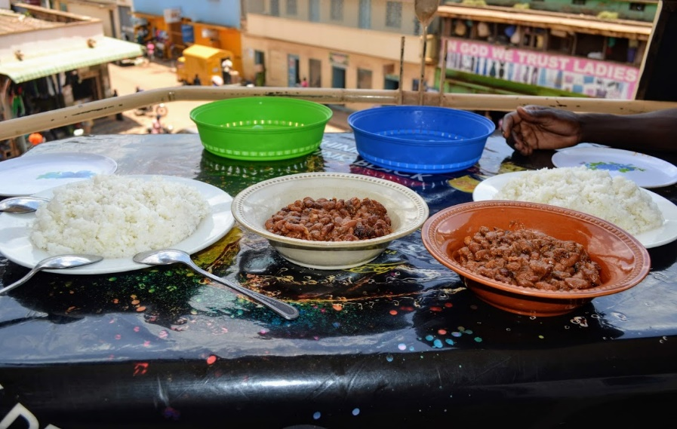
March 3- March 29, 2019
Conducted 18 Ethnographic Interviews
Focused on Ugandan, Congolese, and Darfuri interlocutors
Met with the Refugee Law Project, Makerere University
Ugandans
Male 26 yrs. old
Congolese
Male 29 yrs. old
Darfuris
Female 37 yrs. old
Male 32 yrs. old
Male 29 yrs. old
Male 34 yrs. old
Male 45 yrs. old
Male 50 yrs. old
Male 40 yrs. old
Female 52 yrs. old

Slide 8
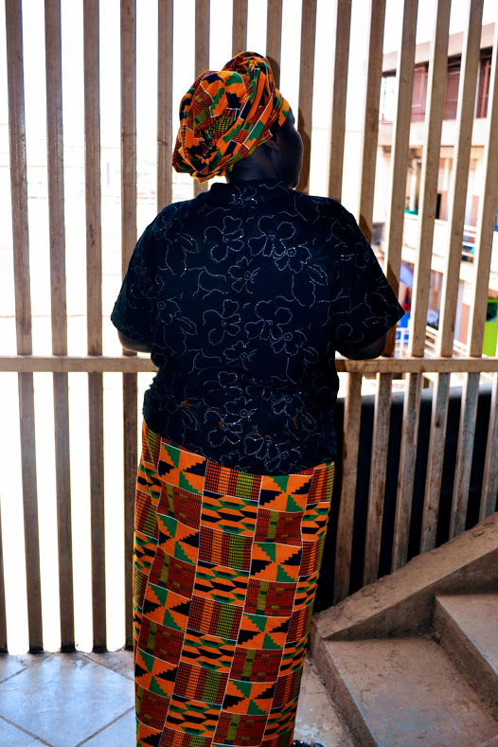
Dr. Suzie Nansozi Muwanga, Uganda
All Ugandans are skeptical why the government of Uganda is going against its East African neighbors
Corruption only solidified this view: http://www.thenewhumanitarian.org/news/2019/02/28/donors-freeze-uganda-refugee-aid-after-un-mismanagement-scandal
Is the humanitarian aid a win-win situation for the country and the refugees?
Longer wait times in medical clinics
Decrease in quality of services
Competition breeds resentment

Slide 9
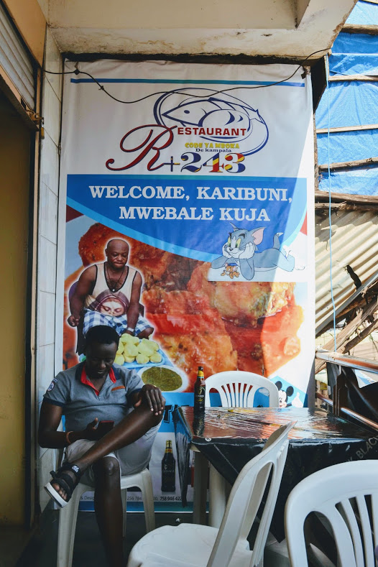
Pierre*, 36 years old, Democratic Republic of the Congo
As of March 2019, had been in Uganda for 4 months with his wife and 3 children
Originally entered and went to a refugee settlement on the border with the DRC-has a mixed migration background (refugee +economic migrant)
However, there was no food and he helped organize a protest, which put him in a precarious situation
He went immediately to Kampala, but now has difficulty finding stable work and is unsure how we will get his oldest child into school next year

Slide 10
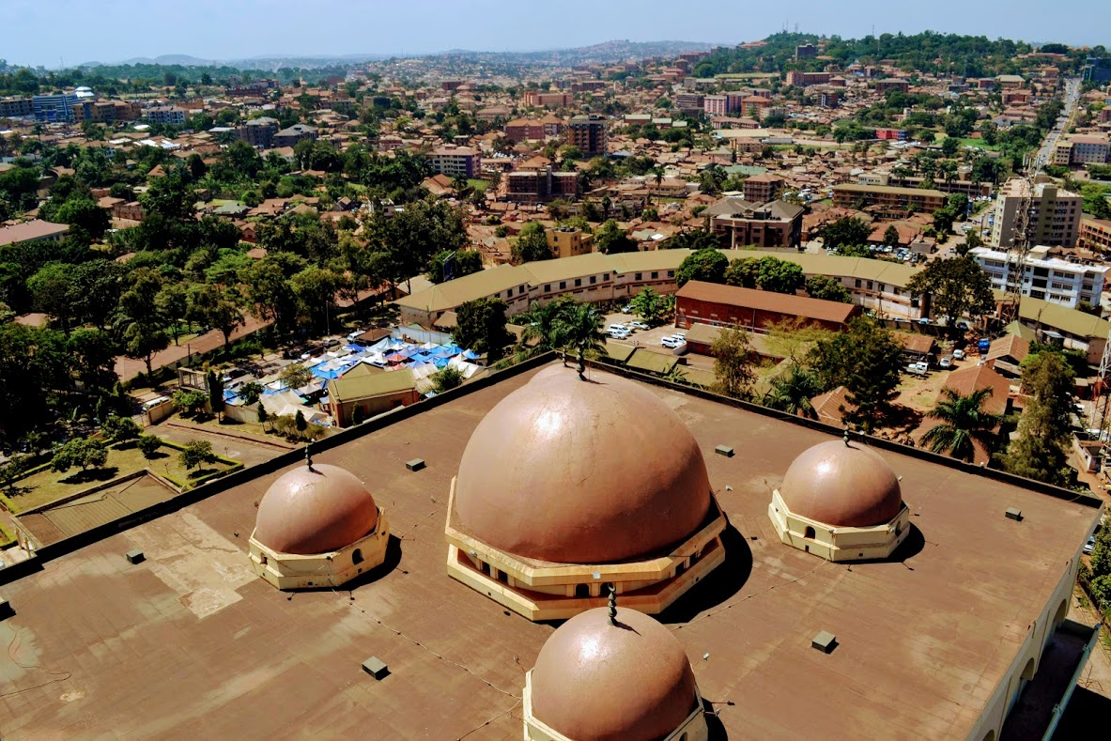
Abdul Salam*, 29 years old, Western Darfur State, Sudan
8 years in Kampala; registered refugee. Younger brother in Kampala and older brother in S. Sudan, rest of family still in Darfur
Journeyed from Darfur to S. Sudan (2 months), then Uganda
Has a Bachelor’s which he paid for himself by selling goods in S. Sudan (porous borders)
Happy Uganda has stability, but it concerned with the 2021 presidential elections. If there was a political issue, believes Uganda would kick them out, no problem

Slide 11
Conclusion
While Uganda’s welcoming of refugees and progressive laws should be lauded by the international community, the view of Uganda as a “refugee paradise” should be further critiqued
Uganda is able to exploit the EU/international system for their own personal gain. However, this gain is rarely seen by the public or the refugee communities.
In order to gain transparency and accountability, Uganda attempts to manage migration at the expense of refugees.
Uganda 2019-2020 Refugee Response Plan: https://data2.unhcr.org/en/documents/details/69674
927 million USD (2019), 826 million USD(2020), over 100 partners

Slide 12
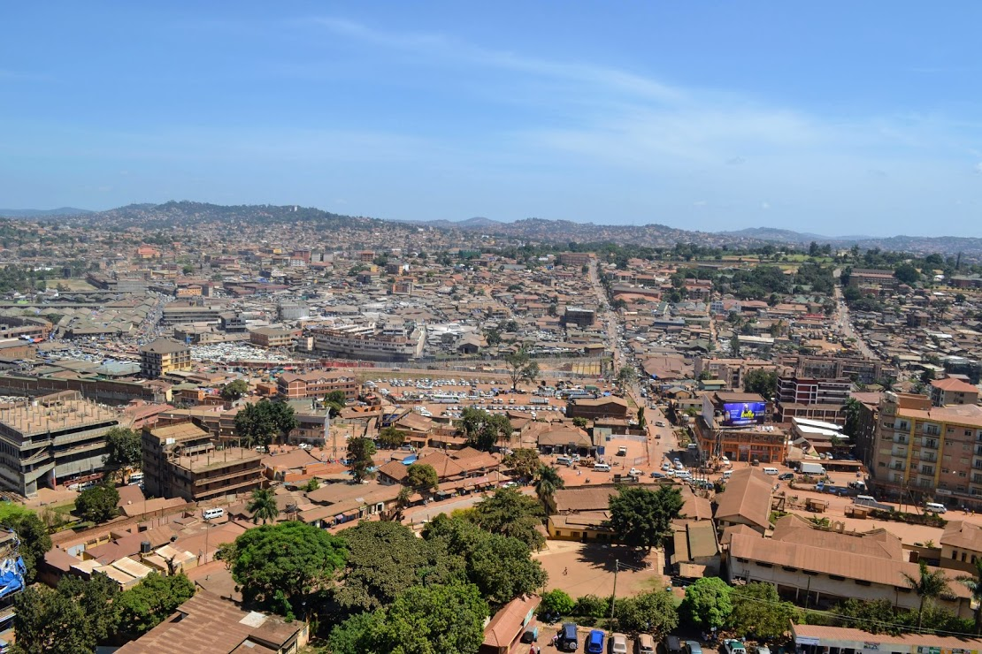
T
H
A
N
K
Y
O
U
!

