Slide 1
A NEW MODEL FOR MANAGING DISPLACEMENT
How the case of Syrian visitors in KSA relates to Nigeria, Malaysia, and a potential solution for alleviating the crisis in North Africa
Emina Osmandzikovic

Slide 2
Table of content
Alternative models of managing displacement – transcending the line between ‘refugees’ and ‘migrants’
The cases of Malaysia and Nigeria – commonalities and differences
The Saudi model towards displaced Syrians – intricacies, lessons and applicability
The countries of North Africa – brief history of restructuring and limiting (irregular) migration
The link between the Saudi model and the countries of North Africa
The link between the Saudi model and the countries of East Africa
Global applicability and the relevance of the 1951 Refugee Convention
The importance of data collection in changing the status quo
Limitations and next steps
Q & A

Slide 3
ALTERNATIVE MODELS OF MANAGING DISPLACEMENT
transcending the line between ‘refugees’ and ‘migrants’

Slide 4
Alternative models of managing displacement
Historically, despite clear definitions that set the foundation of refugee assistance, the world’s governments had been content with yielding the primary responsibility of refugee reception to the UNHCR. However, there remains a gap that is yet to be filled by effective response mechanisms on regional and local levels.
Displacement is, unfortunately, becoming a semi-permanent status for many; namely, displaced persons cannot be seen as a temporary issue that is quickly resolved.
The most evident example is the Syrian refugee crisis with 5.6 million Syrians having fled the country as a result of an armed conflict that shows no signs of ending. Plus, it is unlikely that many of displaced Syrians will be able to return to Syria for at least a generation.
In contrast, in the first quarter of 2019, only 492 people arrived in Italy via the Central Mediterranean route (compared to approximately 6,000 in the first quarter of 2018), of which only 44 nationals from the Horn of Africa.
However, there remains a gap that is yet to be filled by effective response mechanisms on regional and local levels that, in a dual manner, address the needs of the local population in addition to properly tackling the issues related to refugees and asylum.
The three cases of Saudi Arabia, Malaysia and Nigeria serve as examples of alternative approaches to reception and accommodation of displaced populations. The Malaysian approach was designed and implemented in collaboration with UNHCR in its entirety, recognizing the protection needs of displaced Acehnese refugees. The case of Nigeria includes a regional agreement as an overarching mechanism of the normalization of refugees’ protection and access to the labour markets in the greater region.
Overall, the West African approach to reception and accommodation of displaced populations has a regional treaty as its backbone in addition to an agreement with the UNHCR and a recognition of refugees as such. The West African approach has successfully attempted to bridge the gap between asylum and economic aspects of migration, wherein the mandate of the treaty was expanded to incorporate asylum as a beneficiary category. What makes this case different is a relatively low number of refugees and asylees who are addressed by the program, in addition to them being scattered across several countries, rather than one.
Although situated in different regions with contrasting number of beneficiaries, the three above-mentioned cases have been constructed as a direct consequence of locally-based and region-specific occurrences that have galvanized government actions.

Slide 5
THE CASES OF MALAYSIA AND NIGERIA
commonalities and differences

Slide 6
The cases of Malaysia and Nigeria
MALAYSIA - The Malaysian approach was designed and implemented in collaboration with UNHCR in its entirety, recognizing the protection needs of displaced Acehnese refugees.
Prior to 2005, the government of Malaysia had labelled all undocumented persons as illegal immigrants, including refugees, resulting in massive and indiscriminate deportations of vulnerable populations. In the aftermath of the 2004 tsunami that triggered a magnitude 9.1 earthquake, devastated the coast of Indonesia’s Aceh province and killed more than 170 000 people, the Malaysian government made a decision to regularize the status of refugees and vulnerable migrants from the Indonesian Aceh province.
The special permit granted the Acehnese refugees (i) the right to enter and remain on the territory of Malaysia for a period of two years, (ii) the right to work and have access to healthcare facilities comparable to those enjoyed by migrants in a regular situation on the national territory, and (iii) access to primary education on a discretionary basis.
NIGERIA - The case of Nigeria includes a regional agreement as an overarching mechanism of the normalization of refugees’ protection and access to the labour markets in the greater region.
The regularization of Sierra Leonean and Liberian refugees in Nigeria in 2007 included 339 people of concern and was done as a part of a larger regional agreement, as based on ECOWAS. The multipartite agreement acknowledged that the ECOWAS Protocols can be applied to refugees from Sierra Leone and Liberia in Nigeria. Moreover, the agreement promoted the exploration of a legal migrant status by all parties as a solution for refugees upon cessation of their refugee status.
The agreement specified that the Sierra Leonean and Liberian refugees: (i) have the possibility to opt for legal migrant status on the basis of the ECOWAS Free Movement Protocol, (ii) have the governments of Sierra Leone and Liberia provide them with valid ID and travel documents, (iii) have the government of Nigeria provide them with residence permits for a period of two years, with the possibility of renewal, allowing them to work, reside and move freely within the country, and (iv) have the UNHCR cover the fees incurred for the issuance of passports and residence permits.

Slide 7
THE SAUDI MODEL TOWARDS DISPLACED SYRIANS
intricacies, lessons and applicability

Slide 8
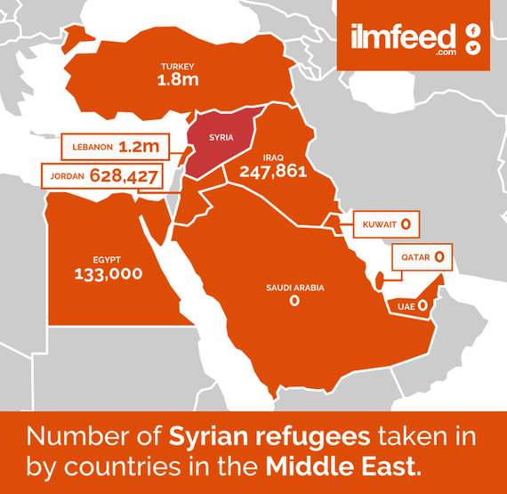
The Saudi model towards displaced Syrians
As a comprehensive program, the Saudi approach to reception and accommodation of displaced populations has demonstrated a wide area of coverage, flexibility, and adaptability in the wake of external crises. At its core, the approach covers legal status, education, healthcare, employment and societal integration. In terms of social integration, interviews and subsequent topic modelling were done with displaced Syrians in KSA with five themes emerging sense of displacement, family, uncertainty, legal status regulation and education for children.

Slide 9
THE COUNTRIES OF NORTH AFRICA
brief history of restructuring and limiting (irregular) migration

Slide 10
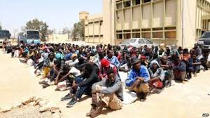
The countries of North Africa | Libya
As the deadliest migration route to Europe, Libya infamously depicts the criminalization of migrant detention, which has led to the proliferation of recidivist government policies toward migrants and refugees around the world with global complicity.
The legitimation of such a response was given more wind to push forward by EU’s unremitting complicity, resulting in an intricate network of detention facilities burgeoning across Libya that preceded both the post-2011 era of lawlessness in the country and the 2015 European refugee crisis. In early November, 200 migrants, kicked out of a detention camp in the south of Tripoli, marched on Hotel GDF and forced their way inside, joining 800 already camped there, in a base designed to hold a maximum of 600, according to The Guardian.
However, the precarious operation of migration on Libyan soil has a long and torrid history that deeply implicates the European Union and extends further back into history from the Libyan civil war of 2011 and the European refugee crisis of 2015. Historically, Libya’s unique strategic position has been the starting platform for restrictive and all-encompassing measures for different types of migrants, under the heavy influence and support of various EU Member States.
As early as 2005, Italy commented on deplorable conditions in Libya’s detention centres in front of the European Commission. The peak of Libya’s changing policies from the open-border 1990s was the imposition of the strict visa system in 2007, which paved the way for fortification of detention centres across the country and the criminalization of (irregular) migration, primarily oriented toward African migrants, according to some accounts.
In Libya, things are now worse than ever before. The Libyan interior ministry official, Mabrouk Abdelahfid, was appointed and tasked with closing or improving detention centres in May this year, however progress has been painstakingly slow.

Slide 11
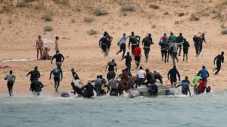
The countries of North Africa | Morocco
In 2018, Morocco became the main departure point for migrants to Europe, overtaking Libya where the coast guard has prevented more departures with help from the European Union. Morocco is only 14 kilometers south of the Spanish coast, and shares land borders with the small Spanish enclaves of Melilla and Ceuta on its northern coast, which are surrounded by a 6 meter-high fence topped with razor wire.
Under a new crackdown this year, authorities are sending undocumented migrants they pick up to southern towns, far from the land and sea borders with Spain. They are also clearing migrant camps in the forests and halting the sale of dinghies and inflatables. According to official figures as of May the country had stopped 30,000 people from illegally crossing to Spain this year and busted 60 migrant trafficking networks.
Morocco is also about to complete a new 3 meter-high fence within its own territory around Ceuta to deter crossings, according to residents near the enclave.
As crossing to Europe becomes ever harder, many Africans are now deciding to stay in Morocco and seek work, benefiting from a legalization policy launched by Morocco in 2013. Over 50,000 migrants, 75% of whom are from Sub-Saharan Africa, obtained residency cards since 2013, according to official figures.
Most migrants work in the informal sector doing low-paid jobs shunned by Moroccans, however.
The President of Tangier region, Ilyas El Omari, urged the EU to help Morocco and his region integrate migrants through training programs and investment to create jobs and avoid tension between locals and migrants. The EU promised last year to give 140 million euros in border management aid to Morocco.

Slide 12
THE LINK WITH THE SAUDI MODEL

Slide 13
The link with the Saudi model of better migration management
One of the potential solutions for the migrant crisis in North Africa might be a hybrid model that encompasses the Nigerian, Malaysian and Saudi models, aided by the IOM and UNHCR, in order to alleviate the overall situation in countries with acute crises, such as Morocco and Libya.
Given the importance of the Nigerian, Malaysian and Saudi cases for non-signatory countries of the 1951 Refugee Conventions that are finding themselves stranded between the sea of (irregular) migrants and refugees, and the European Union, it is essential to take away from these ‘unorthodox’ cases and assess how they can be applied in countries hit by the global refugee crisis the hardest – countries of North Africa.
One potential avenue is to better understand how the governments can localize the solution to the refugee/migrant crisis, regionalize their alliance in order to alleviate migrants and refugees from harsh socio-economic conditions, and make a regionally agreed-upon agreement with the European Union in order to alleviate their own bargaining situation in the crisis.
Moreover, there needs to be a semi-structured survey of different types of migrants in the region in order to better understand their needs, their conditions in their countries of origin and their aspirations, so that their placement, with or without the help of the UN (refer to the cases of Malaysia and Nigeria) can be optimally accommodated.

Slide 14
THE 1951 REFUGEE CONVENTION
Global applicability and regionally-specific relevance

Slide 15
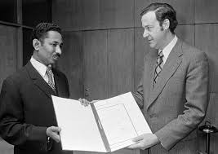
The 1951 Refugee Convention | the forgotten truth
The 1951 Convention and the 1967 Protocol have been created as a locally-based solution to the direct consequence of World War II - the largest refugee crisis recorded in history at the time. In the aftermath of World War II, the UN Refugee Agency was established with the aim of assisting nations to accommodate displaced populations in Europe and has since expanded its mandate to engage with displaced populations globally.
In practice, however, states have outsourced the bulk of their responsibilities to the UN Refugee Agency. With respect to the agency’s already strained mandate and an exponentially increasing number of emerging crises that onset more forced displacement, the fact stands that the organization has no logistical capability of addressing the needs of such a large number of persons in need. According to the UNHCR, twenty people were driven from their homes every minute in 2016, or one every three seconds. As of 2018, the number of forcibly displaced people is almost 70 million globally, unprecedented numbers that are demonstrating the shortcomings in the Convention system.
In Europe, a place of refuge to more than a million Syrians, the 1951 Convention signatory countries have had a difficult time processing an unprecedented number of asylum applications in the midst of the refugee crisis. This is due to an over reliance on the UNHCR to handle initial reception and resettlement and an absence of political will to accept Syrian refugees. The role of the UNHCR is supposed to be supportive of the States Parties in receiving displaced persons but States have deferred responsibility to the office for both reception and settlement. The Syrian crisis sets an ominous precedent for upcoming humanitarian crises as it shows how the current global regime struggles in its initial response as well as providing long-term sustainable solutions for displaced persons.

Slide 16
DATA COLLECTION AS A WAY OF CHANGING THE STATUS QUO

Slide 17
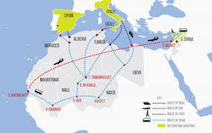
The importance of data collection within displacement
Overall, as a comprehensive program, the Saudi approach to reception and accommodation of displaced populations has demonstrated a wide area of coverage, flexibility, and adaptability in the wake of external crises. At its core, the approach covers legal status, education, healthcare, employment and societal integration. In terms of social integration, interviews and subsequent topic modelling were done with displaced Syrians in KSA with five themes emerging sense of displacement, family, uncertainty, legal status regulation and education for children.
The Saudi model, however, is not unique in providing an alternative to traditional approaches to refugee reception and integration, wherein Nigeria and Malaysia both transcended the line between ‘migrants’ and ‘refugees’ in order to accommodate a large population of concern, alleviate them from poverty, morph their legal status and provide more stability to their respective regions. Struggling with an unprecedented number of refugees and migrants, both the countries of North Africa and the EU Member States on the other side of the Mediterranean can take from the three examples in order to create a more comprehensive system and a new model for managing displacement.

Slide 18
LIMITATIONS AND NEXT STEPS
The issue of applicability and generalizability, especially in active combat zones (ex: Libya)

Slide 19
Q & A

