Slide 1
Governing with Integration ____________________________
Migration control between North Africa and Europe
Nina Violetta Schwarz
Humboldt University Berlin/Germany

Slide 2
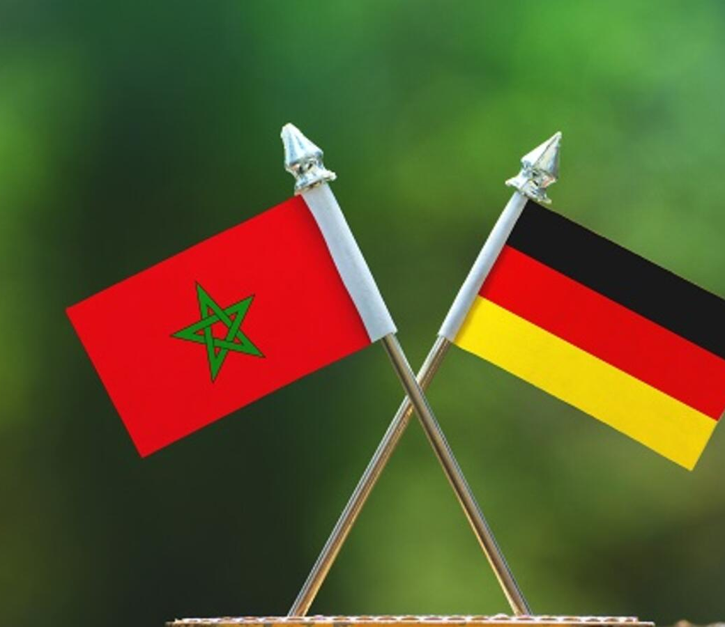
Establishment of integration projects by the German government in Morocco

Slide 4
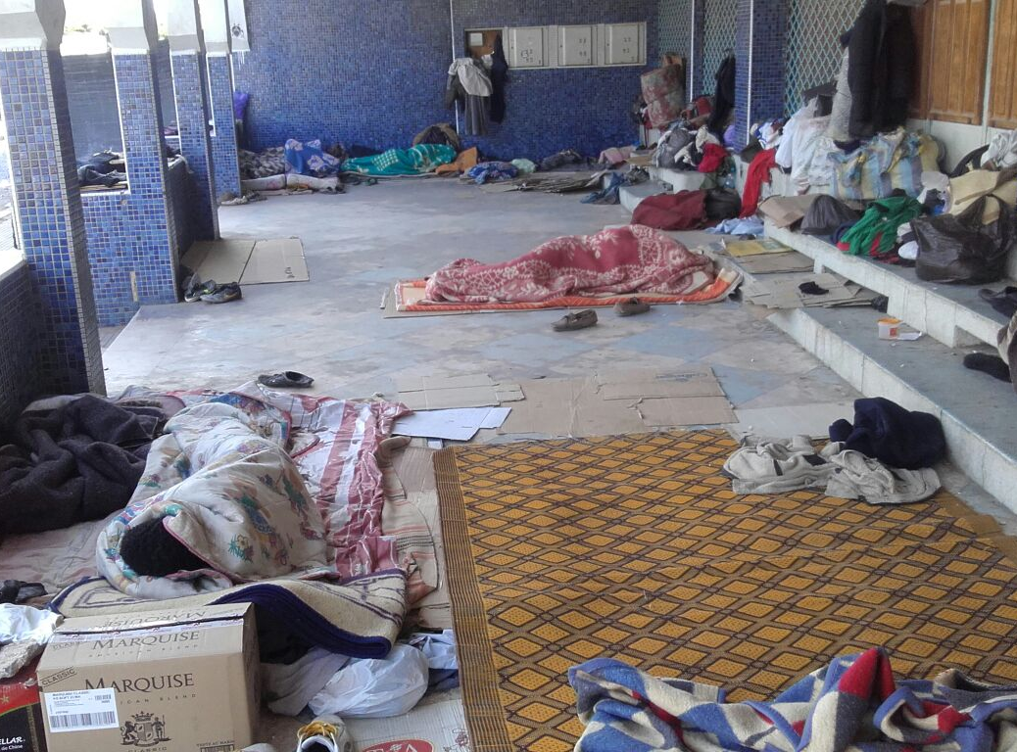
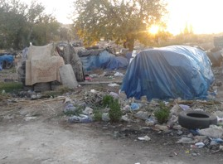
Precarious living conditions of migrants in Morocco

Slide 5
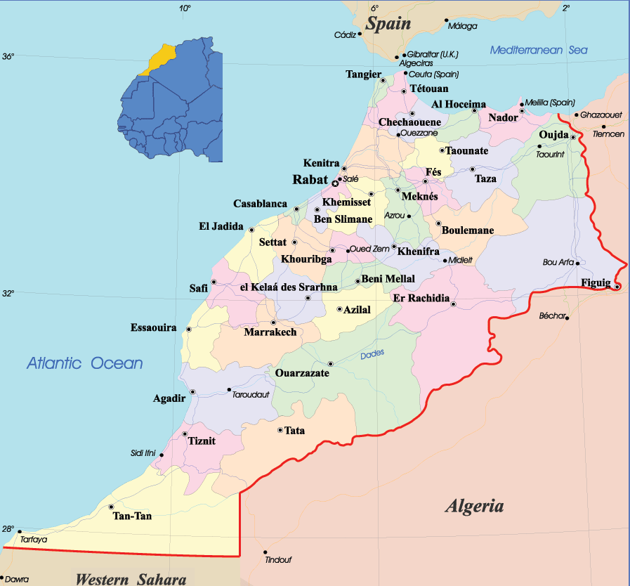
Morocco 2013
New Ministry of Migration and “Immigration Strategy” followed by the announcement of three relevant migration laws concerning asylum, integration and human trafficking.
Ministère Chargé des Marocains Résidant à l’Etranger et des Affaires de la Migration (MCMREAM)
Stratégie nationale d’Immigration (SNIA)

Slide 6
GIZ German federal enterprise for international cooperation and Caritas Morocco: Integration and Reintegration in Morocco

Slide 7
Integration projects in Morocco soft tool of migration management gain legitimacy within discourses on migration policy via the morally charged discourses on humanitarianism are part of a “politics of fixation”

Slide 9
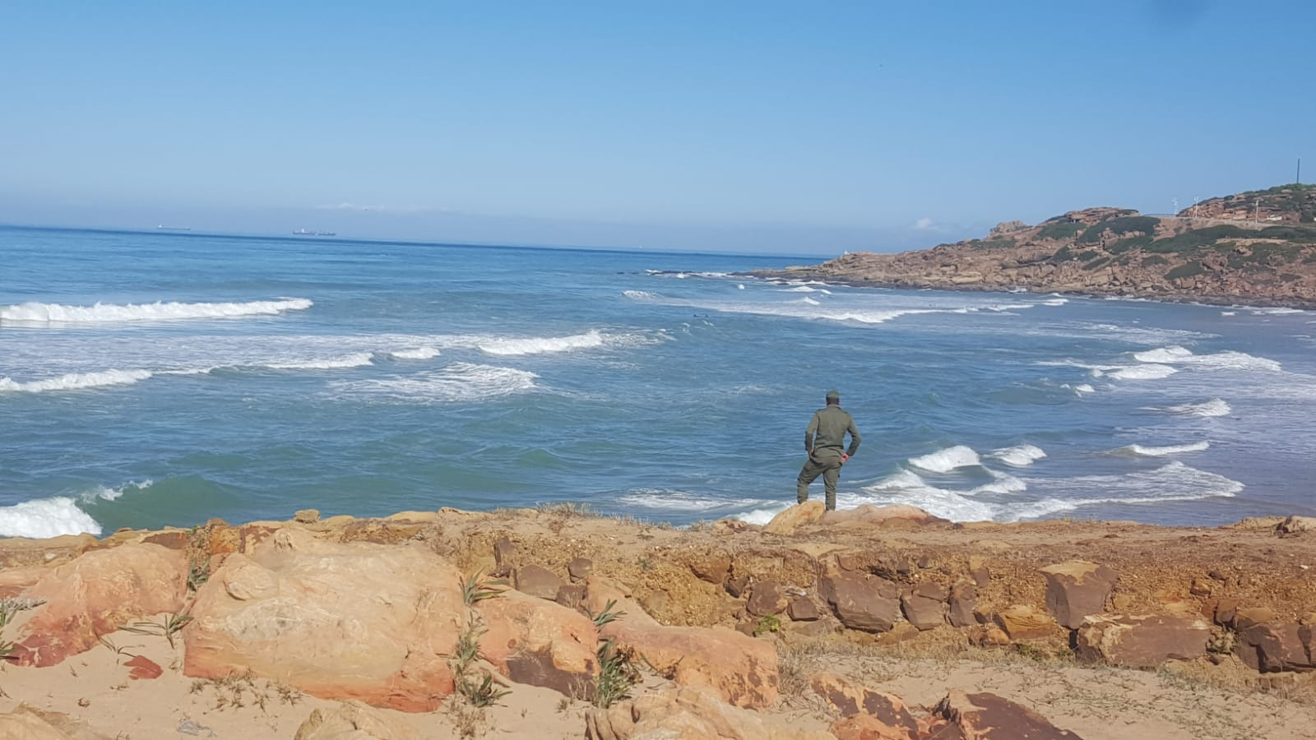
Thank you for listening!
Nina Violetta Schwarz
schwarzn@hu-berlin.de
alarmphone.org
alarmphone.org/en/2019/11/12/the-hidden-battlefield/

