Slide 1
Corruption with Human Face? Interrogating Political Graft, Elite Social Responsibility and Amorphous Wealth Redistribution in Nigeria
Mike Opeyemi OMILUSI
Department of Political Science
Ekiti State University, Nigeria

Slide 2
Introduction
“There was corruption during our time but it was internalized more than we do it now. They did not export it (loot) to the United States, they did not export it to the United Kingdom, they did not export it to Dubai, they ploughed it into the Nigerian economy” .
Ambassador Ignatius Olisaemeka (2018)
“Is it not frustrating that while we shout ourselves hoarse on the need for probity and accountability in government, many of our leaders are still pilfering our resources for personal use while the rest of us suffer from basic necessities of life. I think it is high time they (corrupt leaders) are encouraged to invest the looted monies here so that ordinary Nigerians can benefit”.
Workshop Participant (2016)

Slide 3
These two statements summarise the emerging perception of Nigerians concerning the ruling elite and high-level corruption in the country on the one hand and by inference, the country’s greatly flawed value system which celebrates wealth acquired by questionable means on the other hand.
************************************************************************
"I am doing my best now to utilize our resources to develop the country. We are already getting results on road, rail and power. My frustration is that some people still have plenty stolen money stashed in Europe, US and other countries" .
- President Muhammadu Buhari, while addressing the Nigerian community in Paris on November 12, 2018

Slide 4
Problem Statement
Nigeria still remains one of the most corrupt nations on the planet. Transparency International (TI, 2019) ranked the country 144 out 180 in its 2018 corruption perceptions index.
Thus, “corruption remains an endemic issue in Africa’s largest economy, harming its public finances, deterring business investment, exasperating inequality, reducing the standard of living, and weakening the social contract between the government and its people” (Musser, 2019).
The failure to lift citizens out of poverty is an indictment on successive Nigerian governments which have mismanaged the country’s vast oil riches through incompetence and corruption.
Now, the use of proceeds from high-level corruption to maintain the local content chain by the rapacious elites with a view to pacifying the growing needs of the poor is gaining momentum in the country.
Put differently, benefits captured by local elites are sought after by the masses, thus favouring rentier attitudes rather than competitive solutions to national development.

Slide 5
Objectives/Methodology
The study examines how Nigerian elites audaciously engage in the exclusive elements of neo-patrimonialism (corruption, rent-seeking, stealing resources, personal enrichment) and the emerging trend of demand for investment of looted funds in communities.
It seeks to contribute towards understanding of the inter-relationships between public treasury looting by the Nigeria’s ruling class and the declining humanity of the poor .
It also interrogates the utility and citizen perception of government’s social investment programmes in addressing poverty.
This study comprises a qualitative examination of secondary data readily available in the public domain and primary sources of data gathering (Survey in particular).
Though the survey targeted a sample population of 1000 respondents, only 240 responded. They include individuals under every group of the society: civil servants, artisans, youths, women groups, community leaders, religious leaders, students and politicians, etc.

Slide 6
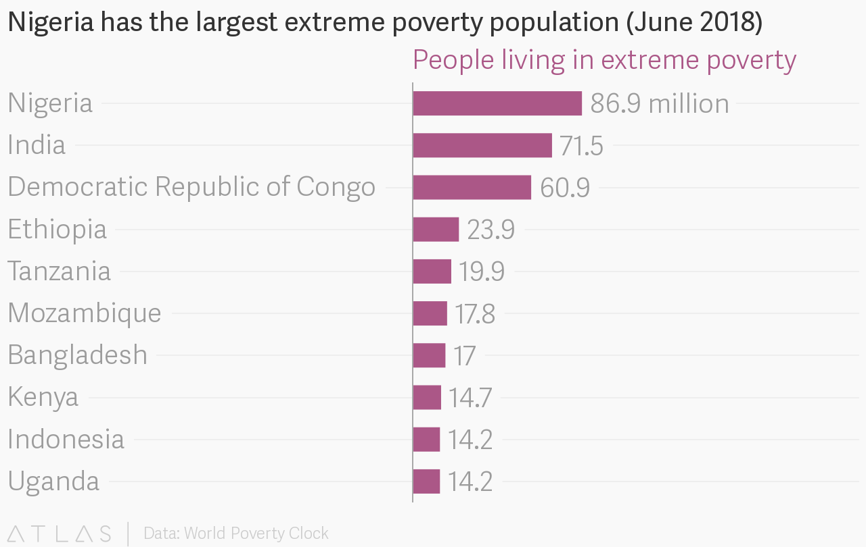
Poverty and Inequality
Evidence suggests a two-way causal relationship between poverty and inequality.
The quality of life in Nigeria is absolutely deplorable (The Guardian, 2019). Overall, about 90 million people - roughly half Nigeria's population - live in extreme poverty, according to estimates from the World Data Lab's Poverty Clock.
The truth of the matter is that endemic corruption in Nigeria has severally been linked to the present vast incidence of poverty in the midst of plenty. In other words, Nigerians sink into a deeper abyss of poverty just as resources meant for human development are being feathered away .
The resultant inequality in society has led to frustration, hopelessness and despair, and laid the foundation for criminal activities.

Slide 7
Findings
Corruption has, in the last three decades, assumed a dimension that threatens the authority and power of the state, and the continued existence of the country.
Indeed, as this figure shows, 74 percent of the respondents in this study are of the strong opinion that corruption has sunk into the business culture in Nigeria (indicating always and frequently), and this can be seen majorly in the government ministries, departments and agencies.

Slide 8
Findings
Corruption in the public sector remains a sore spot in Nigeria’s quest to instil transparency and accountability in the polity. The failure to deliver social services, the endemic problem of power supply and the collapse of infrastructure are all linked with corruption.
Many of the respondents (about 70 percent) strongly believe that the infrastructural decay and the level of poverty in the country are caused by the corrupt political leaders.

Slide 9
Findings
Much as the Western media assiduously report the miserable living conditions in the country occasioned by grand corruption, they fail to explain how the proceeds from the looting are indeed sitting in Europe, North America, Australia, New Zealand and the offshore enclaves controlled by the West.
This may have partly informed why about 74 percent of the respondents in this study are of the opinion that stolen funds by corrupt public officials should be invested in the country with a view to creating more economic opportunities and developments internally.

Slide 10
Corruption and Social Investment
The redistributive power of the government’s social investments, packaged as (1) National Home-Grown School Feeding Programme (which aims to provide meals to school children), (2) the Conditional Cash Transfer (CCT) Programme, (3) the Government Enterprise Empowerment Programme (which provides soft loans ranging from N10,000 to N100,000 for artisans, traders, market women, amongst others) and (4) the N-Power initiative (designed to hire half a million unemployed graduates), under the present administration, has received little attention from the general public when juxtaposed with the realities on the ground.
One of the emerging realities in Nigeria is that while the country scores high in the Corruption Perception Index, it scores low in the Human Development Index (UNDP, 2018), implying that investment in citizens’ welfare is low because the incidence of corruption is high.

Slide 11
Anti-corruption war and social investment
What really are the intervening variables between 2015, when the present administration came on board, and now?
In the table here, it is revealed that about 88 out of hundred respondents repudiate the effectiveness of anti-corruption war in alleviating poverty among the citizens. They do not see its impact on the excruciating poverty in the country. However, about 10% of them are of the opinion that the anti-corruption war is really effective in alleviating poverty in Nigeria.

Slide 12
Anti-corruption war and social investment
The Presidency recently (October) noted that a total of 620,947 poor and vulnerable Nigerians are currently benefitting from the National Cash Transfer programme- a key component of the National Social Investment Programme of the Federal Government (The Nation, 2019).
Ordinarily, findings suggest that cash transfers can be effective instruments to redistribute income to the poor (Lindert, Skoufias and Shapiro, 2006) via the direct cash transfers and for reducing long-term poverty via incentives for investments in human capital.
In this study however, as indicated in the table, about 76 percent of the respondents do not see substantial benefits for the poor through the federal government social security programmes. Nevertheless, 23 percent are of the opinion that government social security programmes really benefit the poor.

Slide 13
Anti-corruption war and social investments
It is discovered that shortfall in budgetary releases in the last three years- 16% in 2016, 36% in 2017 and 53% in 2018- have hampered the effective implementation of the programme and the goal of uplifting the living standards of the poor citizens.
Though a commendable initiative (plans to rescue the poor from their poverty), many respondents in this study (84.50 percent of them) do not believe government's promise to lift 100 Million Nigerians out of poverty in 10 years is realistic. They are of the opinion that funds for such programmes are usually mismanaged by some corrupt government officials and political leaders.

Slide 14
Recommendations
Since the advent of the current representative democracy in 1999, the Nigerian government has attempted to address governance issues through a series of reforms and by establishing anti-corruption bodies; and has developed various social protection interventions. In reality, making the impact felt by the citizenry has been very challenging. Thus, more effective ways of sustainably reducing poverty levels should be adopted.
(1). It is generally believed that education and knowledge transfer play a very important role in terms of poverty reduction (Liu, 2018), particularly in addressing longer-term poverty. This study suggests that Nigeria should demonstrate more commitment to this crucial sector through improved budgetary allocations, not only by the central government, but by other sub-national governments where most rural poor reside.

Slide 15
Recommendations
(2). Governance must be demystified and made less attractive for criminal-minded people who pose as leaders and politicians. This can be done simply by stripping political offices of all needless trappings. Overall, support for efficient and transparent financial management and functioning accountability mechanisms, at all levels of government, must be sustained over a long period.
(3). Attempts to address corruption must be coordinated with efforts to address other closely related problems, such as weak rule of law, physical and economic insecurity and weak political accountability. The rule of law, transparency and accountability of public sector serve as the foundation for the good governance and the economic growth of a country.
(4). As a state policy, the Nigerian government should spend more on programs aimed at redistributing income from more wealthy Nigerians to the less wealthy. More importantly, structural economic change to facilitate a more diversified and inclusive economy is desirable to move the country out of perpetual “potential greatness” and backwardness.

Slide 16
Recommendations
(5). Being a critical stakeholder and partner in economic development, a provider of income, jobs, goods and services to enhance people’s lives and help them escape poverty, the private sector remains one of the best placed institutions to make a significant positive contribution towards improving social, economic and environmental conditions in Africa. This private sector engagement is capable of reducing the economic and social vulnerability of poor, vulnerable and marginalised groups.
(6). Lastly, citizens should, rather than embracing their oppressors and demanding for crumbs as compensation, hold public office holders to account. They (Citizens) should pressure government to prosecute corrupt individuals in the country to serve as deterrent to others. Obviously, contributing to poverty reduction and development involves helping to create societies free from oppression and strengthening the ability of poor people to improve their lives through their own means and resources.

Slide 17
Conclusion
As earlier noted, the failure to lift citizens out of poverty is an indictment on successive Nigerian governments which have mismanaged the country’s vast oil riches through incompetence and corruption. More important to this study is the perception of the direct victims of corrupt practices about how proceeds of such should be utilised for common good; thereby seemingly legitimising what ordinarily is a crime. This contradiction finds meaning in the unabated inhuman conditions in which many Nigerians find themselves over decades- precipitating a turning point where demands are made for local content component of looted commonwealth to ameliorate their living standard.
Generally, Nigeria lacks national records through which it can properly identify its poorest people, much less strategically executing social investment policies in an effective manner. This, coupled with the corrupt tendency of public officials, clearly explains why government’s efforts in redistributing wealth in the country remain amorphous. This observation suggests the need for a deeper analysis of the prospects and conditions for successful national policy implementation in developing countries.

