Slide 1
Consumers’ engagement in poverty elimination through cause-related marketing. A review of the literature.
Omneya Moharam, Assistant Lecturer of Marketing, Pharos University in Alexandria
Omneya Yacout, Professor of Marketing,
Alexandria University

Slide 2
Main Points
1
Introduction
2
Consumers Engagement in CRM
3
CRM In Egypt
4
Recommendations

Slide 3
Introduction
Facts about poverty, review on CSR and CRM

Slide 4
Poverty in Africa
One in three Africans— 422 million people—live below the global poverty line.
They represent more than 70 percent of the world's poorest people
Africa has now reached a milestone in the fight against poverty. As of March 2019—and for the first time since the start of the SDGs—more Africans are now escaping extreme poverty
Resulting in a 1 million-person reduction in total African poverty in 2020.
By 2030, Africa will reduce the ranks of its extremely poor by 45 million and relative poverty will decline from 33.5 percent today to 24 percent.
There are six additional countries whose poverty rates are expected to reach below 5 percent; Ethiopia, Ghana, Kenya, Angola, Côte d’Ivoire, Djibouti.

Slide 5
Poverty in Egypt
Egypt announced that who earns less than LE 8,282 (US$ 501.03) annually and $1.3 daily, lives under poverty line.
The percentage of Egyptians, who live in extreme poverty, rose to 32.5 in 2018 from 27.8 percent in 2015, with an increase of 4.7 percent (CAMPAS,2019)
The highest percentage of poverty among 99 million Egyptians was recorded in Upper Egypt

Slide 6
The Concept of Corporate Social Responsibility CSR
Consumer awareness and education changed the consumption patterns of consumers
01
Technological forces and the use of the internet made consumers to easily track companies and their CSR efforts (Till & Nowak, 2000).
02
Causing marketers to take into consideration social aspects and ethics from company’s objectives setting (Santoso et al., 2015).
03

Slide 7
The Concept of Corporate Social Responsibility CSR
Companies assumed that consumers will reward them for their support for social programs, based on this assumption they started to engage in social causes
In fact, research has proven that consumers will punish firms who are not considering society in their business goals and strategies (Becker-Olsen, Cudmore, & Hill, 2006).

Slide 8
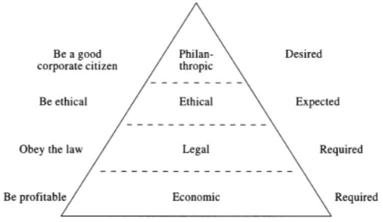
The concept of CSR first appeared in the USA by the 1950s and 1960s and became universal in the 1990s (Barsoum & Refaat, 2015).
Carroll mentioned that the concept as ''the total corporate social responsibility of a business that entails the simultaneous fulfillment of the firm's economic, legal, ethical and philanthropic responsibilities''
The Pyramid of Corporate Social Responsibility

Slide 9
The Concept of Cause-related Marketing CRM
A marketing strategy used to promote sales by supporting philanthropic causes in society (Deigh et al., 2016).
CRM partnering a social cause became a philanthropic trend
(Thomas, Kureshi, & Vatavwala, 2019)
Companies are using CRM to induce product trial and differential positioning for their brands
CRM can be mentioned to be a CSR and fundraising initiative has become very attractive in recent years (Ferraris, Giudice, Grandhi, & Cillo, 2019).

Slide 10
CRM Benefits
Win-Win-Win Strategy
WIN
Society
WIN
Company
WIN
Customers

Slide 11
Meet Our Team
Himalaya Drug Company, along with Smile Train India through “Project Muskaan” in the year 2016
Montblanc, who initiated a campaign of “Signature for Good” campaign,
Yoplait in the United States in 2014 initiated “Friends in the Fight”.
TOMS Shoes supporting needy child

Slide 12
Consumers’ Engagement in CRM

Slide 13
How to Engage Consumers in CRM?
The level of association of CRM can be either on organizational level, or, product line level, or, finally on brand level; (Varadarajan & Menon, 1988).
In a general form, CRM strategy is depending on the main three managerial functions of planning, implementation, and evaluation (Thomas et al., 2019).

Slide 14
01 | 02 | 03
Planning | Implementation | Evaluation
Consumer Characteristics Proximity Choice of product (type) Choice of cause/ product (level of fit) Donation Magnitude | Communication message execution Message appeal (positive/ negative) Donation message framing | CRM effectiveness versus other marketing tools Brand Image and awareness Consumers’ Behavioral Responses
 |  | (Thomas, Kureshi, & Vatavwala, 2019)
Infographic Style

Slide 15
Planning CRM to Gain Consumers’ Adoption
Skepticism when exists affects negatively CRM
Altruism is the concern for the happiness of other human beings (Schwartz, 1977),
characteristics
Religiosity the extent to which an individual’s committed to the religion

Slide 16
Planning CRM to Gain Consumers’ Adoption
Distance between the donation activity and the consumer and can be categorized as global, national, regional, or local (Varadarajan & Menon, 1988).
A survey by Cone Roper (2000) suggests that as 55 % of consumers think that local causes are most important, followed by national 30% causes, and global 10%
Proximity
May either enhance or weaken consumer response to CRM

Slide 17
Planning CRM to Gain Consumers’ Adoption
Hedonic products/ pleasure-oriented consumers' products
Utilitarian products / goal-oriented consumer product
Product Type
CRM is more effective with products perceived as hedonic than with those perceived as utilitarian (Chang, 2008, 2011; Strahilevitz, 1999; Strahilevitz and Myers, 1998)
Or utilitarian (Melero & Montaner, 2016; Subrahmanyan, 2004).

Slide 18
Planning CRM to Gain Consumers’ Adoption
The degree of similarity and compatibility that consumers perceive exists between a social cause being supported and the brand itself (Lafferty, 2007).
Fit between brand and cause may impact the success of the CRM strategy.
Brand-Cause Fit
Functional-based fit occurs when the product or service of a sponsoring brand is used by beneficiaries of the cause.
Image-based fit occurs when the values of the brand are similar to the values of the cause regardless of the product
Low or High fit?

Slide 19
Planning CRM to Gain Consumers’ Adoption
Amount of contribution a consumer would add to the cause by product purchase (Strahilevitz, 1999; Henderson and Arora, 2010).
Percentage of profit, or percentage of the price?
Donation Magnitude
A percentage of 5% and 25% were identified as the two most acceptable levels (Chang, 2016).
size of the donation can influence brand choice (Pracejus et al., 2003).
High or Low Magnitude?

Slide 20
CRM In Egypt

Slide 21
Why CRM in Egypt?
Egypt along with other third world countries are considered to be a potential needy spot for social responsibility initiatives (Mouss, 2006; Salama, 2009).
Low GDP, Currency depreciation, High population, High poverty
Developing countries, in general, are still facing challenges regarding corporate social responsibility in general unlike the developed world.

Slide 22
Why CRM in Egypt?
According to the (“Corporate Social Responsibility Forum,” 2017), the Egyptian government is encouraging the private sector to participate in societal and sustainable development
To achieve the universal sustainable
development goals SDGs 2030.

Slide 23
Egyptians Consumption
Egypt has the second-highest Gross Domestic Product (GDP) at Purchasing Power Parity (PPP) among African countries
In the FY 2019, real Gross Domestic Product (GDP) growth reached 5.6 percent, up from 5.3 percent in FY18. (World Bank, 2019)
Egypt is reforming its economy, but poverty is rising
Egypt is a place where 'the rich are few and have much, the poor are many and have little

Slide 24
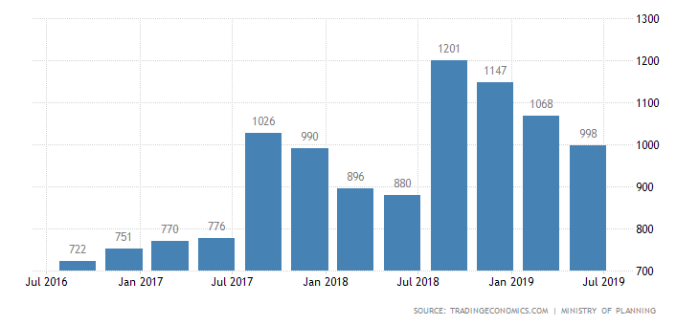
Consumers’ spending's in Billion EGP

Slide 25
Egyptian Households Expenditure
Food and Non - Alcoholic Beverages 34.4 %
Housing, Water, Electricity, Gas & Other Fuels 17.5 %
Health 10.0 %
Transport 6.3 %
Clothing and Footwear 5.6 %
Education 4.8 %
Alcoholic Beverages, Tobacco and Narcotics 4.7 %
Furnishings, H.H. equipment and routine H.H maintenance 4.1 %
Restaurants & Hotels 4.0 %
Miscellaneous Goods& Services 3.9 %
Communication 2.5 %
Recreation and Culture 2.1 % (CAPMAS 2019)

Slide 26
Recommendations

Slide 27
Recommendations
Link CRM to Food, Housing and Health consumptions
High than low donation magnitude
Be clear to avoid skepticism
Support Local proximity causes, Hedonic than utilitarian products
Direct CRM message to consumers’ with high religiosity
High than low brand-cause fit

Slide 28
Thank You

