Slide 1
Analysis & Design of Algorithms (CSCE 2202)
Prof. Amr Goneid
Department of Computer Science and Engineering, AUC
Golden Ratio

Slide 2
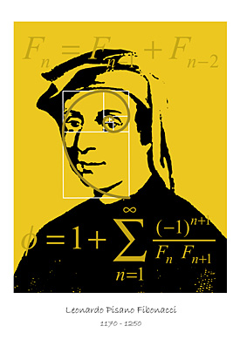
Fibonacci Numbers
Fibonacci numbers represent the sequence:
0,1,1,2,3,5,8,13,21,34,55,89,144,233,377,610,...
Introduced by Leonardo Fibonacci (1202)
Can be computed by the recurrence
relation:
F(n) = F(n-2) + F(n-1) n ≥ 2
with F(0) = 0 , F(1) = 1

Slide 3
Overlapping Sub-Problems
Tracing for n = 5
5
3
4
1
2
2
3
0
1
0
1
1
2
0
1
n | 0 | 1 | 2 | 3 | 4 | 5
F(n) | 0 | 1 | 1 | 2 | 3 | 5

Slide 4
Computing Fibonacci Numbers (Dynamic Programming Method)
Table F[0..n]
F[0] = 0; F[1] = 1;
if ( n >= 2)
for i = 2 to n
F[i] = F[i-1] + F[i-2];
return F[n];

Slide 5
Relation to Golden Ratio
F(n) = F(n-1) + F(n-2) with F(0) = 0, F(1)=1
Exponential growth

Slide 6
Fibonacci Numbers

Slide 7
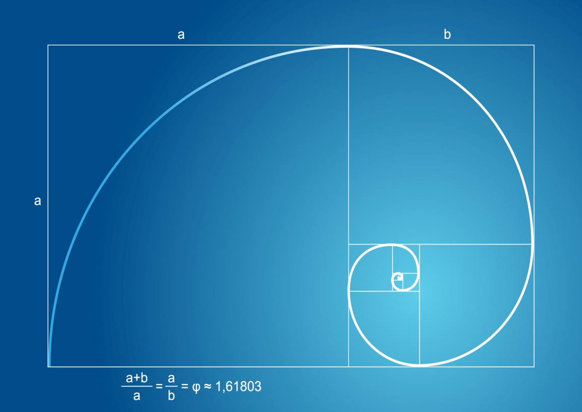
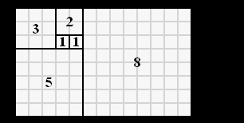
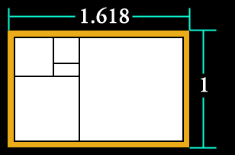
The Golden Ratio Geometry of Nature?

Slide 8
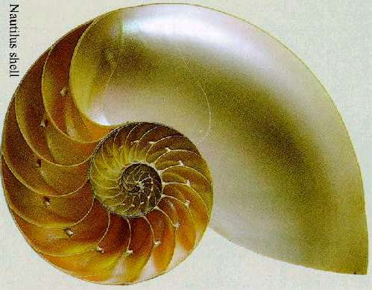
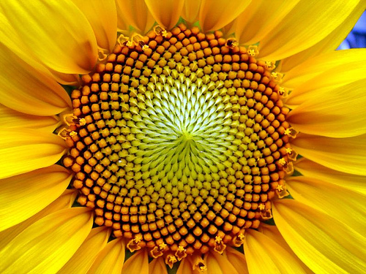
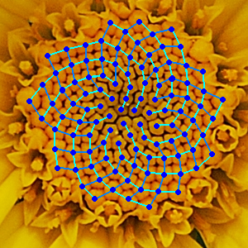
In Nature: Nautilus, Sun Flower

Slide 9
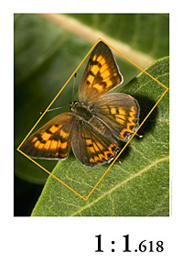
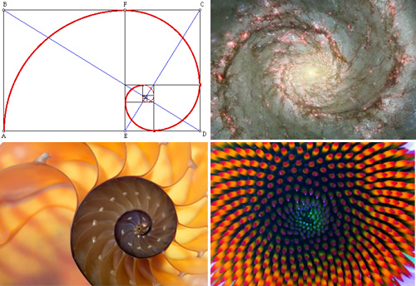
In Nature

Slide 10
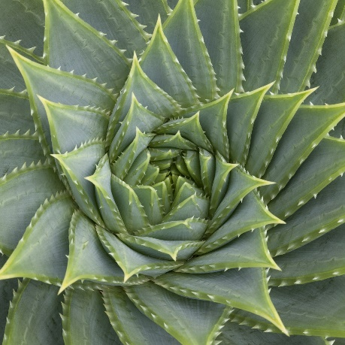
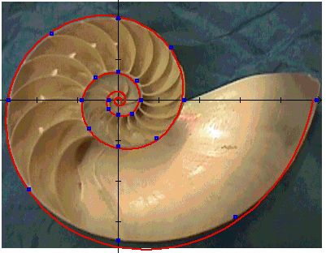
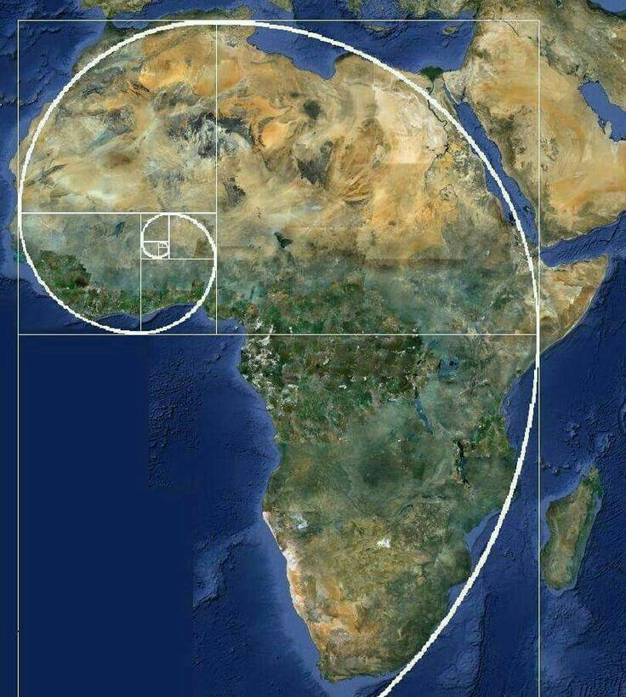
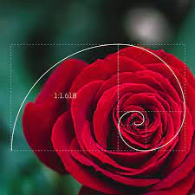
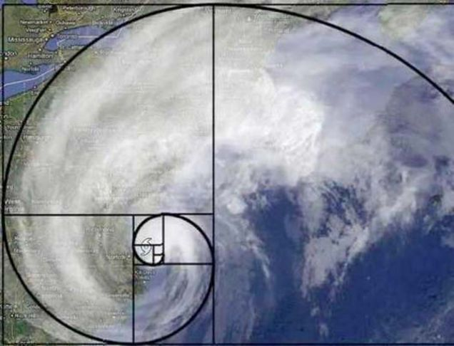
In Nature & Earth

Slide 11
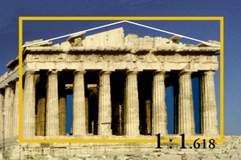
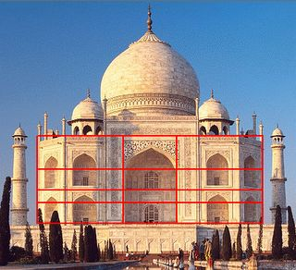
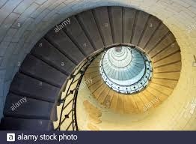
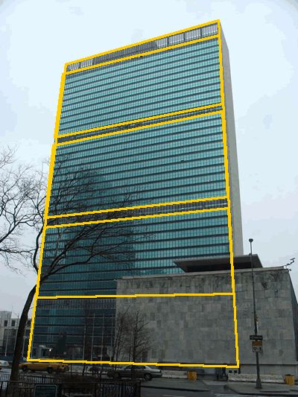
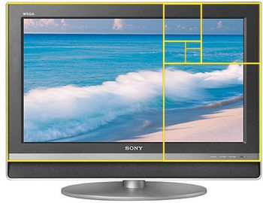
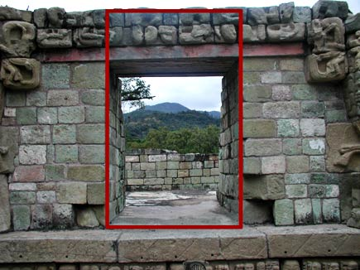
In Architecture & Design

Slide 12
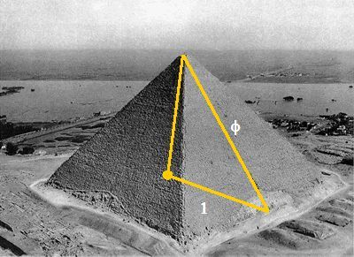
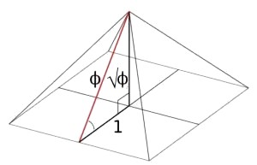
In Architecture & Design: The Great Pyramid of Giza

Slide 13
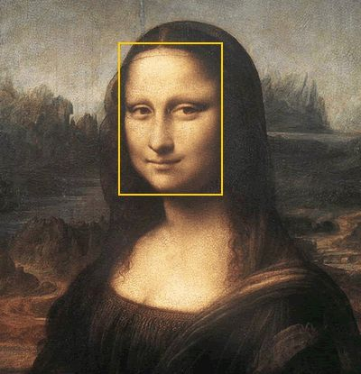
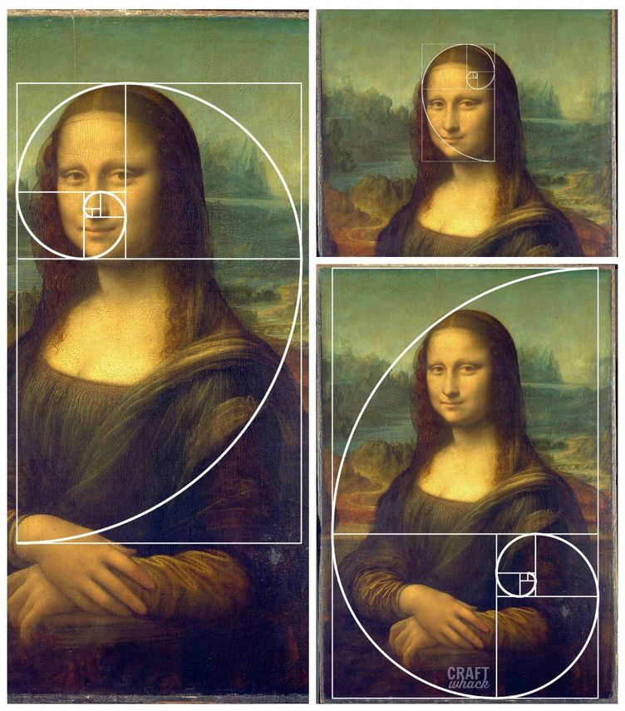
In Art

Slide 14
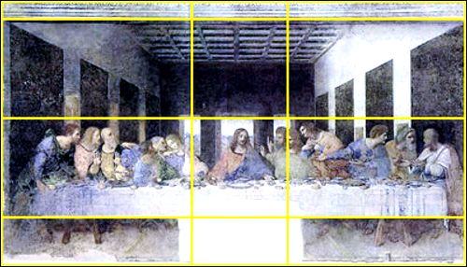
In Art

Slide 15
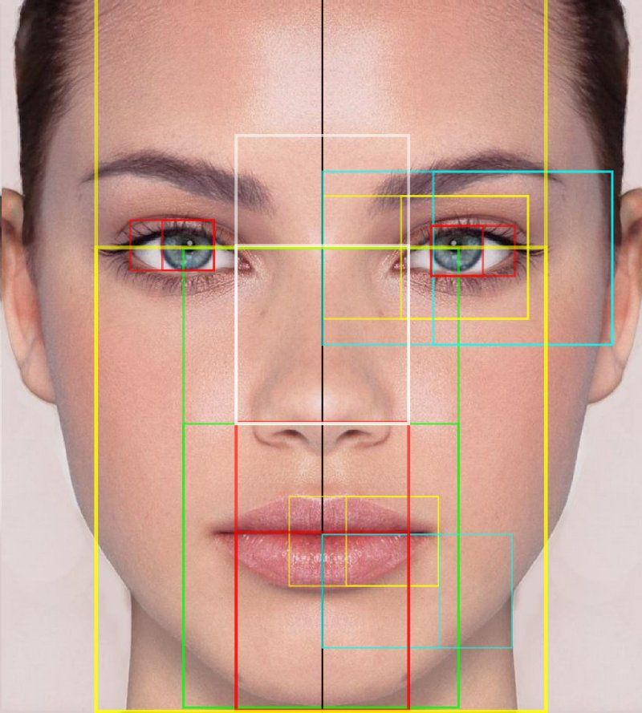
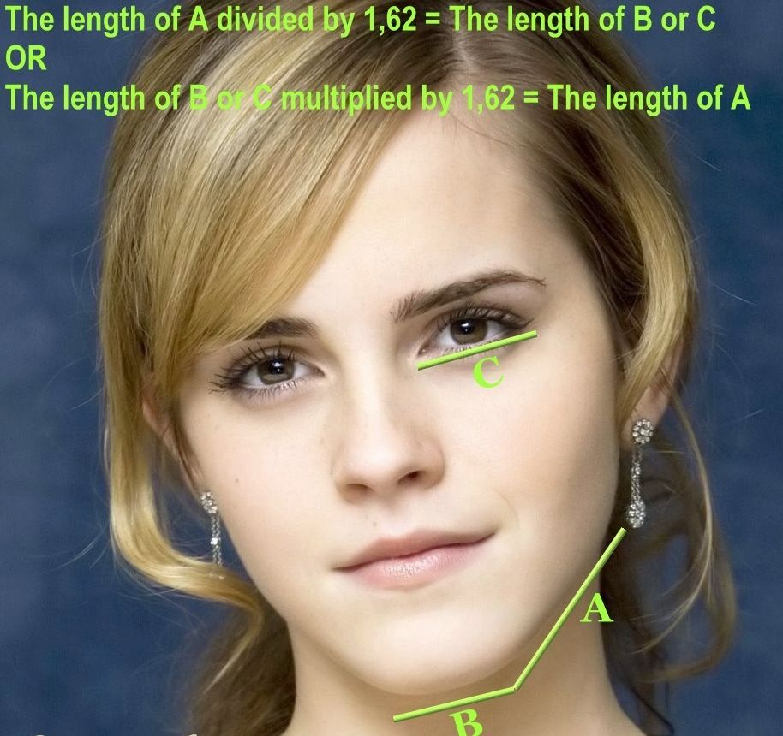
Golden Ratio Faces

Slide 16
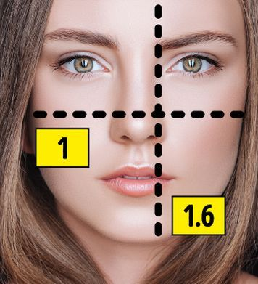
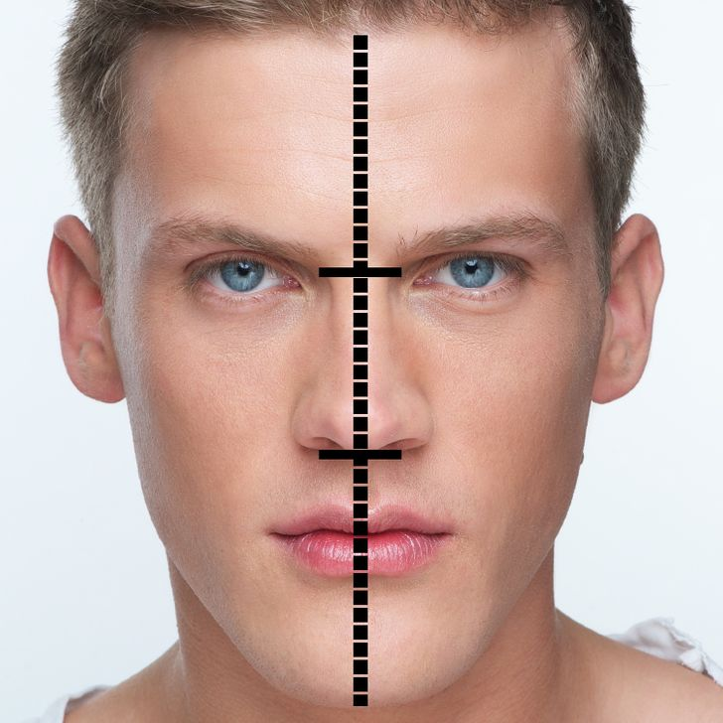
Golden Ratio Faces

