Slide 1
CSCE 2211 Applied Data Structures
Prof. Amr Goneid, AUC
Part 1. Data Modeling and ADTs

Slide 2
Data Modeling

Slide 3
Data Modeling and ADTs
Data Modeling
Abstract Data types (ADTs)
A Classification of Abstract Structures
Another Classification
Special Data Structures
ADT’s: Data Abstraction
ADT Implementation
Examples on Modeling

Slide 4
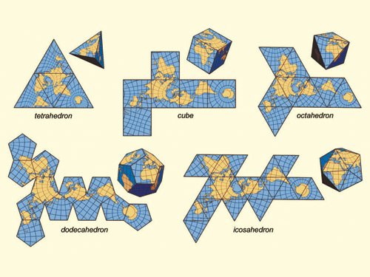
1. Data Modeling
Real-world applications need to be reduced
to a small number of existing problems (top-down
design)
Real-world data need to be described in an
abstract way in terms of fundamental structures
The collection of data in some organization is
called a “Data Structure”
The sequences of operations to be done on the data are called “Algorithms”
A real-world application is basically Data Structures + Algorithms

Slide 5
The Data Cone
Real-world Data
ADTs
Data Structures
Fundamental
Data Types

Slide 6
Abstraction & Data Structures
ADT
Data Structure
+ Algorithms
Fundamental
Data Types

Slide 7
Abstraction & Data Structures
Dictionary
Hash Table
1-D Array

Slide 8
2. Abstract Data Types (ADTs)
An ADT represents the logical or conceptual level of the data.
It consists of:
Collection of data items in some Data Structure
(a Stack is a linear container that can be implemented using arrays (static or dynamic) or linked lists)
Operations (algorithms) on the data items
(Basic Stack operations are push and pop)

Slide 9
Abstract Data Types (ADTs)
The definition of the ADT is separated from its implementation (Data Abstraction). It is defined from the point of view of the one who uses it.
In contrast, a data structure, which is a concrete representation of data, is described from the point of view of an implementer, not a user.

Slide 10
Using ADT’s
An ADT can be used by more than one application.
ADT
ADT
ADT
ADT
ADT
Application
Application
Application
Standard Types/Libraries
User Built ADT’s

Slide 11
3. A Classification of Abstract Structures
According to the relationship between members
Abstract Structures
Sets
Linear
Trees
Graphs

Slide 12
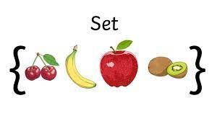
Sets
Order of elements does not matter. Only that they are members of the same set ({1,3,4} is identical to {1,4,3}).
Can be implemented using arrays or linked lists.
Used in problems seeking:
groups
collection
selection
packaging

Slide 13
Linear Structures
Sequential, one-to-one relationship.
Examples:
Tables, Stacks, Queues, Strings and Permutations.
Can be implemented using arrays and linked lists (structs and pointers).
Used in problems dealing with:
Searching, Sorting, stacking, waiting lines.
Text processing, character sequences, patterns
Arrangements, ordering, tours, sequences.

Slide 14
Trees
Non-Linear, hierarchical one-to-many.
Examples:
Binary Trees, Binary Search Trees (BST)
Can be implemented using arrays, structs and pointers
Used in problems dealing with:
Searching
Hierarchy
Ancestor/descendant relationship
Classification

Slide 15
Graphs
Non-Linear, many-to-many.
Can be implemented using arrays or linked lists
Used to model a variety of problems dealing with:
Networks
Circuits
Web
Relationship
Paths

Slide 16
4. Another Classification of Abstract Structures
According to their functions Special
Abstract Structures
Containers
Strings
Dictionaries
Geometric DS
Priority Queues
Disjoint Sets
Graphs

Slide 17
Containers
Permit storage and retrieval of data items independent of content (access by location only).
Support two basic operations:
Put (x,C): Insert item x in container C
Get (C): Retrieve next item from C.

Slide 18
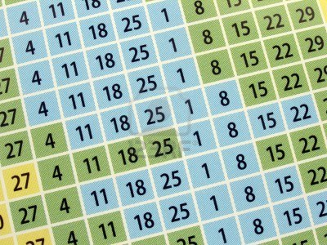
Containers
Examples:
Stacks: Last-In-First-Out (LIFO) structures
Queues: First-In-First-Out (FIFO) structures
Tables: Retrieval by position.

Slide 19
Dictionaries
A form of container that permits
access by content.
Support the following main
operations:
Insert (D,x): Insert item x in dictionary D
Delete (D,x): Delete item x from D
Search (D,k): search for key k in D

Slide 20
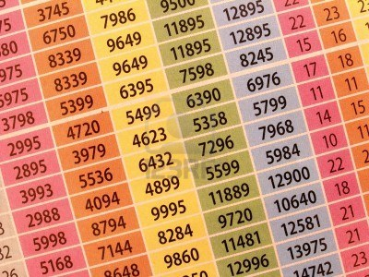
Dictionaries
Examples:
Unsorted arrays and Linked Lists: permit linear search
Sorted arrays: permit Binary search
Ordered Lists: permit linear search
Binary Search Trees (BST): fast support of all dictionary operations.
Hash Tables: Fast retrieval by hashing key to a position.

Slide 21
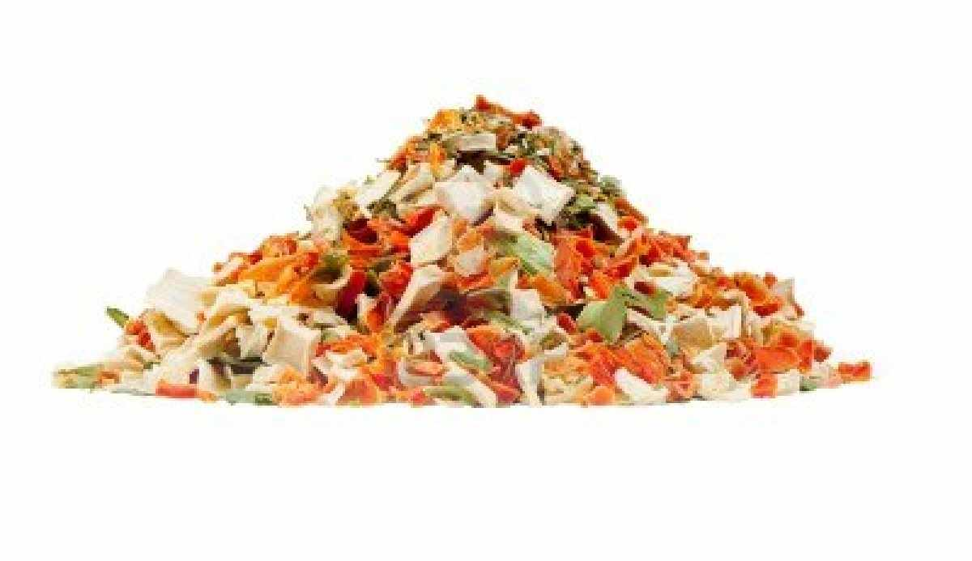
Priority Queues
Allow processing items according to
a certain order (Priority)
Support the following main operations:
Insert (Q,x): Insert item x in priority queue Q
Remove (Q): Return and remove item with Highest/Lowest Priority
Examples:
Heaps and Partially Ordered Trees (POT)
Major DS in HeapSort

Slide 22
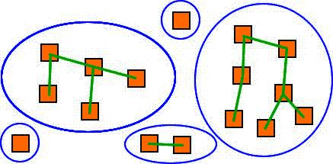
Disjoint Sets
Disjoint sets are collections of elements with no common elements between the sets.
A set can be identified by a parent node and children nodes.

Slide 23
Disjoint Sets
Support the following main operations:
Find (i): Find Parent (set) containing node (i)
Union (i,j): make set (i) the child of set (j)
Examples:
Representation of disjoint collections of data
Representation of Trees, Forests and Graphs

Slide 24
Graphs
Can be used to represent any relationship and a wide variety of structures.

Slide 25
Graphs
Well-known graph algorithms are the basis for many applications. Examples of such algorithms are:
Minimum Spanning Trees
Graph traversal (Depth-First and Breadth-First)
Shortest Path Algorithms

Slide 26
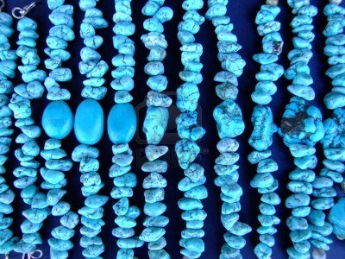
5. Special Data Structures
Strings:
Typically represented as arrays of characters. Various operations support pattern matching and string editing

Slide 27
Special Data Structures
Geometric Data Structures:
Represent collections of data points and regions. Data points can represent segments. Segments can represent polygons that can represent regions.

Slide 28
6. ADT’s: Data Abstraction
The first step in creating an ADT is the process of Data Abstraction
Data Abstraction provides a complete
description of the following items independent
of the way it will be implemented:
A definition of the ADT.
Elements or members of that ADT.
Relationship between the members.
The fundamental operations on the members.

Slide 29
Application Programming Interface (API)
The definition of an ADT provides an Application Programming Interface (API).
The API is the contract that an ADT makes with external clients.
It includes methods’ definitions and their behavior.

Slide 30
7. ADT Implementation
In Object Oriented Programming, ADTs are created as Classes

Slide 31
ADT Implementation
In Object Oriented Programming, ADTs are created as Classes
A Class can be used by more than one application.
Class
Class
Class
Class
Class
Program
Program
Program
Standard Classes
User Classes

Slide 32
8. Examples on Modeling
Problem:
In Encryption problems, we need to do arithmetic on very large integers (e.g. 300 digits or more)
ADTs:
List
Data Structures:
1-D array or Linked List

Slide 33
Examples on Modeling
Problem: (Knapsack Problem)
We have (n) objects each with a weight and a price and a container with maximum capacity (m). Select whole or fractions of the objects such that the total weight does not exceed (m) and the total price is maximum
ADTs:
Priority Queue
Data Structures:
1-D array or List

Slide 34
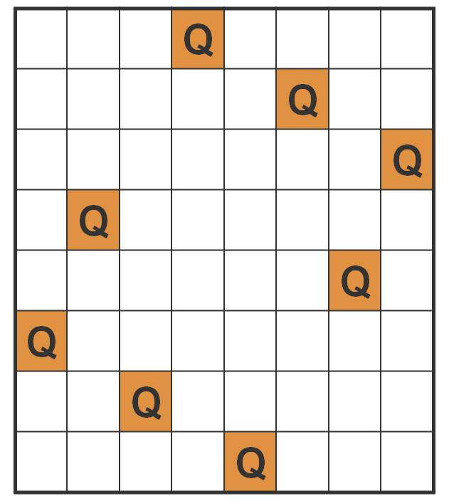
Examples on Modeling
Problem: (Chess Games)
8-Queens problem, Knight’s Tour problem, etc
ADTs:
Board ADT
Data Structures:
2-D array

Slide 35
Examples on Modeling
Problem: (Dictionary)
We would like to build and use a small dictionary of words that translates from language (A) to language (B)
ADTs:
List
Data Structures:
1-D array or linked list

Slide 36
Examples on Modeling
Problem: (Small and fast Directory)
We would like to build and use a small and fast directory to check username and pass word logins
ADTs:
Hash Table
Data Structures:
1-D array

Slide 37
Examples on Modeling
Problem: (Large and fast Directory)
We would like to build and use a large and fast telephone directory.
ADTs:
Binary Search Tree
Data Structures:
Linked Structure (Nodes)

Slide 38
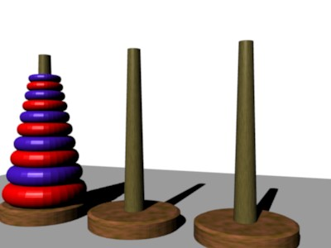
Examples on Modeling
Problems:
Evaluation of arithmetic expressions
The Hanoi Towers game
ADTs:
Stack
Data Structures:
1-D array or Linked List

Slide 39
Examples on Modeling
Problem:
We would like to simulate the waiting process for airplanes to land in an airport.
ADTs:
Queue
Data Structures:
1-D array or Linked List

Slide 40
Examples on Modeling
Problem:
Sorting a set of elements
Selection of the k^{th} smallest (largest) element
ADTs:
Priority Queue
Data Structures:
1-D array

Slide 41
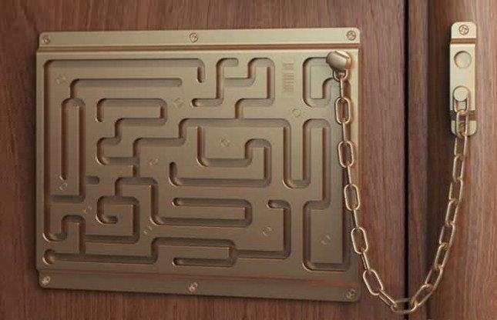
Examples on Modeling
Problem:
Find the shortest path between a source and a destination
Find the exit in a Maze
ADTs:
Graph
Data Structures:
2-D array or Linked list

Slide 42
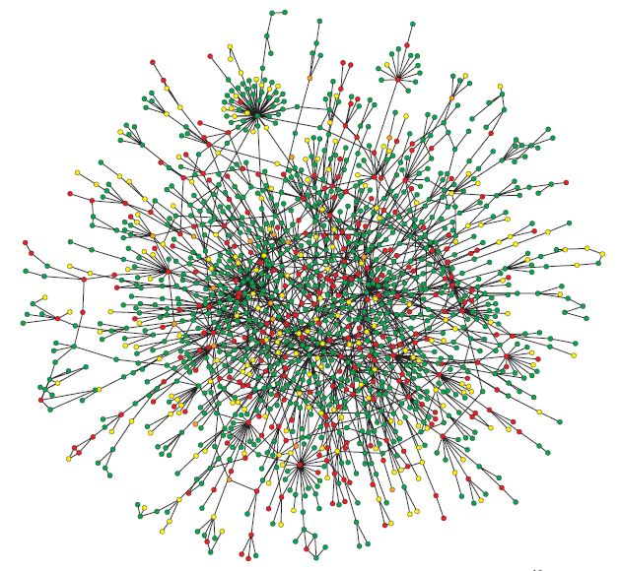
Examples on Modeling
Problem:
Find a wiring scheme for electrical power with minimum cost of wiring
ADTs:
Graph
Priority Queue
Disjoint Sets
Data Structures:
1-D arrays, 2-D array,
Linked list

