Slide 1
CSCE 2211 Applied Data Structures
Prof. Amr Goneid, AUC
Part 10a. Graphs

Slide 2
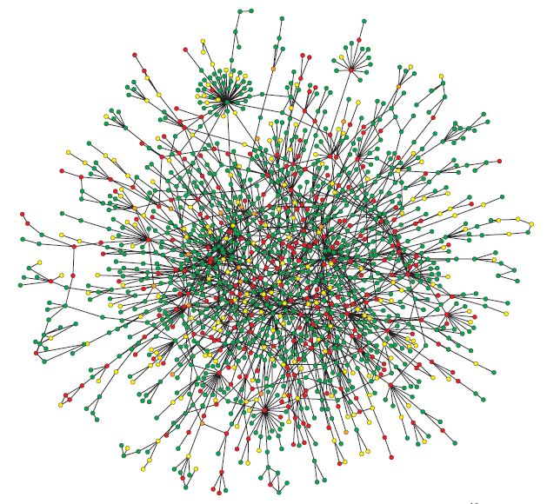
Graphs

Slide 3
Graphs
Basic Definitions
Paths and Cycles
Connectivity
Other Properties
Representation
A Simple Graph Class

Slide 4
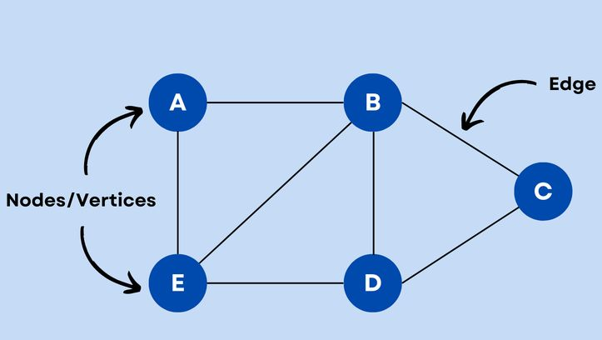
1. Basic Definitions
A graph
is like a road map. Cities are vertices. Roads from city to city are edges.

Slide 5
Basic Definitions
A graph G (V,E) can be defined
as a pair (V,E) , where V is a set
of vertices, and E is a set of
edges between the vertices:
E = {(u,v) | u, v ∈ V}. e.g.
V = {A,B,C,D,E,F,G}
E = {( A,B),(A,F),(B,C),(C,G),(D,E),(D,G),(E,F),(F,G)}
If no weights are associated with the edges, an edge is
either present(“1”) or absent (“0”).
A
F
B
G
E
C
D

Slide 6
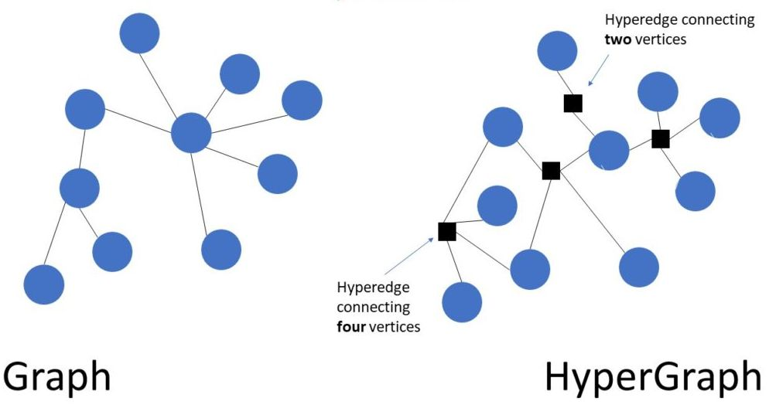
Basic Definitions
Hypergraph:
is a generalization of a graph in which an edge can join any number of vertices. In contrast, in an ordinary graph, an edge connects exactly two vertices.

Slide 7
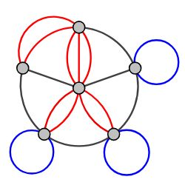
Basic Definitions
Multigraph
is a graph which it is permitted to have multiple edges (also called parallel edges), that is, edges that have the same end nodes. Thus two vertices may be connected by more than one edge.
.

Slide 8
Basic Definitions
Adjacency: If vertices u,v have
an edge e = (u,v) | u, v ∈ V then
u and v are adjacent.
A weighted graph has a weight
associated with each edge.
Undirected Graph is a graph in which the adjacency is
symmetric, i.e., e = (u,v) = (v,u)
A Sub-Graph: has a subset of the vertices and the
edges
3
A
F
2
2
1
B
G
E
1
5
4
2
C
D

Slide 9
Basic Definitions
Directed Graph: is a graph in which
adjacency is not symmetric,
i.e., (u,v) ≠ (v,u)
Such graphs are also called
“Digraphs”
Directed Weighted Graph:
A directed graph with a weight
for each edge. Also called a network.
3
A
F
2
2
1
B
G
E
1
5
4
2
C
D

Slide 10
2. Paths & Cycles
Path: A list of vertices of a graph where each vertex
has an edge from it to the next vertex.
Simple Path: A path that repeats no vertex.
Cycle: A path that starts and ends at the same vertex
and includes other vertices at most once.
A
F
A
F
B
G
E
B
G
E
C
D
C
D

Slide 11
Directed Acyclic Graph (DAG)
Directed Acyclic Graph (DAG): A directed graph with no path that starts and ends at the same vertex
A
F
B
G
E
C
D

Slide 12
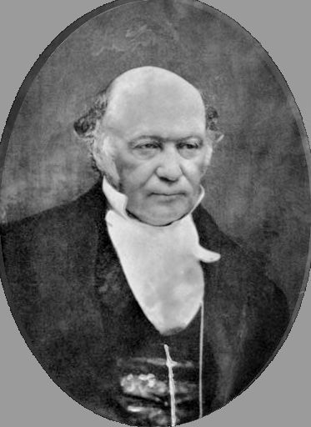
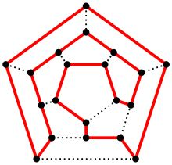
Hamiltonian Cycle
Hamiltonian Cycle:
A cycle that includes all other vertices only once,
e.g. {D,B,C,G,A,F,E,D}
Named after Sir William Rowan Hamilton (1805 –1865)
The Knight’s Tour problem is a Hamiltonian cycle problem
A
F
B
G
E
C
D
Icosian Game

Slide 13
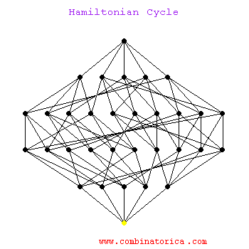
Hamiltonian Cycle Demo
Hamiltonian Cycle Demo
A Hamiltonian Cycle is a cycle that visits each node exactly once. Here we show a Hamiltonian cycle on a 5-dimensional hypercube. It starts by completely traversing the 4-dimensional hypercube on the left before reversing the traversal on the right subcube.

Slide 14
Hamiltonian Cycle Demo
Hamiltonian cycles on hypercubes provide constructions for Gray codes: orderings of all subsets of n items such that neighboring subsets differ in exactly one element.
Hamiltonian cycle is an NP-complete problem, so no worst-case efficient algorithm exists to find such a cycle.
In practice, we can find Hamiltonian cycles in modest-sized graphs by using backtracking with clever pruning to reduce the search space.

Slide 15
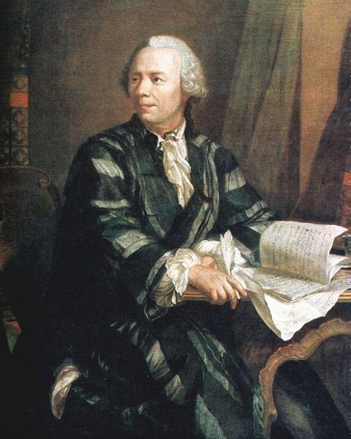
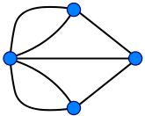
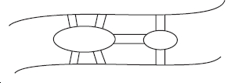
Euler Circuit
Leonhard Euler Konigsberg Bridges
(1736) (not Eulerian)

Slide 16
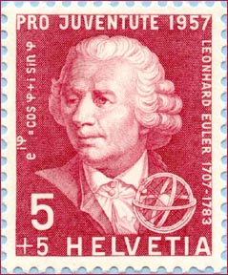
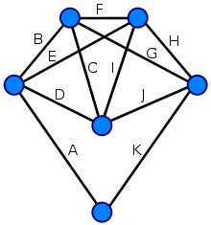
Euler Circuit
Euler Circuit:
A cycle that includes every edge once.
Used in bioinformatics to reconstruct the DNA sequence from its fragments

Slide 17
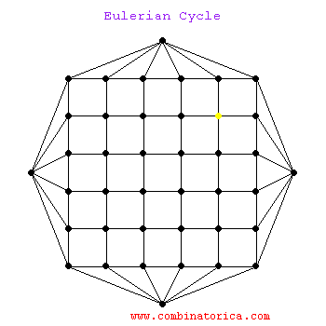
Euler Circuit Demo
Euler Circuit Demo
An Euler circuit in a graph is a traversal of all the edges of the graph that visits each edge exactly once before returning home. A graph has an Euler circuit if and only if all its vertices are that of even degrees.
It is amusing to watch as the Euler circuit finds a way back home to a seemingly blocked off start vertex. We are allowed (indeed required) to visit vertices multiple times in an Eulerian cycle, but not edges.

Slide 18
3. Connectivity
Connected Graph: An undirected graph with a path
from every vertex to every other vertex
A Disconnected Graph may have several connected
components
Tree: A connected Acyclic graph
A
F
A
F
B
G
E
B
G
E
C
D
C
D

Slide 19
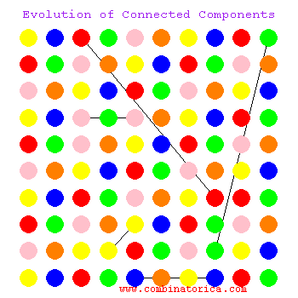
Connected Components Demo
Randomly Connected Graph Demo
What happens when you start with an empty graph and add random edges between vertices?
As you add more and more edges, the number of connected components in the graph can be expected to drop, until finally the graph is connected.
An important result from the theory of random graphs states that such graphs very quickly develop a single ``giant'' component which eventually absorbs all the vertices.

Slide 20
Connectivity
Articulation Vertex: if removed with all of its edges will
cause a connected graph to be disconnected, e.g., G
and D are articulation vertices
A
F
A
F
B
G
E
B
E
C
D
C
D

Slide 21
Connectivity
Degree Of a vertex,
the number of edges connected to
it.
Degree Of a graph,
the maximum degree of any vertex
(e.g. B has degree 2, graph has degree 3).
In a connected graph the sum of the degrees is twice
the number of edges, i.e
A
F
B
G
E
C
D

Slide 22
Connectivity
In-Degree/Out-Degree: the number of edges coming into/emerging from a vertex in a connected graph (e.g. G has in-degree 3 and out-degree 1).
A
F
B
G
E
C
D

Slide 23
Connectivity
Complete Graph:
There is an edge between
every vertex and every
other vertex. In this case,
the number of edges is
maximum:
Notice that the minimum number of edges for a
connected graph ( a tree in this case) is (V-1)
A
D
B
C

Slide 24
Density (of edges)
Density of a Graph:
Dense Graph:
Number of edges is close to E_{max} = V(V-1)/2.
So, E = O(V²) and D is close to 1
Sparse Graph:
Number of edges is close to E_{min} = (V-1).
So, E = O(V)

Slide 25
4. Other Properties
Planar Graph:
A graph that can be drawn in
the plain without edges
crossing
A
D
A
D
B
C
B
C
Non-Planar

Slide 26
Other Properties
Graph Coloring:
To assign color (or any distinctive mark) to vertices
such that no two adjacent vertices have the same color.
The minimum number of colors needed is called the
Chromatic Order of the graph χ(G).
For a complete graph, χ(G) = V.
1
2
4
3

Slide 27
Other Properties
An Application:
Find the number of exam slots for 5 courses. If a single
student attends two courses, an edge exists between them.
EE
Slot | Courses
1 (red) | CS
2 (Green) | EE, Econ, Phys
3 (Blue) | Math
CS
Math
Econ
Phys

Slide 28
5. Representation
Adjacency Matrix:
V x V Matrix a(i,j)
a(i,j) = 1 if vertices (i) and (j) are adjacent, zero otherwise. Usually self loops are not allowed so that a(i,i) = 0.
For undirected graphs, a(i,j) = a(j,i)
Matrix is symmetric
 | A | B | C | D
A | 0 | 1 | 1 | 0
B | 1 | 0 | 1 | 0
C | 1 | 1 | 0 | 1
D | 0 | 0 | 1 | 0
A
D
B
C

Slide 29
Adjacency Matrix
For weighted undirected graphs,
a(i,j) = a(j,i) = w_{ij} (symmetric)
A
D
 | A | B | C | D
A | 0 | 2 | 1 | 0
B | 2 | 0 | 3 | 0
C | 1 | 3 | 0 | 5
D | 0 | 0 | 5 | 0
2
1
5
B
C
3

Slide 30
Adjacency Matrix
For weighted directed graphs,
a(i,j) ≠ a(j,i) Matrix is not symmetric
A
D
 | A | B | C | D
A | 0 | 2 | 1 | 0
B | 0 | 0 | 0 | 0
C | 0 | 3 | 0 | 5
D | 0 | 0 | 0 | 0
2
1
5
B
C
3

Slide 31
Representation
The adjacency matrix is appropriate for dense graphs
but not compact for sparse graphs.
e.g., for a lattice graph, the degree
of a vertex is 4, so that E = 4V.
Number of “1’s” to total matrix size
is approximately 2 E / V² = 8 / V.
For V >> 8, the matrix is dominated by zeros.

Slide 32
Representation
Adjacency List:
An array of vertices with pointers
to linked lists of adjacent nodes, e.g.,
The size is O(E + V) so it is compact for sparse graphs.
A
D
A
B
C
B
C
B
A
C
C
A
B
D
D
C

Slide 33
Edge List
An edge (u,v,w) existing between nodes (u) and (v) with weight (w) is modeled as a structure (Edge).
Space requirements is O(E)
u | A | A | B | C
v | B | C | C | D
w | 2 | 1 | 3 | 5
A
D
2
1
5
B
3
C

Slide 34
6. A Simple Graph Class
To represent a weighted undirected graph with a maximum of V_{max} vertices and E_{max} = V_{max}(V_{max}-1)/2 edges. The verices are numbered 0,1,...V-1.
The graph is assumed to be on a text file in the form of an adjacency matrix. The weights on the edges are assumed to be positive integers with zero weight indicating the absence of an edge.

Slide 35
A Simple Graph Class
When loaded from the text file, the weights are stored in a 2-D array (AdjMatrix) representing the adjacency matrix. Another array (edges) stores the non-zero edges in the graph.
An edge (u,v,w) existing between nodes (u) and (v) with weight (w) is modeled as a class (Edge).

Slide 36
Edge Class
// File: Edge.h
// Definition of Edge class
#ifndef EDGE_H
#define EDGE_H
typedef int weightType; // weights are positive integers
class Edge
{
public:
int u,v; weightType w;
bool operator < (const Edge &e) { return (w < e.w); }
bool operator <= (const Edge &e) { return (w <= e.w); }
}; // end of class Edge declaration
#endif // EDGE_H

Slide 37
Graph Class
// File: Graphs.h
// Graph library header file
#ifndef GRAPHS_H
#define GRAPHS_H
#include <string>
#include "Edge.h"
using namespace std;
const int Vmax = 50; // Maximum number of vertices
const int Emax = Vmax*(Vmax-1)/2; // Maximum number of edges

Slide 38
Graph Class
class Graphs
{
public:
Graphs(); // Constructor
~Graphs(); // Destructor
// Map vertex number to a name (character)
char Vname(const int s) const;
void getGraph(string fname); // Get Graph from text File (fname)
void dispGraph( ) const; // Display Ajacency Matrix
int No_of_Verices( ) const; // Get number of vertices (V)
int No_of_Edges( ) const; // Get Number of Non-zero edges (E)
void dispEdges( ) const; // Display Graph edges
void DFS( ); // Depth First Search Traversal (DFS)

Slide 39
Graph Class
private:
int V, E; // No.of vertices (V) and edges (E)
weightType AdjMatrix[Vmax][Vmax]; // Adjacency Matrix
Edge edges[Emax]; // Array of non-zero edges
int order; // Order of Visit of a node in the DFS
int val[Vmax]; // Array holding order of traversal
void getEdges(); // Get edges from adjacency matrix
void printEdge(Edge e) const; // Output an edge (e)
void visit(int k); // Node Visit Function for DFS
};
#endif // GRAPHS_H
#include "Graphs.cpp"

