Slide 1
CSCE 2211 Applied Data Structures
Prof. Amr Goneid, AUC
Part 10b. Examples of Graph Algorithms

Slide 2
Examples of Graph Algorithms
Graph Traversal
Minimum Cost Spanning Trees
Shortest Paths
Maximum Flow Problem

Slide 3
1. Graph Traversal 1.1 Depth-First Search (DFS)
An Exhaustive Search algorithm
Visits every node in the graph by following node connections in depth.
Recursive algorithm.
An Array val[v] records the order in which vertices are visited. Initialized to “unseen”.
Any edge to a vertex that has not been seen is followed via the recursive call.
Complexity O(|V|² )

Slide 4
Algorithm
// Assume No. of vertices = v and order = 0 initially
// val[1..v] is an array recording the visit order
void DFS( )
{
int k; int unseen = -2;
// Initialize all to unseen
for (k = 1; k <= v; k++) val[k] = unseen;
// Follow Nodes in Depth
for (k = 1; k <= v; k++)
if (val[k] == unseen) visit(k); // Visit node (k) if not visited before
}

Slide 5
The visit Function
void visit (int k) // Recursive visit function
{ int t; //Assume an adjacency matrix a[1..v][1..v]
val[k] = ++order; // Record order of visiting node (k)
for (t = 1; t <= v; t++) // for each vertex t
if (a[k][t] != 0) // if vertices (t) and (k) are adjacent
if (val[t] == unseen) visit(t); // visit (t) if not visited before
}

Slide 6
Example
1
A
start
B
C
F
G
D
E
A | B | C | D | E | F | G
1
VAL[K]

Slide 7
Example
1
A
2
B
C
F
G
D
E
A | B | C | D | E | F | G
1 | 2
VAL[K]

Slide 8
Example
1
A
2
B
3
C
F
G
D
E
A | B | C | D | E | F | G
1 | 2 | 3
VAL[K]

Slide 9
Example
1
A
2
B
3
C
4
F
G
D
E
A | B | C | D | E | F | G
1 | 2 | 3 |  |  | 4
VAL[K]

Slide 10
Example
1
A
2
B
3
C
4
F
G
5
D
E
A | B | C | D | E | F | G
1 | 2 | 3 | 5 |  | 4
VAL[K]

Slide 11
Example
1
A
2
B
3
C
4
F
G
5
D
E
6
A | B | C | D | E | F | G
1 | 2 | 3 | 5 | 6 | 4
VAL[K]

Slide 12
Example
1
A
7
2
B
3
C
4
F
G
5
D
E
6
A | B | C | D | E | F | G
1 | 2 | 3 | 5 | 6 | 4 | 7
VAL[K]

Slide 13
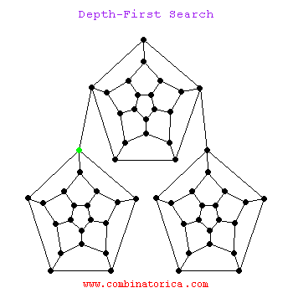
DFS of a Tree
For a tree structure:
DFS is equivalent to Pre-order traversal

Slide 14
Exercises
Show how DFS can be used to determine the number of connected components in a graph.
Explore the non-recursive version of the DFS using a stack. What will happen if you use a queue instead of the stack?

Slide 15
Non-Recursive DFS
// Assume hold = node discovered but not yet visited
// Val[1..v ] is set to “unseen” initially , order = 0
// Assume a stack, initially empty
ALGORITHM DFS(k)
{
push (k) on top of stack;
while stack is not empty
{
pop stack top into (k); val[k] = ++order;
for vertices t = v..1 // Scan from right to left
if (vertices (t) and (k) are adjacent))
if (val[t] == unseen) { push (t) on top of stack; val[t] = hold; }
}
}

Slide 16
Non-Recursive DFS
// Assume unseen = -2 and hold = -1
// Val[ ] is set to “unseen” initially , order = 0
Stact<int> S; // A stack of integers
void DFS(int k)
{
int t; S.push(k);
while (! S.stackIsEmpty())
{ S.pop(k); val[k] = ++order;
for (t = v; t >= 1; t--) // Scan from right to left
if (a[k][t] != 0) if (val[t] == unseen) { S.push(t); val[t] = hold; }
}
}

Slide 17
Graph Traversal 1.2 Breadth-First Search (BFS)
// Replacing the stack by a queue, gives the BFS algorithm
// Also, an Exhaustive Search Algorithm
// Assume a queue, initially empty
ALGORITHM BFS(k)
{
add (k) to end of queue;
while queue is not empty
{
remove queue front into (k); val[k] = ++order;
for vertices t = 1..v // Scan from left to right
if (vertices (t) and (k) are adjacent))
if (val[t] == unseen) { add (t) to end of queue; val[t] = hold;}
}
}

Slide 18
Breadth-First Search (BFS)
// Replacing the stack by a queue, gives the BFS algorithm
Queuet<int> Q; // A queue of integers
void BFS(int k)
{
int t; Q.enqueue(k);
while (! Q.queueIsEmpty())
{
Q.dequeue(k); val[k] = ++order;
for (t = 1; t <= v; t++) // Scan from left to right
if (a[k][t] != 0) if (val[t] == unseen) { Q.enqueue(t); val[t] = hold;}
}
}
Complexity O(|V|² )

Slide 19
Example BFS
1
A
2
B
3
C
4
F
5
G
6
D
E
7
A | B | C | D | E | F | G
1 | 2 | 3 | 6 | 7 | 4 | 5

Slide 20
BFS of a Tree
For a tree structure:
BFS is equivalent to Level-order traversal

Slide 21
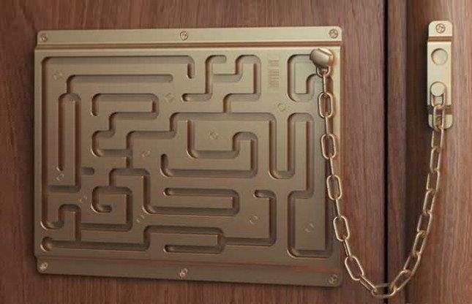
Exercise
in
Model the shown maze
as a graph.
Show how DFS can be
used to find the exit.
out

Slide 22
2. Minimum Cost Spanning Trees (MST) 2.1 Spanning Tree
Consider a connected undirected graph G(V,E).
A sub-graph S(V,T) is a spanning tree of the graph (G) if:
V(S) = V(G) and T ⊆ E
S is a tree, i.e., S is connected and has no cycles

Slide 23
Spanning Tree
S(V,T):
V = {A,B,C,D,E,F,G}
T = {AB,AF,CD,DE,EF,FG}
F
E
A
G
D
B
C

Slide 24
Spanning Tree
Notice that:
|T| = |V| - 1 and adding any edge (u,v) ∉T will produce a cycle so that S is no longer a spanning tree (e.g. adding (G,D))
F
E
A
G
D
B
C

Slide 25
One Graph, Several Spanning Trees

Slide 26
Spanning Forest
For a connected undirected graph G(V,E), a spanning forest is S(V,T) if S has no cycles and T⊆E. S(V,T) will be composed of trees (V₁,T₁), (V₂,T₂), …, (V_{k},T_{k}), k ≤ |V|
F
E
A
G
D
B
C

Slide 27
2.2 Minimum Cost Spanning Tree (MST)
Consider houses A..F connected by
muddy roads with the distances
indicated. We want to pave some
roads such that:
We can reach a house from
any other house via paved roads.
The cost of paving is minimum.
This problem is an example of
finding a Minimum Spanning Tree
(MST)
4
4
G
A
E
7
2
9
3
3
B
C
F
6
4
5
D

Slide 28
Minimum Spanning Tree (MST)
Cost:
For a weighted graph,
the cost of a spanning tree
is the sum of the weights
of the edges in that tree.
Minimum Spanning tree:
A spanning tree of minimum cost
For the shown graph, the
minimum cost is 22
4
4
G
A
E
7
2
9
3
3
B
C
F
6
4
5
D

Slide 29
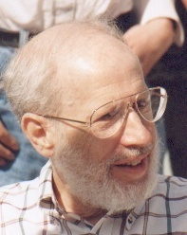
2.3 Kruskal’s Algorithm for MST
The algorithm was written by
Joseph Kruskal in 1956
A Greedy Algorithm:
Builds the MST edge by edge into a set of edges (T). At a given stage, chooses an edge that results in minimum increase in the sum of costs included so far in (T).
The set (T) might not be a tree at all stages of the algorithm, but it can be completed into a tree iff there are no cycles in (T).

Slide 30
Kruskal’s Algorithm for MST
Builds up forests , then joins them in a single tree.
Constraints:
- The graph must be connected.
- Uses exactly V-1 edges.
- Excludes edges that form a cycle.
Uses two representation changes:
A minimum heap for edge weights
A disjoint set for vertices

Slide 31
Abstract Algorithm
-Form Set E of edges in increasing order of costs.
- Set MST T = empty
-Repeat
Select an edge (e) from top.
Delete edge from E set.
Add edge (e) to (T) if it does not form a cycle, otherwise, reject.
-Until we have V-1 successful edges.

Slide 32
Example
Edge | u | v | w | accept
1 | E | F | 2
2 | A | C | 3
3 | C | E | 3
4 | A | E | 4
5 | C | D | 4
6 | E | G | 4
7 | D | F | 5
8 | B | D | 6
4
4
G
A
E
7
2
9
3
3
B
C
F
6
4
5
D

Slide 33
Example
Edge | u | v | w | accept
1 | E | F | 2 | yes
2 | A | C | 3
3 | C | E | 3
4 | A | E | 4
5 | C | D | 4
6 | E | G | 4
7 | D | F | 5
8 | B | D | 6
4
4
G
A
E
7
2
9
3
3
B
C
F
6
4
5
D

Slide 34
Example
Edge | u | v | w | accept
1 | E | F | 2 | yes
2 | A | C | 3 | yes
3 | C | E | 3
4 | A | E | 4
5 | C | D | 4
6 | E | G | 4
7 | D | F | 5
8 | B | D | 6
4
4
G
A
E
7
2
9
3
3
B
C
F
6
4
5
D

Slide 35
Example
Edge | u | v | w | accept
1 | E | F | 2 | yes
2 | A | C | 3 | yes
3 | C | E | 3 | yes
4 | A | E | 4
5 | C | D | 4
6 | E | G | 4
7 | D | F | 5
8 | B | D | 6
4
4
G
A
E
7
2
9
3
3
B
C
F
6
4
5
D

Slide 36
Example
Edge | u | v | w | accept
1 | E | F | 2 | yes
2 | A | C | 3 | yes
3 | C | E | 3 | yes
4 | A | E | 4 | NO
5 | C | D | 4
6 | E | G | 4
7 | D | F | 5
8 | B | D | 6
4
4
G
A
E
7
2
9
3
3
B
C
F
6
4
5
D

Slide 37
Example
Edge | u | v | w | accept
1 | E | F | 2 | yes
2 | A | C | 3 | yes
3 | C | E | 3 | yes
4 | A | E | 4 | NO
5 | C | D | 4 | yes
6 | E | G | 4
7 | D | F | 5
8 | B | D | 6
4
4
G
A
E
7
2
9
3
3
B
C
F
6
4
5
D

Slide 38
Example
Edge | u | v | w | accept
1 | E | F | 2 | yes
2 | A | C | 3 | yes
3 | C | E | 3 | yes
4 | A | E | 4 | NO
5 | C | D | 4 | yes
6 | E | G | 4 | yes
7 | D | F | 5
8 | B | D | 6
4
4
G
A
E
7
2
9
3
3
B
C
F
6
4
5
D

Slide 39
Example
Edge | u | v | w | accept
1 | E | F | 2 | yes
2 | A | C | 3 | yes
3 | C | E | 3 | yes
4 | A | E | 4 | NO
5 | C | D | 4 | yes
6 | E | G | 4 | yes
7 | D | F | 5 | NO
8 | B | D | 6
4
4
G
A
E
7
2
9
3
3
B
C
F
6
4
5
D

Slide 40
Example
Edge | u | v | w | accept
1 | E | F | 2 | yes
2 | A | C | 3 | yes
3 | C | E | 3 | yes
4 | A | E | 4 | NO
5 | C | D | 4 | yes
6 | E | G | 4 | yes
7 | D | F | 5 | NO
8 | B | D | 6 | yes
4
4
G
A
E
7
2
9
3
3
B
C
F
6
4
5
D

Slide 41
Example: Final MST S(V,T)
Edge | u | v | w | accept
1 | E | F | 2 | yes
2 | A | C | 3 | yes
3 | C | E | 3 | yes
4 | A | E | 4 | NO
5 | C | D | 4 | yes
6 | E | G | 4 | yes
7 | D | F | 5 | NO
8 | B | D | 6 | yes
Sum of edges = 22 = min
4
G
A
E
3
3
2
B
C
F
6
4
D
V(S) = 7, V(G) = 7
|T| = |V| - 1 = 6

Slide 42
How to test for Cycles? Simple Union- Simple Find
Given a set (1,2,..,n} initially partitioned into n
disjoint sets (each element is its own parent):
Find (i): return the sub-set that (i) is in (i.e. return the parent set of i).
Union (k,j): combine the two sub-sets that (j) and (k) are in (make k the child of j)
Union builds up a tree, while find will search for the root of the tree.
Cost is O(log n)

Slide 43
How to test for Cycles?
Represent vertices as Disjoint Sets
Initially, each node is its own parent (-1)
A
B
C
D
E
F
G
A | B | C | D | E | F | G
1 | 2 | 3 | 4 | 5 | 6 | 7
-1 | -1 | -1 | -1 | -1 | -1 | -1
Let the parent set
of u be p(u)

Slide 44
How to test for Cycles?
When edge (E,F) is selected, we find that p(E) ≠ p(F). So, we make a union between p(E) and p(F), i.e., p(F) becomes the child of p(E). Same for edge (A,C)
A
B
C
D
E
F
G
A | B | C | D | E | F | G
1 | 2 | 3 | 4 | 5 | 6 | 7
-1 | -1 | 1 | -1 | -1 | 5 | -1
Parent table after selecting (E,F) then (A,C)

Slide 45
How to test for Cycles?
When (C,E) is selected, we find that P(C) ≠ P(E). This means that the edge will be accepted.
Select (A,E), Find will give P(A) = P(E) (cycle, reject).
A
D
E
F
G
B
C
A | B | C | D | E | F | G
1 | 2 | 3 | 4 | 5 | 6 | 7
-1 | -1 | 1 | -1 | 3 | 5 | -1
Parent table after accepting (E,F) then (A,C), then (C,E), then rejecting (A,E)

Slide 46
How to test for Cycles?
When (C,D) is selected, we find that P(C) ≠ P(D). This means that the edge will be accepted.
Select (E,G), Find will give P(E) ≠ P(G) (accept).
D
G
A
E
F
B
C
A | B | C | D | E | F | G
1 | 2 | 3 | 4 | 5 | 6 | 7
-1 | -1 | 1 | 3 | 3 | 5 | 5
Parent table after 5th accepted edge

Slide 47
How to test for Cycles?
When (D,F) is selected, we find that P(D) = P(F). This means that the edge will be rejected.
Select (B,D), Find will give P(B) ≠ P(D) (accept).
D
G
A
E
F
B
C
A | B | C | D | E | F | G
1 | 2 | 3 | 4 | 5 | 6 | 7
-1 | 4 | 1 | 3 | 3 | 5 | 5
Parent table after 6th accepted edge
(Final MST)

Slide 48
Kruskal’s Algorithm
Build a minimum heap of edge weights
Represent the vertices as disjoint sets
i = 0 ;
While ((i < V-1) && (heap not empty)) {
Remove edge (u,v) from heap
Find set (j) of connected vertices having (u)
Find set (k) of connected vertices having (v)
if ( j != k ) { i++; MST [i].u = u; MST [i].v = v; MST [i].w = w;
Make a Union between set (j) and set (k); }
} // Complexity is O(\E\ log |V|)

Slide 49
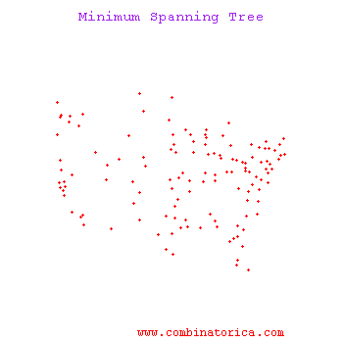
Kruskal’s Algorithm Demo
MST (Kruskal) Demo
Kruskal's algorithm at work on a graph of distances between 128 North American cities. Almost imperceptively at first, short edges get added all around the continent, slowly building forests until the tree is completed.

Slide 50
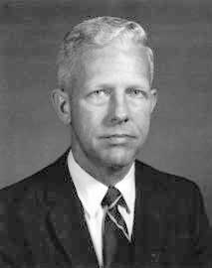
2.4 Prim’s Algorithm for MST
Prim’s algorithm for Minimum Spanning Trees was developed in 1930 by Czech mathematician Vojtěch Jarník and later independently by computer scientist Robert C. Prim in 1957 and rediscovered by Edsger Dijkstra in 1959.
Therefore, it is also sometimes called the DJP algorithm, the Jarník algorithm, or the Prim–Jarník algorithm.
A Greedy Algorithm
Choose any starting vertex.
At any stage, the set of selected edges form a tree
If T is the set of edges selected so far, then T is a tree.
The next edge (u,v) is a minimum cost edge not in T such that
T ∪ {(u,v)} is also a tree.

Slide 51
Prim’s Algorithm
// Given a connected graph, a set of vertices V, and a tree T
ALGORITHM PRIM (G(E,V))
set T = {empty} , V = {first vertex} , done = false
while (T contains less than V-1 edges and not done)
{
choose an edge (u,v) with (u) in V and (v) not in V such that (u,v) is of least cost ;
if there is no such edge then done = true
else { V ← V ∪ {v} , T ← T∪ {(u,v)} };
}

Slide 52
Prim’s Algorithm Example
4
4
c
4
c
c
a
a
a
1
1
1
6
6
6
2
2
2
d
d
d
b
3
b
3
b
3
4
4
c
c
a
a
1
1
6
6
2
2
d
d
b
3
b
3

Slide 53
Prim’s Algorithm
Explore the differences between Prim’s Algorithm and Kruskal’s Algorithm
Make an analysis of the complexity of Prim’s Algorithm and show that it is:
O(|V|²) when graph is represented as an adjacency matrix
O(|E| log |V|) when graph is represented as an adjacency list

Slide 54
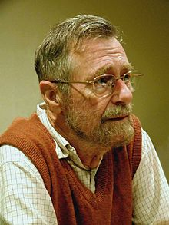
3. Shortest Path Algorithms 3.1 Single Source All Shortest Paths (Dijkstra’s Algorithm)
In a graph G(V,E), find shortest paths from a single source vertex (S) to all other vertices.
Edsger Dijkstra published an algorithm to solve this problem in 1959.
Works for directed or non-directed graphs
Correct only if edge weights are non-negative
Greedy Algorithm with some elements of
Dynamic Programming

Slide 55
Shortest Paths: Dijkstra’s Algorithm
Dijkstra’s Algorithm:
Uses three arrays:
- D_{si} holds distance from (S) to vertex (i).
- P_{i} to flag processed vertices.
- V_{i} holds index of vertex from which we
can directly reach vertex (i).

Slide 56
Initialization
The 3 arrays are initialized as follows:
The algorithm greedily selects the closest node (j) that has not yet been processed and relaxes the minimum distance on all its outgoing edges (i).

Slide 57
Method
Update Rule: New D_{si} = min {D_{si} , D_{sj} + w_{ij} }
closest to S
not yet processed
j
D_{sj}
Already Processed
W_{ij}
S
D_{si}
i
z
x
y
adjacent to j

Slide 58
Dijkstra’s Algorithm (Greedy Algorithm)
ALGORITHM Dijkstra (G(V,E) , S , D, V)
{
// Input: A weighted connected graph G(V,E) with non-negative weights and a source vertex S
// Output: Distance array D and Via array V
Initialize arrays D, P, V
Insert all vertices other than (S) in a minimum heap on distance from source
Repeat
Use the minimum heap to find j = index of unprocessed node closest to (S)
Mark (j) as now processed
for each node (i) not yet processed {
if (i) is adjacent to (j) { Dnew = Dsj + Wij ;
if (Dnew < Dsi ) { Dsi = Dnew; Vi = j; } }
}
Until all vertices are processed
}

Slide 59
Analysis
Initialization and building minimum heap will cost O(|V|)
The repeat loop will be done V-1 times
Finding the node (j) closest to (S) and not yet processed will cost O(|V|)
Updating distances to all nodes adjacent to (j) and not yet processed will cost O(|V|)
Hence, Dijkstra’s algorithm has a complexity of O(|V|²)

Slide 60
Example
Initial Source = A
A
B
C
D
E
0
15
35
∞
20
Dist
15
A
20
yes
No
No
No
No
Processed
B
E
0
A
A
0
A
Via
35
40
10
D
C
35

Slide 61
Example
j = B
A
B
C
D
E
0
15
35
∞
20
Dist
15
A
20
yes
yes
No
No
No
Processed
B
E
0
A
A
0
A
Via
35
40
10
D
C
35

Slide 62
Example
j = B i = D
A
B
C
D
E
0
15
35
55
20
Dist
15
A
20
yes
yes
No
No
No
Processed
B
E
0
A
A
B
A
Via
35
40
10
D
C
35

Slide 63
Example
j = E
A
B
C
D
E
0
15
35
55
20
Dist
15
A
20
yes
yes
No
No
yes
Processed
B
E
0
A
A
B
A
Via
35
40
10
D
C
35

Slide 64
Example
j = E i = C
A
B
C
D
E
0
15
30
55
20
Dist
15
A
20
yes
yes
No
No
yes
Processed
B
E
0
A
E
B
A
Via
35
40
10
D
C
35

Slide 65
Example
j = C
A
B
C
D
E
0
15
30
55
20
Dist
15
A
20
yes
yes
yes
No
yes
Processed
B
E
0
A
E
B
A
Via
35
40
10
D
C
35

Slide 66
Example
j = C i = D
A
B
C
D
E
0
15
30
55
20
Dist
15
A
20
yes
yes
yes
No
yes
Processed
B
E
0
A
E
B
A
Via
35
40
10
D
C
35

Slide 67
Example
j = D
A
B
C
D
E
0
15
30
55
20
Dist
15
A
20
yes
yes
yes
yes
yes
Processed
B
E
0
A
E
B
A
Via
35
40
10
D
C
35

Slide 68
Example
Final
A
B
C
D
E
0
15
30
55
20
Dist
15
A
20
yes
yes
yes
yes
yes
Processed
B
E
0
A
E
B
A
Via
35
40
10
A→B
A→E→C
A→B→D
A→E
D
C
35

Slide 69
How to print the path?
/* The function Vname(k) maps a vertex number to a name (e.g a character A, B,.. etc). Given the via array V resulting from Dijkstra’s algorithm, the following recursive function prints the vertices on the shortest path from source (s) to destination (i). */
void Graphs::PrintPath(int s, int i) const
{
if (i == s) cout << Vname(s);
else
{ PrintPath(s,V[i]); cout << Vname(i); }
}

Slide 70
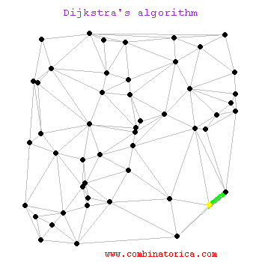
Demo
Shortest Paths Demo

Slide 71
3.2 Single-Source All Shortest Paths, General Weights (Bellman-Ford Algorithm)
Dijkstra’s Algorithm computes Single –source all shortest paths in a directed or undirected graph with positive weights (W_{ij} > 0)
Bellman-Ford Algorithm computes Single –source all shortest paths in a directed or undirected graph with general weights, provided that there is no cycle with a negative length.

Slide 72
Bellman-Ford Algorithm
Named after Richard Bellman and Lester Ford Jr. (1956,1958)
Cannot work if the graph contains a negative cycle reachable from the source, since any path can be made cheaper by more walk through the cycle.
It is a Dynamic Programming (DP) algorithm based on the Principle of Optimality.

Slide 73
Bellman-Ford Algorithm
The Bellman–Ford algorithm relaxes all the edges, doing this |V|-1 times (when there are no cycles of negative length, there is a shortest path between any two vertices that has at most |V|-1 edges). Complexity is O(VE).

Slide 74
Bellman-Ford Algorithm
Given that W_{si} is the initial cost from source (s) to nodes (i), a distance array is initially set at
D¹_{si} = W_{si} for i = 1…|V|,
Consider a target vertex (u ≠ s) with u having at least one incoming edge (at least one edge in a non-directed graph).
All vertices (i) such that edge (i,u) ∈ E are candidates to reach (u). Hence, there are two distances to compete:
D_{su} and min_{i} (D_{si} + W_{iu})
Hence, the update rule is:

Slide 75
Bellman-Ford Algorithm
DP Update Rule (a Recurrence Relation):
u
D_{su}
W_{ui}
i
S
i
D_{si}
i
D¹_{su} = W_{su}
D^{k}_{su} = min (D^{k-1}_{su} , min_{i} {D^{k-1}_{si} + W_{iu}}), k = 2,3,…, |V|-1

Slide 76
Bellman-Ford Algorithm
ALGORITHM Bellman-Ford (W[1..n, 1..n], s , n , D[1..n])
{
// W is the cost matrix of the graph
// n = |V| and s is the source vertex.
// D is the shortest distance from s to all other nodes
for i = 1 to n do { D_{si} = W_{si} ; }
for k = 2 to n-1 do
for (each u ≠ s, and u has at least one incoming edge)
for (each edge (i , u) ∈ E) // Relax
if (D_{su} > D_{si} + W_{iu}) D_{su} = D_{si} + W_{iu}
}

Slide 77
Bellman-Ford Algorithm
For analysis of the algorithm:
The k loop costs O(V)
The two inner loops will cost O(V²) if the adjacency matrix is used and O(E) if we use adjacency list
The overall complexity is O(V³) when we use an adjacency matrix and O(VE) when we use an adjacency list.

Slide 78
Exercise
Given the shown graph with W(i,j) = Cost Matrix
0 6 5 ∞ ∞
∞ 0 ∞ -1 ∞
∞ -2 0 4 3
∞ ∞ ∞ 0 3
∞ ∞ ∞ ∞ 0
Trace the Bellman-Ford algorithm
and show that the final shortest
distance from “A” is:
A
6
5
B
C
-2
-1
3
4
D
E
A | B | C | D | E
0 | 3 | 5 | 2 | 5
3

Slide 79
3.3. All Pairs Shortest Paths (Floyd’s Algorithm)
Given a weighted directed graph G = (V,E) with n = |V| vertices.
Find for each pair of vertices (i,j) ∈ V the cost of the shortest path from i to j.
Dijkstra's algorithm finds the shortest paths from a single source vertex to all other vertices in a graph with nonnegative edge path costs. Complexity is O(|V|²).
Obviously, we can solve this problem by running Dijkstra’s algorithm (V) times, once for each node as a source vertex. The complexity would be O(|V|³).

Slide 80
Floyd’s Algorithm
An alternate algorithm (Floyd’s Algorithm) uses dynamic programming and also has a complexity of O(|V|³).
The algorithm was developed by Robert Floyd (1962)
Because it has a similarity with Warshall’s algorithm, it is sometimes called Floyd-Warshall algorithm.

Slide 81
Example
For each pair of cities (i,j), find the cost of the shortest path from i to j.
A: Athens
B: Brussels
C: Copenhagen
D: Dublin
E: Edinburgh
15
A
20
B
E
35
40
10
D
C
35

Slide 82
Example
A⁰(i,j) = Cost Matrix
0 15 35 Inf 20
15 0 Inf 40 Inf
35 Inf 0 35 10
Inf 40 35 0 Inf
20 Inf 10 Inf 0
A⁵(i,j) Final Solution
15
A
20
B
E
35
40
10
0 15 30 55 20
15 0 45 40 35
30 45 0 35 10
55 40 35 0 45
20 35 10 45 0
D
C
35

Slide 83
All Pairs Shortest Paths
Let A be an (n x n) matrix (n = |V|) such that A^{k}(i,j) is the length of the shortest path from i to j with internal nodes numbered ≤ k. Hence, the final solution is A^{n}(i,j).
A dynamic programming approach would first set A⁰(i,j) then computes A¹(i,j) , A²(i,j), etc.
For this purpose, let:

Slide 84
All Pairs Shortest Paths
A shortest path from i to j with internal vertices no higher than k either goes through vertex k or it does not.
vertices numbered
at most k-1
i
j
k

Slide 85
All Pairs Shortest Paths
If it does not pass through k, then there will be no change from the previous cost, i.e.,
A^{k}(i,j) = A^{k-1}(i,j)
If it goes through k then
A^{k}(i,j) = A^{k-1}(i,k) + A^{k-1}(k,j)
On the k^{th} iteration, the algorithm determines shortest paths between every pair of vertices i, j that use only vertices among 1,…,k as intermediate.

Slide 86
All Pairs Shortest Paths
Transition from the k-1 state to the k state follows the update rule:
A^{k}(i,j) = min { A^{k-1}(i,j) , A^{k-1}(i,k) + A^{k-1}(k,j) } , k ≥ 1
A^{(k-1)}(i,k)
k
i
A^{(k-1)}(k,j)
A^{(k-1)}(i,j)
j

Slide 87
All Pairs Shortest Paths (Algorithm)
Given the cost adjacency matrix C(1..n, 1..n) for a graph with n vertices:
C(i,i) = 0
C(i,j) = w_{ij} for i ≠ j , (i,j) ∈ E and C(i,j) = ∞ if (i,j) ∉ E
Use a matrix A(1..n,1..n) in which A(i,j) stores the cost of the shortest path between (i,j)
use a 2-D array P(1..n,1..n) to hold the indices of the nodes in the shortest path.

Slide 88
All Pairs Shortest Paths (Algorithm)
ALGORITHM Shortest_Paths (C , A , P , n)
{
// Initialize to get A⁰(i,j) and to zero indices matrix
// Assume vertices to have indices 1..n
for i = 1 to n do
for j = 1 to n do
{ A(i, j) = C(i, j); P(i, j) = 0 }

Slide 89
All Pairs Shortest Paths (Algorithm)
Analysis:
It is easy to see that the complexity of Floyd’s algorithm is Θ (n³)
// Consider each vertex to be intermediate
for k = 1 to n do
for i = 1 to n do
for j = 1 to n do
if (A(i, k) + A(k, j) < A(i, j))
{ // Update shortest path
A(i, j) = A(i, k) + A(k, j);
P(i, j) = k;
}
}

Slide 90
Example
A⁰(i,j) = Cost Matrix
0 15 35 Inf 20
15 0 Inf 40 Inf
35 Inf 0 35 10
Inf 40 35 0 Inf
20 Inf 10 Inf 0
A¹(i,j)
15
A
20
B
E
35
40
10
0 15 35 Inf 20
15 0 50 40 35
35 50 0 35 10
Inf 40 35 0 Inf
20 35 10 Inf 0
D
C
35

Slide 91
Example
A²(i,j)
0 15 35 55 20
15 0 50 40 35
35 50 0 35 10
55 40 35 0 75
20 35 10 75 0
A³(i,j)
15
A
20
B
E
35
40
10
0 15 35 55 20
15 0 50 40 35
35 50 0 35 10
55 40 35 0 45
20 35 10 45 0
D
C
35

Slide 92
Example
A⁴(i,j)
0 15 35 55 20
15 0 50 40 35
35 50 0 35 10
55 40 35 0 45
20 35 10 45 0
A⁵(i,j) Final Solution
15
A
20
B
E
35
40
10
0 15 30 55 20
15 0 45 40 35
30 45 0 35 10
55 40 35 0 45
20 35 10 45 0
D
C
35

Slide 93
All Pairs Shortest Paths Indices Matrix P
In the indices matrix P , P(i,j) holds the indices of the vertices on the shortest path (i to j)
0 | 0 | 5 | 2 | 0
0 | 0 | 5 | 0 | 1
5 | 5 | 0 | 0 | 0
2 | 0 | 0 | 0 | 3
0 | 1 | 0 | 3 | 0

Slide 94
All Pairs Shortest Paths Listing nodes on shortest paths
ALGORITHM List_Nodes (A , P, n)
{
for i = 1 to n do
for j = 1 to n do
if (A(i,j) < ∞) { cout << i <<” ”; Between(P, i, j); cout << j <<” ”; }
}
void Between (P, i, j)
{
k = P(i , j);
if (k > 0) { Between(P, i, k); cout << k << ” ”; Between(P, k, j); }
}

Slide 95
All Pairs Shortest Paths Exercise
-2
The graph shown has a negative cycle of length -1. Construct its edge cost matrix and show that:
The update rule for Floyd’s algorithm does not hold.
e.g., A²(1,3) = -∞
A
B
C
1
1

Slide 96
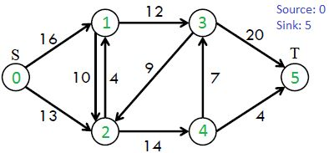
4. Maximum Flow Problem
The max flow problem is a classic optimization problem in graph theory that involves finding the maximum amount of flow that can be sent through a network of pipes, channels, or other pathways, subject to capacity constraints.
We have a directed graph with a source node S and a sink node T, and each edge has a capacity that represents the maximum amount of flow that can be sent through it.

Slide 97
Maximum Flow Problem
Applications:
- Traffic movement
- Hydraulic systems
- Electrical circuits
- Layout

Slide 98
Maximum Flow Problem
Each vertex, except S and T, can receive and send an equal amount of stuff through it. S can only send and T can only receive stuff.
The goal is to find the maximum amount of flow that can be sent from S to T, while respecting the capacity constraints on the edges.
In many cases, the solution of this problem is done using the Ford-Fulkerson algorithm. This is a greedy approach for calculating the maximum possible flow in a network or a graph (1956)

Slide 99
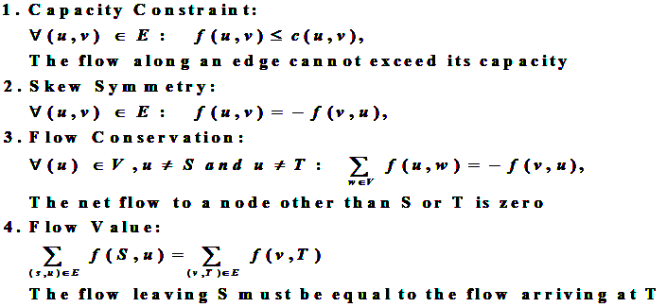
The Ford-Fulkerson Algorithm
Let G(V,E) be a graph, and for each edge from u to v, let c(u,v) be the capacity and f(u,v) be the flow. We want to find the maximum flow from the source S to the sink T. After every step in the algorithm the following is maintained:

Slide 100
The Ford-Fulkerson Algorithm
Before exploring the algorithm, we define the following:
Residual Capacity: capacity of the edge - current flow through the edge.
Residual Graph: same graph with capacities replaced by the residual capacities
Augmenting Path: a simple path from source to sink in a residual graph
Pseudocode
Ford_Fulkerson (Graph G, Node S, Node T)
Initialize flow of all edges E to 0.
while(there is augmenting path(P) from S to T in the residual graph):
Find augmenting path between S and T.
Update the residual graph.
Increase the flow.
return

Slide 101
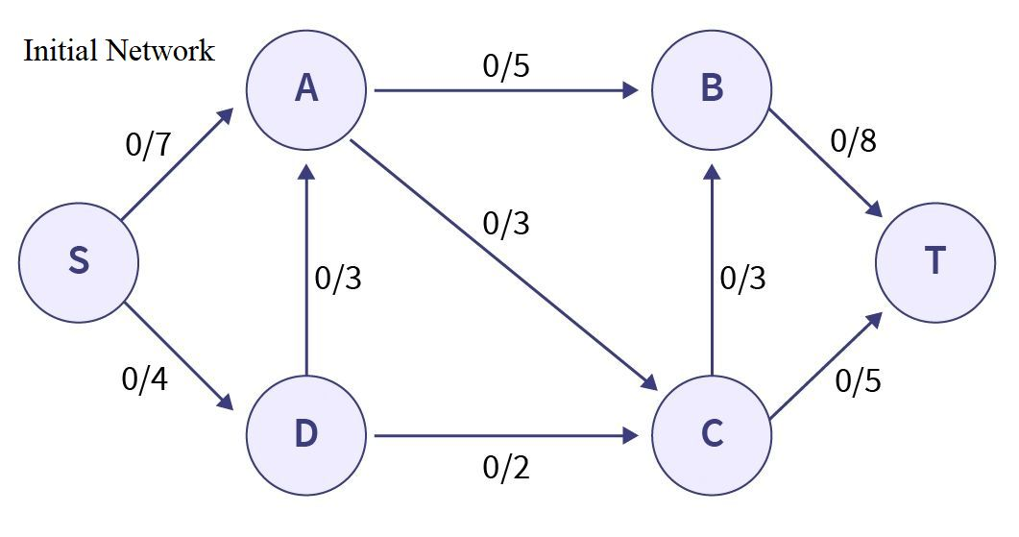
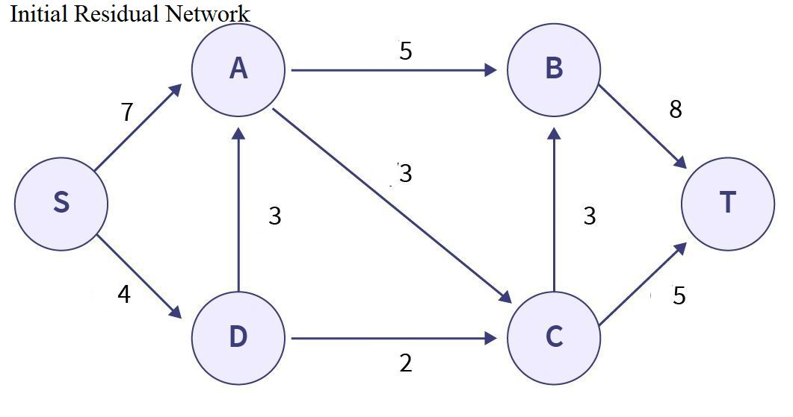
Maximum Flow Example
Initial Network
Flow = 0

Slide 102
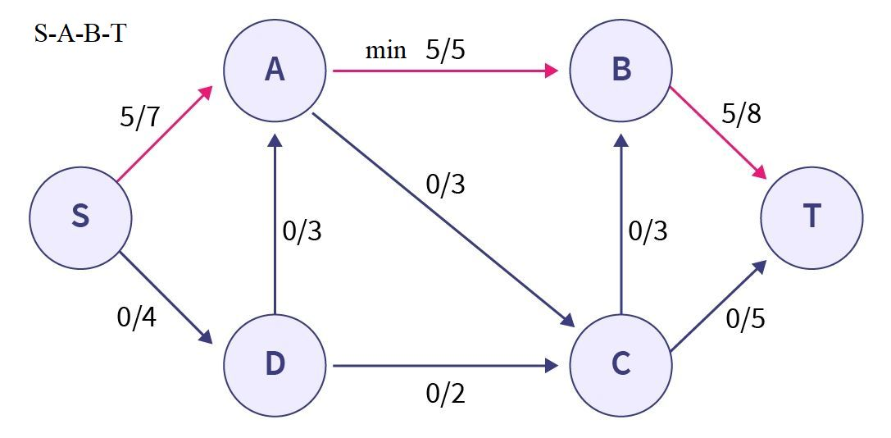
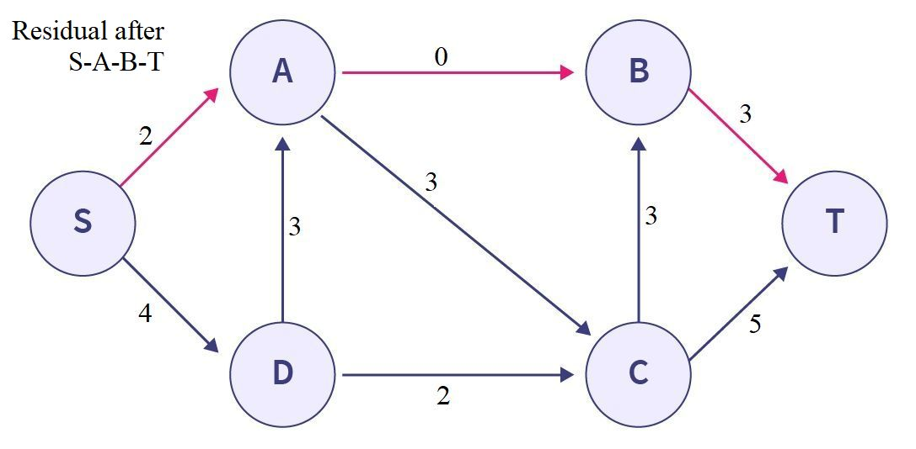
Maximum Flow Example
Choosing augmented path: S-A-B-T Min capacity = 5
Flow = 0 + 5

Slide 103
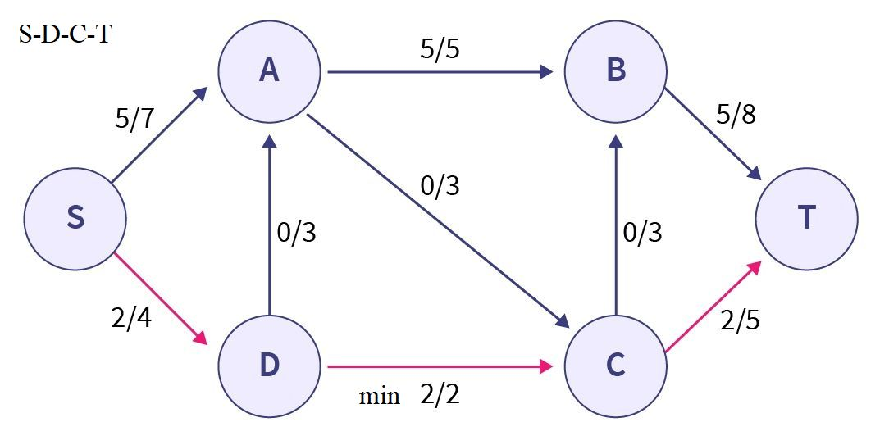
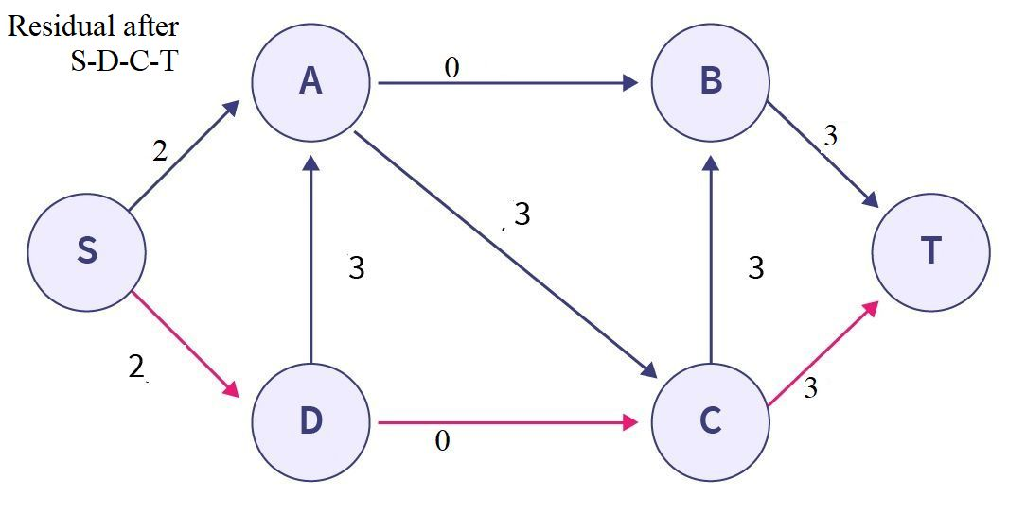
Maximum Flow Example
Choosing augmented path: S-D-C-T Min capacity = 2
Flow = 0 + 5 + 2

Slide 104
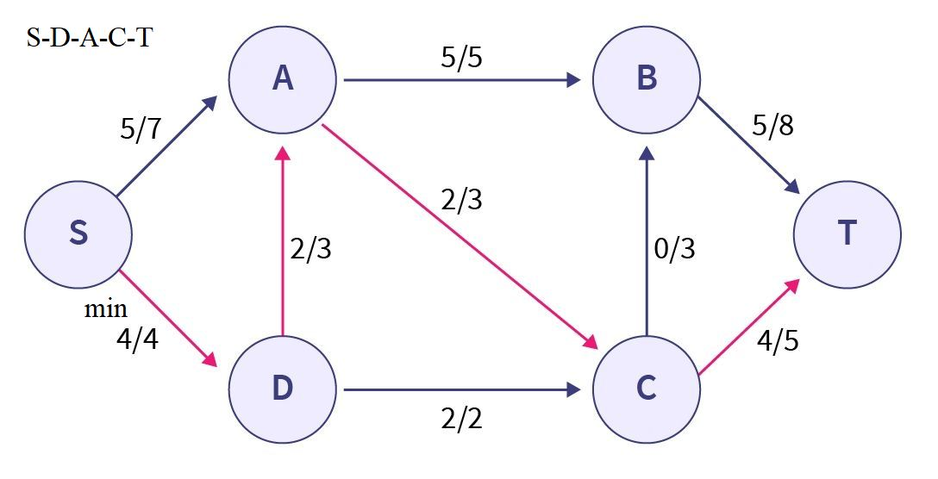
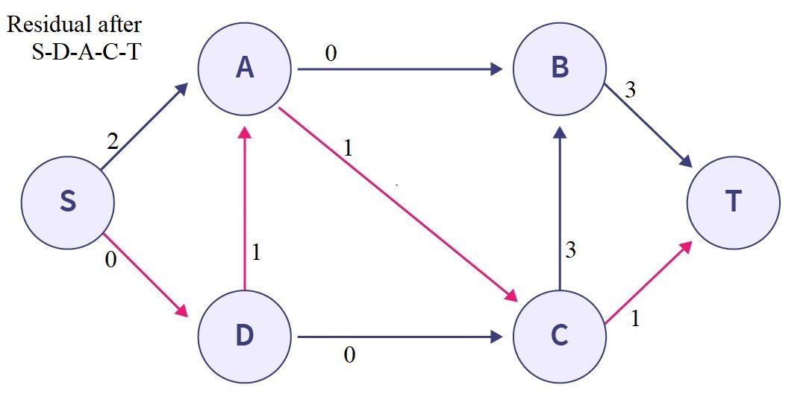
Maximum Flow Example
Choosing augmented path: S-D-A-C-T Min capacity = 2
Flow = 0 + 5 + 2 + 2

Slide 105
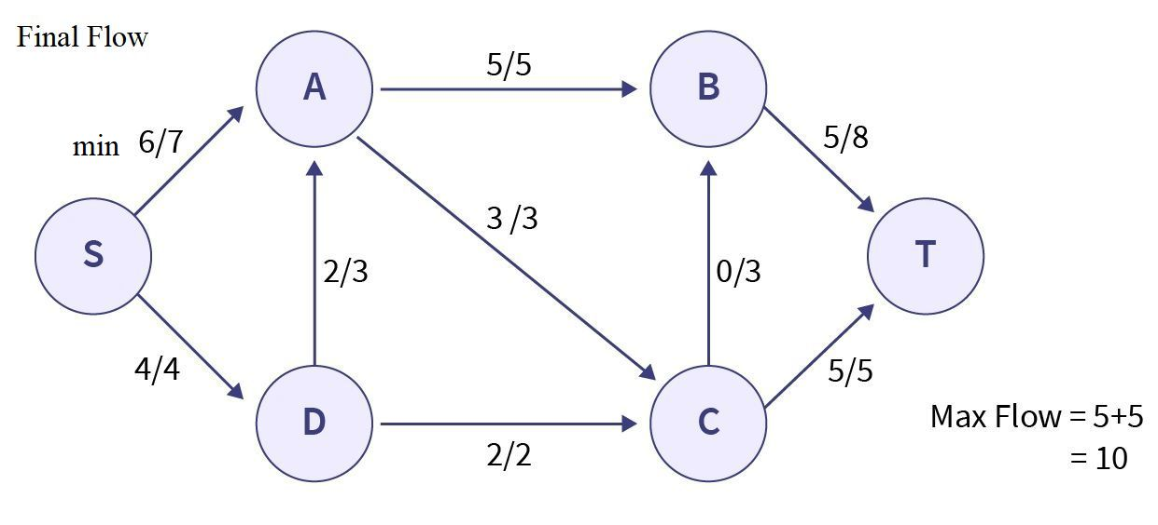
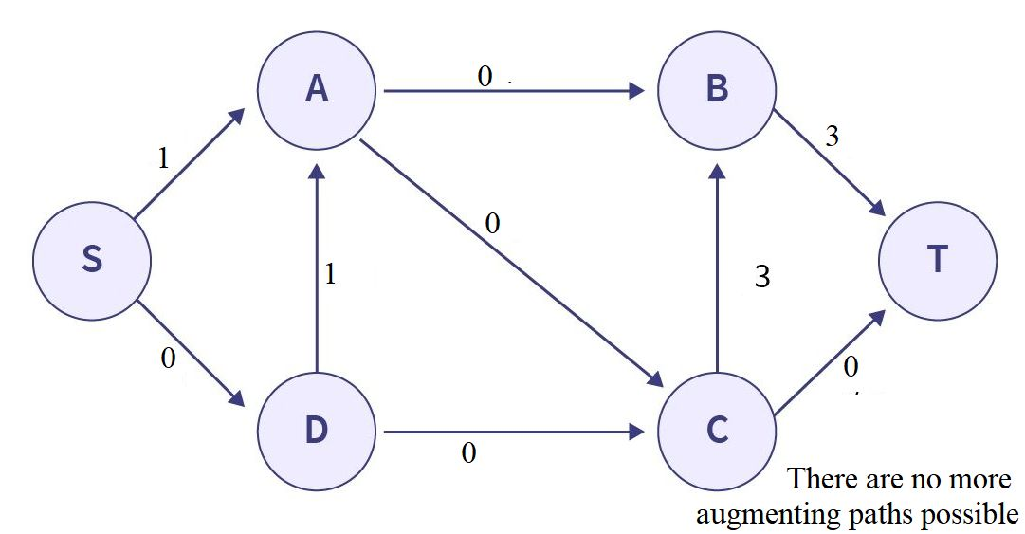
Maximum Flow Example
Choosing augmented path: S-A-C-T Min capacity = 1
Flow = 0 + 5 + 2 + 2 +1 = 10
There are no more augmenting paths possible
Maximum Flow = 10

Slide 106
Complexity
The Ford-Fulkerson algorithm has a complexity of O(E f), where E is the number of edges in the graph and f is the maximum flow in the graph.
A variation of the Ford–Fulkerson algorithm with guaranteed termination and a runtime independent of the maximum flow value is the Edmonds–Karp algorithm, which runs in O(E V²) time, where V is the number of vertices in the graph.

