Slide 1
CSCE 2211 Applied Data Structures
Prof. Amr Goneid, AUC
Part 2. Fundamental Linear Data Structures

Slide 2
Fundamental Linear Data Structures

Slide 3
Fundamental Linear Data Structures
The linked list
The Stack
The Queue

Slide 4
The Linked List
A sequence of nodes linked by pointers:
First node pointed to by head. Contains a data element (e) and a next pointer to next node.
Last node’s next is NULL.
A cursor points to the current node. It can advance in one way only to next node, e.g. to traverse whole list.
e
NULL
head
First
Last
next
cursor

Slide 5
ADT Linked List
Linked List Abstraction:
Linked List: a container of data in the form of a linear configuration of nodes in which we can insert and delete nodes in any order. Each Node is linked to its successor in the list. If it also supports search by contents, it can represent a dictionary ADT.
Node: a container for one data item and has a direct relationship with at most two other nodes, its predecessor (if any) and its successor (if any).
Head node: or first node is the only node without a predecessor.
Current node: special node in the list, indicated by the current position.
Previous Node: the predecessor of the current node

Slide 6
Basic Linked List Operations
Insert or remove head node (can be used for a stack version)
Inserting a node after a given node
Insert or remove tail node (can be used for a queue version)
Delete a node
Retrieve head node or tail node: (Acts as a container)
Search by key content (Acts as a Dictionary)

Slide 7
Variations on Linked Lists
The Circular List:
Notice that tail->next == head
head
tail
cursor

Slide 8
Variations on Linked Lists
The Doubly Linked List
To advance: cursor = cursor->next;
To back : cursor = cursor->back;
back
next
cursor

Slide 9
Variations on Linked Lists
The Circular Doubly Linked List
The 2-D List:

Slide 10
Implementations
The SLL (Simple Linked List) can be implemented using arrays. It can also be implemented using vectors. The vector provides a growable array implementation of the List ADT. The disadvantage is that insertion of new items and removal of existing items is expensive.
(for a revision of the vector class, see Revision Slides R3.
The fully dynamic implementation uses the linked nodes. A full implementation of the Linked List class is found in Revision Slides R2 and at:
http://www1.aucegypt.edu/faculty/cse/goneid/csce2211/codes.rar

Slide 11
Implementations
STL has the List container which provides a doubly linked list implementation of the List ADT. The advantage of using the list is that insertion of new items and removal of existing items is cheap.
Both vector and list are inefficient for searches. The complexity is linear so that T(n) = O(n)

Slide 12
The Stack
A simple data container consisting of a linear list of elements
Access is by position (order of insertion)
All insertions and deletions are done at one end, called top
Last In First Out (LIFO) structure
Two basic operations:
push: add to top, complexity is O(1)
pop: remove from top, complexity is O(1)

Slide 13
Example
push
top
++top
top
top
top
top--
pop

Slide 14
Stack Class Operations
construct: construct an empty stack
stackIsEmpty → bool : return True if stack is empty
stackIsFull → bool : return True if stack is full
push(el) : add element (el) at the top
pop(el): retrieve and remove the top element
stackTop(el): retrieve top element without removing it

Slide 15
Implementation Files
The stack can be implemented using:
Run-Time array or vector. In Case of using vectors, It uses the back, push_back, and pop_back implementation from vector, so the implementation is trivial. All operation are very fast O(1)
A linked list Full implementation of the Stack class is found at:
http://www1.aucegypt.edu/faculty/cse/goneid/csce2211/codes.rar

Slide 16
Some Applications of Stacks
Conversion from Decimal to Hexadecimal
Balancing Enclosure Symbols
Evaluation of Postfix Expressions
Converting Infix Expressions to Postfix
Backtracking
Hanoi Towers

Slide 17
(a) Decimal to Hexadecimal Conversion
// Covert from Decimal to Hexadecimal
string DEC-to_HEX(n)
{
Stackt <char> s; string H = “”;
do
{ rem = n % 16; n = n / 16;
if (rem < 10) c = char (int('0') + rem);
else c = char (int('A') + rem - 10);
s.push(c);
}while ( n != 0);
while (!s.stackIsEmpty()) {s.pop(c); H = H + c;}
return H;
}

Slide 18
(b) Balancing Enclosure Symbols
Given a text file containing a sequence of characters, we
want to check for balancing of the symbols ( ) , [ ] , { }.
Algorithm:
bool EnclosureBalance (filename)
{
Open file filename;
Initialize an empty stack of characters;
balanced = true;
for each character (ch) read until end of file :
{
If (ch is a left symbol) push ch on the stack;

Slide 19
Balancing Enclosure Symbols
else if (ch is a right symbol) then
if (stack is empty) balanced = false;
else
{
pop the stack;
if (popped symbol is not the corresponding
left symbol) balanced = false;
}
}
At the end of the file,
if (stack is not empty) balanced = false;
return balanced;
}

Slide 20
Balancing Enclosure Symbols
{a * (b + c) } Balanced
{a * (b + c [ i ] } Not Balanced
 | (
{ | { | {
 |  | [
 | ( | ( | (
{ | { | { | { | {

Slide 21
(c) Evaluation of Postfix Expressions
Regular expressions are written in “infix” notation, i.e., operator between two operands, e.g.,
(A+B) * (C- (D+E))
Parentheses are used to force precedence

Slide 22
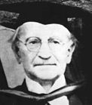
Evaluation of Postfix Expressions
Reverse Polish Notation (RPN) or “postfix” does without parentheses (invented by Lukasiewics).
e.g. the expression (A+B) * (C- (D+E)) becomes:
A B + C D E + - *
Postfix expressions like A B + are evaluated as A + B

Slide 23
Evaluation of Postfix Expressions
The idea is:
Scan from left to right until an operator (+,-,*,/) is encountered.
Apply operator between the previous operands.
Replace the two previous operands by the result.
This suggests to use a stack to store operands
and the results.

Slide 24
Evaluation of Postfix Expressions (Algorithm)
Initialize a stack (S) of characters
For each character from left to right
Get next character
If operand, push it on S
If an operator:
Pop two values (error if there are no two values)
Apply operator
Push result back onto (S)
At the end, result is on top of (S) (the only value, otherwise an error)

Slide 25
Evaluation of Postfix Expressions (Example)
(A+B) * (C- (D+E)) → A B + C D E + - *
(2+3)*(2- (4+1)) → 2 3 + 2 4 1 + - *
 |  |  |  |  | E
 |  |  |  | D | D | D+E
 | B |  | C | C | C | C | C-(D+E)
A | A | A+B | A+B | A+B | A+B | A+B | A+B | Final
 |  |  |  |  | 1
 |  |  |  | 4 | 4 | 5
 | 3 |  | 2 | 2 | 2 | 2 | -3
2 | 2 | 5 | 5 | 5 | 5 | 5 | 5 | -15

Slide 26
(d) Conversion from Infix to Postfix Expression
Initialize an operator stack, s
While not end of infix expression do the following:
read next symbol
in case the symbol is:
an operand: write the operand
‘(‘: push onto s
‘)’: pop and write all operators until encountering‘(‘, then pop ‘(‘
‘*’ or ‘/’: 1-pop and write all ‘*’ and ‘/’ operators from the top down to but not including the top most ‘(‘,’+’,’-’ or to the bottom of the stack
2-push the ‘*’ or ‘/’
‘+’ or ‘-’: 1-pop and write all operators from the top down to but not including the topmost ‘(‘ or to the bottom of the stack
2-push the ‘+’ or ‘-’
End of exp: pop and write all operators

Slide 27
Conversion from Infix to Postfix Expressions
Example: (A+B) * (C- (D+E)) → A B + C D E + - *

Slide 28
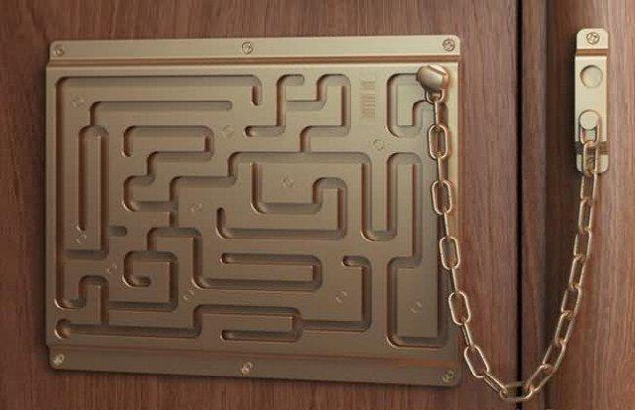
(e) Backtracking (Maze Problem)

Slide 29
Backtracking (Maze Problem)
in
A
out
F
G
B
E
C
D

Slide 30
Backtracking (Maze Problem)
We may choose to move in the order:
South – East – North – West
A stack is used to record the tracks.
When we move on a new track, we push it on the stack.
When we run out of tracks, we backtrack by popping the last track from the stack.
Later in the course, we will do this using a recursive algorithm using the system stack. The algorithm is called Depth First Search

Slide 31
Backtracking (Maze Problem)
The stack will develop as shown
pop
exit
D
C | C |  | E |  |  |  | G
B | B | B | B | B |  | F | F
A | A | A | A | A | A | A | A
steps

Slide 32
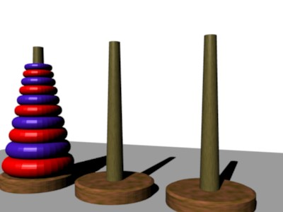
(f) The Towers of Hanoi
See e.g.,
http://mathworld.wolfram.com/TowerofHanoi.html

Slide 33
Learn on your own about:
Use of run-time stack in function calls
Removing recursion using a stack

Slide 34
The Queue
A simple data container consisting of a linear list of elements
Access is by position (order of insertion)
Insertions at one end (rear) , deletions at another end (front)
First In First Out (FIFO) structure
Two basic operations:
enqueue: add to rear, complexity is O(1)
dequeue: remove from front, complexity is O(1)

Slide 35
2. Array Models
Model 1: Variable Front and Rear
Problem: Not possible to enqueue although there is space.
 | 0 | 1 | 2 |  |  |  |  | n-1
Q |  |  | F |  |  | R
Dequeue |  |  |  | F |  | R
Dequeue |  |  |  |  | F | R
Enqueue |  |  |  |  | F |  | R
Enqueue |  |  |  |  | F |  |  | R

Slide 36
Array Models
Model 2: Fixed Front, variable Rear
Problem: To empty a queue of n elements we have to shift the elements to the left each time we dequeue.
Total number of shifts = (n-1) + (n-2) + …..+ 2 + 1 = n(n-1)/2 = O(n²)
Too Expensive
 | 0 | 1 | 2 |  |  |  |  | n-1
Q
Dequeue
Dequeue
Dequeue
Dequeue

Slide 37
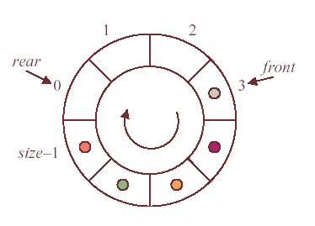
Array Models
Model 3: Ring Model
The queue is viewed as a circular array
When last array element is reached, we move back to start
To enqueue:
rear = (rear + 1) % size
To dequeue:
front = (front + 1) % size
Both rear and front advance clockwise
Keep a count of the number of elements
in the queue
Initially, the queue is empty:
front = 1 rear = 0 count = 0
No need to do any shifts !

Slide 38
Queue Class Operations
construct: construct an empty queue
queueIsEmpty → bool : return True if queue is empty
queueIsFull → bool : return True if queue is full
enqueue(el) : add element (el) at the rear
dequeue(el): retrieve and remove the front element
queueFront(el): retrieve front without removing it
queueRear(el): retrieve rear without removing it
queueLength → int : return the current queue length

Slide 39
Implementation Files
The queue can be implemented using:
Run-Time array
A linked list
(see Revision Slides R1 and R2)
Full implementation of the queue class is found at:
http://www1.aucegypt.edu/faculty/cse/goneid/csce2211/codes.rar

Slide 40
Some Queue Applications
Simulation of waiting lines
Simulation of serviceable events
Job scheduling
Input/Output Buffering
Multiprogramming

Slide 41
Simulation of a Waiting Line
Queues can simulate
waiting lines
A waiting line is a queue
of jobs waiting to be
served by a server on
FCFS
(First Come First Serve)
basis.

Slide 42
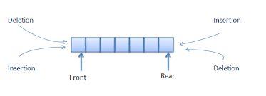
Learn on your own about:
Using Queues in buffering and scheduling
The Deq (Double-Ended Queue) container

