Slide 1
CSCE 2211 Applied Data Structures
Prof. Amr Goneid, AUC
Part 3a. Introduction to the Analysis of Algorithms
(Complexity Bounds)

Slide 2
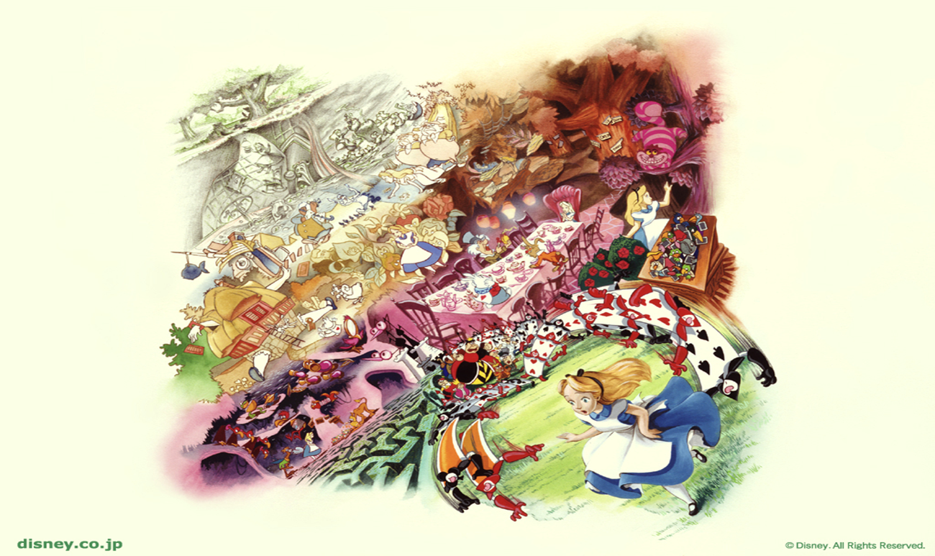
Introduction to the Analysis of Algorithms

Slide 3
Introduction to the Analysis of Algorithms (Complexity Bounds)
Algorithms
Space & Time Complexities
Bounds
See Lecture Notes on 2202 Lecture Notes on Part 3

Slide 4
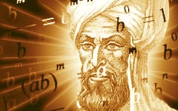
Algorithms
The word Algorithm comes from the name of Abu Ja’afar Mohamed ibn Musa Al Khowarizmi (c. 825 A.D.)
An Algorithm is a function f
to do a certain task,
f : input X → output Y
An Algorithm is supposed to solve a general, well-specified problem

Slide 5
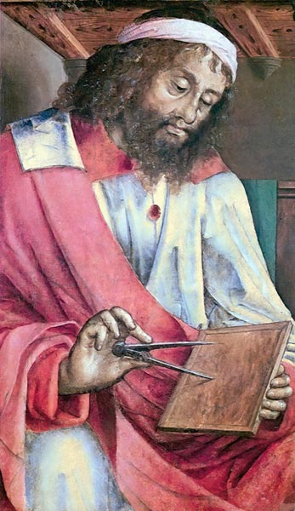
Algorithms
Example: Euclide’s Algorithm for the GCD
(Dates about 200 B.C.)
ALGORITHM Euclid(m, n)
//Computes gcd(m, n) by Euclid’s algorithm
//Input: Two nonnegative, not-both-zero integers m and n
//Output: Greatest common divisor of m and n
while n > 0 do
r ←m mod n
m←n
n←r
return m

Slide 6
Algorithms
Euclide’s Algorithm for the GCD
(Recursive Version)
"The Euclidean algorithm is the granddaddy of all algorithms, because it is the oldest nontrivial algorithm that has survived to the present day”.
Donald Knuth, The Art of Computer Programming, Vol. 2
function gcd(m, n)
if n = 0 return m
else return gcd (n, m mod n)

Slide 7
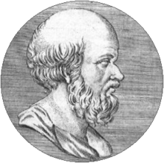
Algorithms
Example: The Sieve of Eratosthenes is a method used to compute all primes less than N. It was invented by Eratosthenes of Cyrene (276 BC - 194 BC).
The algorithm to do this uses an
array of size N+1:
a₀, a₁, a₂, ...a_{i},....., a_{N}
and the objective is to set a_{i} = 1
if i is a prime, and to zero if it is not.

Slide 8
Algorithms
ALGORITHM SIEVE (a[0..N])

Slide 9
Space & Time Complexities
The main goal is to determine the cost of running an algorithm and how to reduce that cost. Cost is expressed as Complexity
Time Complexity
Space Complexity

Slide 10
Space & Time Complexities
Time Complexity
Depends on:
- Machine Speed
- Size of Data (n) and
Number of Operations
needed T(n)
Space Complexity
Depends on:
- Size of Data
- Size of Program

Slide 11
Time Complexity
Expressed as T(n) = number of operations required.
(n) is the Problem Size:
n could be the number of specific operations, or the size of data (e.g. an array) or both.

Slide 12
Number of Operations T(n)
Each “atomic" operation (+, -, =, <, >=, etc.) is one operation.
Loops and function calls are not simple operations, but depend upon the size of the data and the contents of a function. We do not consider ``sort'' to be a single step operation.
Each memory access is one operation.
We measure T(n) of an algorithm by counting the number of specific operations.

Slide 13
Number of Operations T(n)
Example (1): Factorial Function
Let T(n) = Number of multiplications.
For a given n , then T(n) = n (always)
ALGORITHM factorial (n)
{
f = 1;
if ( n > 0 )
for (i = 1 to n) f = f * i ;
return f ;
}
1 muliplication

Slide 14
Factorial Algorithm: Exact Algorithm
Because T(n) = n always, then T(n) = Θ(n)
Algorithm is “tightly Bound”, i.e. “Exact”
T(n)
Θ(n)
n

Slide 15
Exact Algorithms, Another Example
T(n) is independent of data values
Example: position of maximum in an array
T(n) = the number of comparisons of array elements
Hence T(n) = Θ(n)
// elements in array a [0…n-1]
m = 0;
for (i = 1 to n-1) if (a_{i} > a_{m}) m = i;
1 comparison

Slide 16
Number of Operations T(n)
Example (2): Linear Search in an array a[ ]
T(n) = number of array element comparisons.
Best case: T(n) = 1
Worst case:
linSearch (a, target, n)
{
for (i = 0 to n-1)
if (a_{i} == target) return i;
return -1;
}

Slide 17
Complexity of the Linear Search Algorithm
T(n) = 1 in the best case. T(n) = n in the worst case
We write that as: T(n) = Ω(1) and T(n) = O(n)
Algorithm is “loosely Bound”
O(n)
T(n)
Ω(1)
n

Slide 18
Bounds
Bounds describe the limiting behavior of algorithm complexity at large (n), i.e., their Asymptotic Performance.
These are:
Worst Case: Upper Bound (Big O complexity)
Best Case: Lower Bound (Big Ω complexity)
Exact or Tight Bound (Big Θ complexity)

Slide 19
Asymptotic Notation
We use asymptotic notation to express the complexity of algorithms as the problem size becomes very large:
Ψ is the asymptotic notation (bound), Θ , Ο , or Ω and g∞(n) is some function of n.

Slide 20
Asymptotic Notation
For tightly bound number of operations T_{Θ} (n) = g_{Θ} (n) :
For Best Case number of operations T_{Ω} (n) = g_{Ω} (n) :
For worst Case number of operations T_{O} (n) = g_{O}(n) :
g_{Θ} (n):
Take n→ ∞
Obtain g∞ (n):
Complexity T (n) = Θ (g∞ (n)): :
g_{Ω} (n):
Take n→ ∞
Obtain g∞ (n):
Complexity T (n) = Ω (g∞ (n)): :
g_{O} (n):
Take n→ ∞
Obtain g∞ (n):
Complexity T (n) = O (g∞ (n)): :

Slide 21
Bounds
An Average Case complexity can also be obtained if the probabilities of the different data sets are known.
Algorithms are usually compared on the basis of the upper bound (Big O complexity)

Slide 22
Bounds
T(n) is Time Complexity
T(n)
UB
T(n)
UB1
Tav
UB2
LB
n
n₀
n

Slide 23
Tight Bound
We say T(n) = Θ(f(n)), or Big Θ iff there exist positive constants c₁ , c₂ , n₀ such that
c₁f(n) ≤ T(n) ≤ c₂f(n) for all n ≥ n₀
T(n)
c₂f(n)
c₁f(n)
n

Slide 24
Tight Bound
It follows that, if an algorithm always costs
T(n) = c f(n) for the same (n ≥ n₀ ) independent of the data, it is an Exact algorithm.
In this case we say T(n) = Θ(f(n)), or Big Θ.
An example is the factorial function with a cost of T(n) = n for n ≥ 0 (always). Hence T(n) = Θ(n)
is of Complexity

Slide 25
Bounds
If the cost T(n) of an algorithm for a given size (n) changes with the data values, it is not an exact algorithm.
In this case, we find the Best Case (Lower Bound) and the Worst Case (Upper Bound)

Slide 26
Upper Bound
Upper Bound (Big O):
T(n) is O(f(n))
if T(n) grows at most as fast as f(n), i.e.
T(n) = O(f(n))
iff T(n) ≤ c f(n) for n ≥ n₀
c and n₀ are positive constants.

Slide 27
Bounds
T(n)
T(n)
T(n) = O(f(n))
T(n) = Ω (f(n))
f(n)
f(n)
n₀
n
n₀
n

Slide 28
Upper Bound
Example:
Find positive constants c and n₀ to prove that
T(n) = (n+1)² = O(n²)
i.e. what are c and n₀ such that
(n+1)² ≤ cn² for n > n₀

Slide 29
Lower Bound
Lower Bound (Big Ω):
T(n) is Ω(f(n))
if T(n) grows at least as fast as f(n), i.e.
T(n) = Ω(f(n))
iff T(n) ≥ c f(n) for n ≥ n₀
c and n₀ are positive constants.
The linear search function is an example where
T(n) = Ω(1) and T(n) = O(n)

Slide 30
Constants do not matter
If T(n) = c f(n) we still say that T(n) is O(f(n)) or Ω (f(n)) or Θ (f(n))
Constants are always dropped
They can be related to machine or language properties
Examples:
T(n) = 4 (best case) then T(n) = Ω (1)
T(n) = 6 n² (worst case) then T(n) = O(n²)
T(n) = 3 n (always) then T(n) = Θ (n)

Slide 31
Constants do not matter
T(n) = 4 (best case) then T(n) = Ω(1)
T(n) = 6 n² (worst case) then T(n) = O(n²)
T(n) = 3 n (always) then T(n) = Θ(n)
is of
Number of Operations
Complexity

Slide 32
Drop Constants
T(n) ≤ 5.5 n³ for n ≥ 2 hence T(n) = O(n³)
T(n) ≥ 30 n for n ≥ 1 hence T(n) = Ω(n)
T(n) = 6 log₂ n for n ≥ 2 hence T(n) = Θ(log n)

Slide 33
Important Remarks
Big-O complexity is usually used to describe the general behavior of an algorithm. We can still use it to describe tightly bound algorithms
Comparison of algorithms based on Big-O. Lower bound complexities (Big-Ω) are not very useful.
The functional form f(n) of worst case complexity obtained from the number of operations should be the least growing function. For Example:
T(n) ≤ 5n, then T(n) = O(n), O(n²), O(2^{n})…
Correct complexity is T(n) = O(n)

