Slide 1
CSCE 2211 Applied Data Structures
Prof. Amr Goneid, AUC
Part 3b. Introduction to the Analysis of Algorithms
(Complexity Calculations)

Slide 2
Introduction to the Analysis of Algorithms
(Complexity Calculations)
See Lecture Notes on 2202 Lecture Notes on Part 3

Slide 3
Time Complexity Calculations
Evaluating Number of Operations T(n)
Sequential Statements & Function calls
Selection Statements
Repetition Statements - Nested loops
Examples of Algorithm Analysis
Uniqueness Test
Insertion Sort
Maximum Subsequence Sum Problem
Rules for Big-O
Comparing Complexities
Types of Complexities
Intractable Algorithms

Slide 4
Evaluating No. of Operations T(n) Sequential Statements & Functions
Usually we specify a certain type of operations, e.g., additions, array comparisons, etc.
Simple Statements:
T(n) = no. of specified operations.
e.g. for z = 2*x + y , T(n) = 2 arithmetic operations
Code blocks:
T(n) = Sum of sub-block T(n)’s
Function calls
Treated as a whole algorithm

Slide 5
No. of Operations T(n) Selection Statements
c = condition, s = statement block
if (c) s;
T(n) = T_{c}(n) for c false (best case)
= T_{c}(n) + T_{s}(n) for c true (worst case)
If (c) s1; else s2;
T(n) = T_{c}(n) + min(T_{s1}(n),T_{s2}(n)) (best case)
T(n) = T_{c}(n) + max(T_{s1}(n),T_{s2}(n)) (worst case)

Slide 6
No. of Operations T(n)
Example:
T(n) = no. of comparisons
Given that fun1(n) does n+2
comparisons, module1 does
n² and module2 does n⁴.
Find worst case T(n) for the
segment:
if ( c == fun1(n)) call module1;
else call module2;
Process | T(n)
== | 1
fun1(n) | n+2
module1 | n²
module2 | n⁴
Worst case total | ?

Slide 7
No. of Operations T(n)
if ( c == fun1(n)) call module1;
else call module2;
T(n) = (n+2) + 1 + max (n² , n⁴) = 3 + n + n⁴
Hence T(n) = O(n⁴)

Slide 8
No. of Operations T(n) Repetition Statements: for Loops
for (i = j; i <= k; i++)
For Loop Example:
T(n) = No. of multiplications
Fun(i,n) does 2i+n multiplications
m = n*n
for (i =1; i <= m; i++)
Fun(i,n);
Process | T(n)
Compute m | 1
Fun(i,n) | 2i + n
Total | T(n) = ?

Slide 9
No. of Operations T(n) Repetition Statements: for Loops
m = n*n
for (i =1; i <= m; i++)
Fun(i,n);
2i + n

Slide 10
No. of Operations T(n) Repetition Statements: while Loops
while Loop Example:
In the following code:
Fun(i,n) does 3i + log n comparisons, find
T(n) = no. of comparisons. Show that
i = 0;
while(i <= n)
{Fun(i,n); i++;}

Slide 11
No. of Operations T(n) Repetition Statements: while Loops
while loop runs for i = 0…n
Each iteration executes 1 comparison to enter loop (i <= n) plus Fun(i,n) with 3i + log n comparisons. Add an extra comparison in the while to exit loop.

Slide 12
Nested Loops
Example: Find the sum of all elements in a 2-D array of size (nxn)
The no. of floating point additions T(n) as a function of n is:
sum ← 0.0;
for (i = 0 to n-1)
for (j = 0 to n-1)
sum ← sum + a_{ij}
∑_{i}
∑_{j}
1

Slide 13
Running Time
The number of operations can be used to predict the running time of an algorithm for a given problem size (n)
Example:
The number of operations of a sorting algorithm is directly proportional to (n log n). Direct time measurement gives 1 ms to sort 1000 items. Find how long it will take to sort 1,000,000 items.
Solution:

Slide 14
Examples of Algorithm Analysis (a) Uniqueness Test
Check whether all the elements in a given array are distinct
Input: An array A[0…n-1]
Output: Return “true” if all the elements in A are distinct and “false” otherwise

Slide 15
Uniqueness Test

Slide 16
Uniqueness Test

Slide 17
(b) Insertion Sort
The general idea of the insertion sort is that for each element, find the slot where it belongs.
Performs successive scans through the data. When an element is out of sequence (less than its predecessor), it is pulled out and then inserted where it should belong.
Array elements have to be shifted to the right to make space for the insertion.

Slide 18
How it works
2
7
1
5
8
6
3
4
1
2
7
5
8
6
3
4
1
2
5
7
8
6
3
4
1
2
5
6
7
8
3
4
1
2
3
5
6
7
8
4
1
2
3
4
5
6
7
8

Slide 19
Insertion Sort Algorithm
InsertSort (a[0..n-1 ])
{ for i =1 to n-1
{
j = pointer to element a_{i};
v = copy of a_{i};
while( j > 0 && a_{j-1} > v)
{ move data right: a_{j} ← a_{j-1}
move pointer left: j-- }
Insert v at the last (j) location: a_{j} ← v;
}
}

Slide 20
Analysis of Insertion Sort
Best case when the array is already sorted in
ascending order; while loop works zero times

Slide 21
Analysis of Insertion Sort
Worst case when the array is inversely sorted, while loop iterates (i) times:

Slide 22
(c) Maximum Subsequence Sum Problem Statement
Given a sequence of integers (possibly negative), a₁,a₂,...,a_{n}, find start (i) and end (j) indices that maximize the value of
(This is zero if all integers are negative).
Example: -2, 11, -4, 13, -5, -2,
S_{max} = a₂+a₃+a₄= 20

Slide 23
Maximum Subsequence Sum Algorithm 1
Analyze This. Show that T(n) = O(n³) (cubic)
O(n)
O(n)
O(n)

Slide 24
Maximum Subsequence Sum Algorithm 2
Analyze This. Show that T(n) = O(n²) (Quadratic)
O(n)
O(n)
1

Slide 25
Maximum Subsequence Sum Algorithm 3
Notice that any desired S_{max} cannot start with Negative S_{ij.} If this
happens, we jump to a new start at i = j + 1
Analyze This. Show that T(n) = O(n) (Linear)
O(n)
1
1

Slide 26
Summary of Rules for Big-O
Rule | Example
For constant k, O(k) < O(n) | O(7) = O(1) < O(n)
For constant k, O(kf) = O(f) | O(2n) = O(n)
O(|f|+|g|) = O(|f|) + O(|g|) = | O(6n²+n) = O(6n²) + O(n) = O(n²)
Max (O(|f|) , O(|g|)
Nesting of loop O(g) within a loop O(f) gives O(f * g) | O(n⁴ * n²) = O(n⁶)
O(n^{m-1}) < O(n^{m}) | O(n²) < O(n³)
O((log n)^{k}) < O(n) | O(log n) < O(n)

Slide 27
Comparing Complexities
Dominance:
If lim_{(n->∞)} f(n)/g(n) = ∞
then f(n) dominates (i.e. grows faster)
If lim_{(n->∞)} f(n)/g(n) = 0
then g(n) dominates.
If lim_{(n->∞)} f(n)/g(n) = constant
then both grow at the same rate.

Slide 28
Comparing Complexities
Examples:
if a > b then nª dominates n^{b}
Why?
n² dominates (3n+2)
Why?
n² dominates (n log n)
Why?

Slide 29
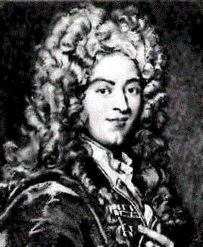
Using l’Hopital’s Rule (1696)
Example: Show that
f(n) = n^{(k+α)} + n^{k} (log n)² and
g(n) = k n^{(k+α)}
grow at the same rate.

Slide 30
Comparing Complexities
Which grows faster:
f(n) = n³ or g(n) = n log n
f(n) = n ^{0.001} or g(n) = log n
f(n) = 2^{n+1} or g(n) = 2^{n}
f(n) = 2^{n} or g(n) = 2^{2n}

Slide 31
Exercises
Which function has smaller complexity ?
f = 100 n⁴ g = n⁵
f = log(log n³) g = log n
f = n² g = n log n
f = 50 n⁵ + n² + n g = n⁵
f = e^{n} g = n!

Slide 32
Types of Complexities
Constant Complexity
T(n) = constant independent of (n)
Runs in constant amount of time ➔ O(1)
Example: cout << a[0][0]
T(n)
O(kn)
O(n)
O(k)
n

Slide 33
Types of Complexities
Logarithmic Complexity
Log₂n = m is equivalent to n=2^{m}
Reduces the problem to half ➔ O(log₂n)
Example: Binary Search
T(n) = O(log₂n)
Much faster than Linear Search which has T(n) = O(n)

Slide 34
Linear vs Logarithmic Complexities
T(n)
O(n)
O(log₂n)
n

Slide 35
Types of Complexities
Polynomial Complexity
T(n) = a_{m}n^{m}+…+ a₂n² + a₁n¹ + a₀
If m=1, then O(a₁n+a₀) ➔ O(n)
If m > 1, then ➔ O(n^{m}) as n^{m} dominates

Slide 36
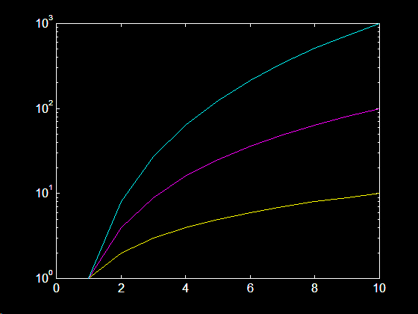
Polynomials Complexities
O(n³)
O(n²)
Log T(n)
O(n)
n

Slide 37
Types of Complexities
Exponential
Example: List all the subsets of a set of n elements {a,b,c}
{a,b,c}, {a,b},{a,c},{b,c},{a},{b},{c},{}
Number of operations T(n) = O(2^{n})
Exponential expansion of the problem ➔ O(a^{n}) where a is a constant greater than 1

Slide 38
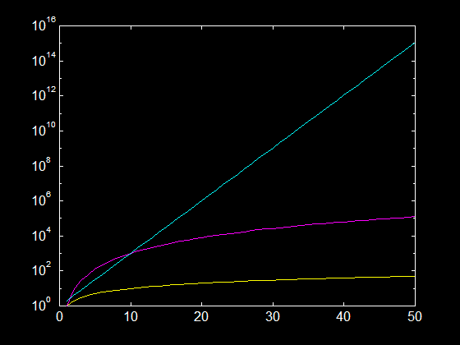
Exponential VS Polynomial
O(2^{n})
Log T(n)
O(n³)
O(n)
n

Slide 39
Types of Complexities
Factorial time Algorithms
Example:
Traveling Salesperson Problem (TSP):
Find the best route to take in visiting n cities away from home. What are the number of possible routes? For 3 cities: (A,B,C)

Slide 40
Possible routes in a TSP
Number of operations = 3!=6, Hence T(n) = n!
Expansion of the problem ➔ O(n!)

Slide 41
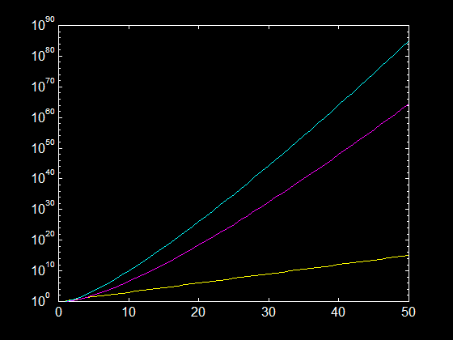
Exponential Vs Factorial
O(n^{n})
Log T(n)
O(n!)
O(2^{n})
n

Slide 42
Execution Time Example
Example:
For the exponential algorithm of listing all subsets of a given set, assume the set size to be of 1024 elements
Number of operations is 2¹⁰²⁴ about 1.8*10³⁰⁸
If we can list a subset every nanosecond the process will take 5.7 * 10²⁹¹ yr!!!

Slide 43
Intractable Algorithms
P (Polynomial) Times O(n^{α}) , α ≥ 0 :
O(1), O(log n), O(log n)², O(n), O(n log n),
O(n²), O(n³), ….
NP (Non-Polynomial) Times:
O(2^{n}) , O(e^{n}) , O(n!) , O(n^{n}) , …..
Intractable Algorithms

Slide 44
Intractable Algorithms
Polynomial time is
GOOD
Try to reduce the polynomial power
NP (e.g. Exponential) Time is
BAD

