Slide 1
CSCE 2211 Applied Data Structures
Prof. Amr Goneid, AUC
Part 4. Trees

Slide 2
Trees
General
Binary Trees
Tree Traversal

Slide 3
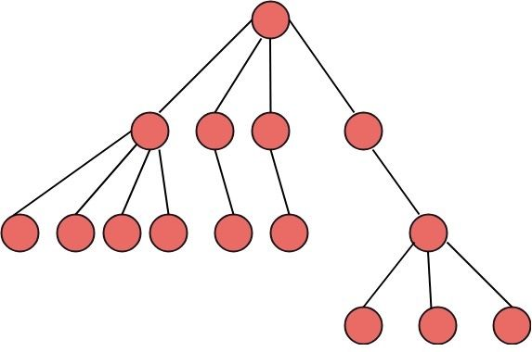
1. General
A Tree is a non-linear, hierarchical one-to-many data structure.
A special tree is the
Binary Tree
a
b
c
d
e
f
g

Slide 4
General
Can be implemented using arrays, structs and pointers
Used in problems dealing with:
Searching
Hierarchy
Ancestor/descendant relationship
Classification

Slide 5
Tree Terminology
A tree consists of a finite set of nodes (or vertices) and a finite set of edges that connect pairs of nodes.
A node is a container for data
An edge represents a relationship between two nodes.
a
a node
a
an edge
b

Slide 6
Tree Terminology
A non-empty tree has a root node (e.g.node a). Every other node can be reached from the root via a unique path (e.g. a-d-f). a is the parent of nodes b and c because there is an edge going from a down to each. Moreover, b and c are children of a.
root
a
child of a
b
c
d
parent of g
e
f
g

Slide 7
Tree Terminology
The descendants of a are (b, c, d, and e), nodes that can be reached by paths from a.
The ancestors of e are (c and a), nodes found on the path from e to a.
Nodes (b, d, and e) are leaf nodes (they have no children).
Each of the nodes a and c has at least one child and is an internal node.
a
b
c
Siblings
d
e

Slide 8
Tree Terminology
Each node in the tree (except leaves) may have one or more subtrees
For a tree with n nodes there are n-1 edges
a
b
c
d
e
f
g

Slide 9
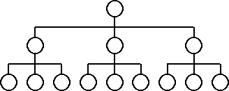
General
A Tree of degree m = 2,3,…is a tree in which a parent node has at most m children (m-way tree)
The root is at level (L = 1) and the height h = maximum level
A tree with m = 3 and height h = 3
Level 1
Level 2
Level 3

Slide 10
General: Tree as a Recursive Structure
Let n(L) = number of nodes in level (L). A level is full if
n(L) = m n(L-1) with n(1) = 1
The above recurrence relation can be solved by successive substitution:

Slide 11
General: Full Tree
A tree of degree m is FULL if all levels are completely filled. In this case, the Total Number of Nodes (N) is:

Slide 12
2.The Binary Tree
A binary tree is a tree in which a parent has at most two children. It consists of a root and two disjoint subtrees (left and right).
The root is at level (L = 1) and the height h = maximum level
The maximum number of nodes in level L is
Level 1
a
A binary tree of height h = 3
Left
Right
Level 2
b
c
Level 3
d
e
f

Slide 13
The Full Binary Tree
A binary tree is full iff the number of nodes in level L is 2^{L-1}
a
b
c
d
e
f
g

Slide 14
The Full Binary Tree
A full binary tree of height h has n nodes, where

Slide 15
The Full Binary Tree

Slide 16
The Full Binary Tree
The cost of search for nodes in level L is L 2^{L-1}
Hence, the total search cost is

Slide 17
The Balanced Tree
A balanced binary tree has the property that the heights of the left and right subtrees differ at most by one level.
i.e. |h_{L} – h_{R}| ≤ 1
A Full tree is also a balanced tree
h_{L}
h_{R}

Slide 18
Complete Binary Tree
A binary tree is Complete iff the number of Nodes at level 1 <= L <= h-1 is 2^{L-1} and leaf nodes at level h occupy the leftmost positions in the tree
i.e. all levels are filled except the rightmost of the last level.
Missing Leaves
Missing Leaves

Slide 19
Complete Binary Tree
1
A complete binary tree can be efficiently implemented as an array, where a node at index i has children at indexes 2i and 2i+1 and a parent at index i/2 (with one-based indexing).
A | B | C | D | E
A
2
3
B
C
4
5
D
E

Slide 20
Binary Tree as a Recursive Structure
A binary tree is a recursive structure
e.g. it can be defined recursively as:
if (not empty tree)
1. It has a root
2. It has a (Left Subtree)
3. It has a (Right Subtree)
Recursive structure suggests recursive processing of trees (e.g. Traversal)
a
b
c
d
e
f

Slide 21
Binary Tree as a Recursive Structure
Empty
a,b,c,d,e,f
a
b,d,e
c,f
b
c
d
e
f

Slide 22
3. Tree Traversal
Traversal is to visit every node ( to display, process, …) exactly once
It can be done recursively
There are 4 different binary tree traversal orders:
Pre-Order: Root is visited before its two subtrees (Depth-First)
In-Order: Root is visited in between its two subtrees
Post-Order: Root is visited after its two subtrees
Level-Order: Traversal Level-by-Level (Breadth-First)

Slide 23
Pre-Order Traversal
Algorithm: complexity is O(n)
The resulting visit order = {a} {b , d , e} {c , f }
PreOrder ( tree )
{
if ( not empty tree)
{
Visit (root);
PreOrder (left subtree);
PreOrder (right subtree);
}
}
1
a
2
5
b
c
4
3
d
e
f
6

Slide 24
Pre-Order Traversal
Pre-Order Traversal is also called Depth-First traversal
1
2
5
3
4
6
7

Slide 25
In-Order Traversal
Algorithm: complexity is O(n)
The resulting visit order = {d , b , e} {a} {f , c }
InOrder ( tree )
{
if ( not empty tree)
{
InOrder (left subtree);
Visit (root);
InOrder (right subtree);
}
}
4
a
2
6
b
c
3
1
d
e
f
5

Slide 26
Post-Order Traversal
Algorithm: complexity is O(n)
The resulting visit order = {d , e , b} {f , c } {a}
PostOrder ( tree )
{
if ( not empty tree)
{
PostOrder (left subtree);
PostOrder (right subtree);
Visit (root);
}
}
6
a
3
5
b
c
2
1
d
e
f
4

Slide 27
Example: Expression Tree
The expression A – B * C + D can be represented as a tree.
In-Order traversal gives: A – B * C + D
This is the infix representation
Pre-Order traversal gives: + - A * B C D
This is the prefix representation
Post-Order traversal gives:
A B C * - D +
This is the postfix (RPN) representation
+
-
D
A
*
B
C

Slide 28
Level-Order (Breadth-First) Traversal
Pre-order (a.k.a. Depth-First traversal) can be implemented using an iterative (non-recursive) algorithm. In this case, a stack is used
If the stack is replaced by a queue and left pointers are exchanged by right pointers, the algorithm becomes Level-order traversal (a.k.a. Breadth-First traversal)

Slide 29
Iterative Preorder Traversal
void iterative_preorder ( )
{ t = root;
Let s be a stack
s.push (t);
while(!s.stackIsEmpty())
{ s.pop(t); process(t->key);
if ( t _{right} is not empty) s.push(t _{right});
if ( t _{left} is not empty) s.push(t _{left}); }
}

Slide 30
Level Order Traversal
void levelorder ( )
{ t = root;
Let q be a queue;
q.enqueue(t);
while(!q.queueIsEmpty())
{ q.dequeue(t); process(t->key);
if ( t _{left} is not empty) q.enqueue(t _{left});
if ( t _{right} is not empty) q.enqueue(t _{right}); }
}

Slide 31
Level-Order Traversal
Traversal order: {D,B,F,A,C,E,G}
1
D
2
3
B
F
4
5
6
7
A
C
E
G

Slide 32
Binary Tree Traversal Demo
Binary Tree Traversal Demo

