Slide 1
CSCE 2211 Applied Data Structures
Prof. Amr Goneid, AUC
Part 5a. Dictionaries and Binary Search Trees

Slide 2
Dictionaries and Binary Search Trees
BST

Slide 3
Dictionaries and Binary Search Trees
The Dictionary Data Structure
The Binary Search Tree (BST)
Search, Insertion and Traversal of BST
Removal of nodes from a BST
Binary Search Tree ADT

Slide 4
1. The Dictionary Data Structure
A Dictionary is a form of container that permits access by content.
A dictionary DS should support the following main operations:
Insert (D,x): Insert item x in dictionary D
Delete (D,x): Delete item x from D
Search (D,k): search for key k in D

Slide 5
The Dictionary Data Structure
Examples:
Unsorted arrays and Linked Lists: permit linear search
Sorted arrays: permit Binary search
Ordered Lists: permit linear search
Binary Search Trees (BST): fast support of all dictionary operations.
Hash Tables: Fast retrieval by hashing key directly to a position.
Tries: Prefix Trees

Slide 6
The Dictionary Data Structure
3 types of dictionaries:
Static Dictionaries
built once and never change.
support search, but not insertion or deletion.
implemented using arrays or Hash tables
Semi-dynamic Dictionaries
support insertion and search
no deletion.
implemented as arrays, linked lists or Hash tables

Slide 7
The Dictionary Data Structure
Fully Dynamic Dictionaries
Fast support of all dictionary operations.
Binary Search Trees are best.
Hash tables are also great for small sized dictionaries
Tries are best for string keys.

Slide 8
The Dictionary Data Structure
In the following, we present the design and implement a dictionary data structures that is based on the Binary Search Tree (BST).
This will be a Fully Dynamic Dictionary and basic operations are usually O(log n)

Slide 9
2. The Binary Search Tree (BST)
A BST is a binary tree that stores keys or key-data pairs in
its nodes and has the following properties:
A key identifies uniquely the node (no duplicate keys)
If (u , v , w) are nodes such that (u) is any node in the left subtree of (v) and (w) is any node in the right subtree of (v) then:
key(u) < key(v) < key(w)
v
w
u

Slide 10
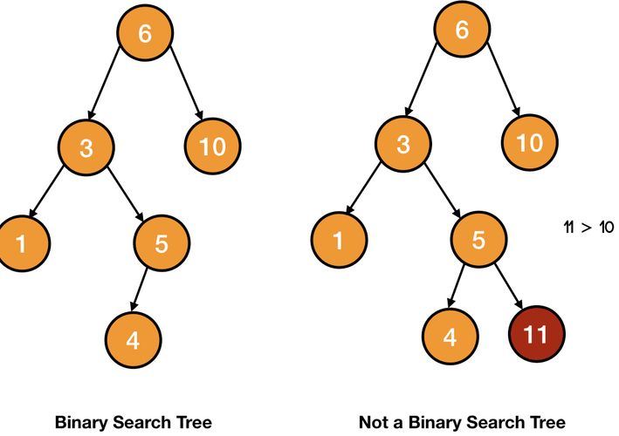
Examples Of BST

Slide 11
3. Search, Insertion & Traversal of BST Searching Algorithm (Pseudo Code)
Searches for the item with same key as k
in the tree (t).
bool search(t,k)
{
if (t is empty) return false;
else if (k == key(t)) return true;
else if (k < key(t))
return search(t_{left} , k);
else
return search(t_{right} , k);
}

Slide 12
Searching for a key
Search for the node containing e:
Maximum number of comparisons is tree height, i.e. O(h)

Slide 13
Building a Binary Search Tree
Tree created from root downward
Item 1 stored in root
Next item is attached to left tree if value is smaller or right tree if value is larger
To insert an item into an existing tree, we must first locate the item’s parent and then insert

Slide 14
Insertion (Pseudo Code)
Inserts key (k)in the tree (t)
bool insert(t, k)
{ if (t is empty)
{
create node containing (k)and attach to (t);
return true;
}
else if (k == key(t)) return false;
else if (k < key(t)) return insert(t_{left} , k);
else return insert(t_{right} , k);
}

Slide 15
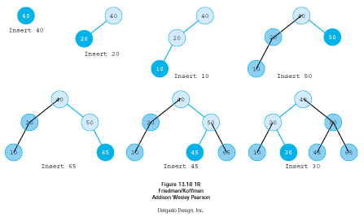
Example: Building a Tree Insert: 40,20,10,50,65,45,30

Slide 16
Effect of Insertion Order
The shape of the tree depends on the order of insertion. Shape determines the height (h) of the tree.
Since cost of search is O(h), the insertion order will affect the search cost.
The previous tree is full, and h = log(n+1) so that search cost is O(log n)

Slide 17
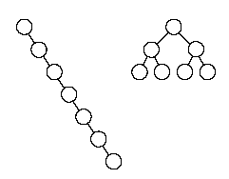
Effect of Insertion Order
The previous tree would look like a linked list if we have inserted in the order 10,20,30,…. Its height would be h = n and its search cost would be O(n)
O(n)
O(log n)

Slide 18
Linked Representation
The nodes in the BST will be implemented as a linked structure:
left | element | right
t
 | 32
32
16
45
 | 16
 | 45
40
 | 40

Slide 19
Traversing a Binary Search Tree
Recursive inorder traversal of tree with root (t)
traverse ( t )
{
if (t is not empty) {
traverse (t_{left});
visit (t);
traverse (t_{right}); }
}

Slide 20
Other Traversal Orders
Pre-order (a.k.a. Depth-First traversal)
Post-Order traversal
Level-order traversal (a.k.a. Breadth-First traversal)

Slide 21
Find Minimum Key
Find the minimum key
in a tree with root (t)
Minkey ( t )
{
if (t_{left} is not empty)
return MinKey(t_{left});
else return key(t);
}
Find the maximum key
in a tree with root (t)
Maxkey ( t )
{
if (t_{right} is not empty)
return MinKey(t_{right});
else return key(t);
}

Slide 22
Demo
BST Animation

Slide 23
In-Order Traversal
In-Order traversal of a BST produces a sorted sequence.
A middle node has an immediate predecessor and an immediate succesor
Node
Immediate Predecessor
Immediate Successor
16 | 18 | 22 | 25 | 44 | 69

Slide 24
4. Removal of Nodes from a BST

Slide 25
Deleting a ROOT Node

Slide 26
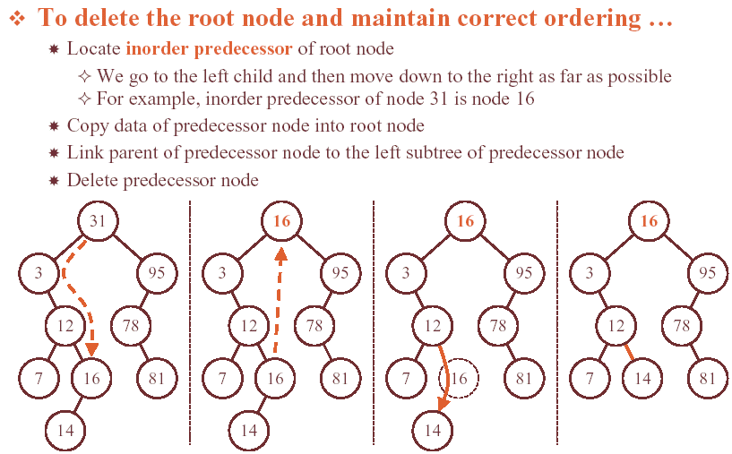
Deleting a ROOT Node

Slide 27
Deleting a ROOT Node (Special Case)

Slide 28
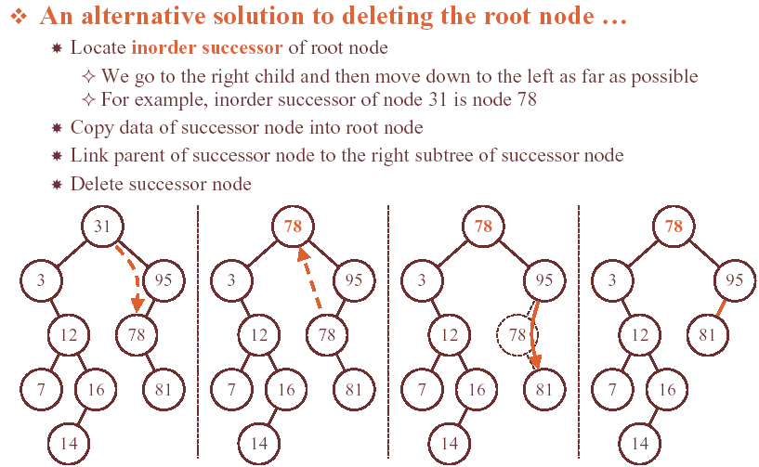
Deleting a ROOT Node (Alternative)

Slide 29
Deleting an Internal Node

Slide 30
Search for Parent of a Node
To delete a node, we need to find its parent.
To search for the parent (p) of a node (x) with key (k)in tree (t):
Notice that:
P is null if (k) is in the root or if the tree is empty.
If (k) is not found, p points to what should have been its parent.
Set x = t; p = null; found = false;
While (not found) and (x is not empty)
{
if k < key(x) descend left (i.e. set p = x; x = x_{left})
else
if k > key(x) descend right (i.e. set p = x;x = x_{right})
else found = true
}

Slide 31
Algorithm to remove a Node
Let
k = key to remove its node
t = pointer to root of tree
x = location where k is found
p = parent of a node
sx = inorder successor of x
s = child of x

Slide 32
Algorithm to remove a Node
Remove (t,k)
{
Search for (k) and its parent;
If not found, return;
else it is found at (x) with parent at (p):
Case (x) has two children:
Find inorder successor (sx) and its parent (p);
Copy contents of (sx) into (x);
Change (x) to point to (sx);
// Now (x) has one or no children and (p) is its parent

Slide 33
Algorithm to remove a Node
Case (x) has one or no children:
Let (s) point to the child of (x) or null if there are no children;
If p = null then set root to null;
else if (x) is a left child of (p), set p_{left} = s;
else set p_{right} = s;
// Now (x) is isolated and can be deleted
delete (x);
}

Slide 34
Example: Delete Root
p = null
40
x
20
60
10
30
50
70

Slide 35
Example: Delete Root
40
x
20
60
p
10
30
50
70
sx

Slide 36
Example: Delete Root
50
20
60
p
10
30
50
70
x
S = null

Slide 37
Example: Delete Root
50
20
60
10
30
null
70
50
x
delete

Slide 38
5. Binary Search Tree ADT
Elements:
A BST consists of a collection of elements that are all of the same type. An element is composed of two parts: key of <keyType> and data of <dataType>
Structure:
A node in a BST has at most two subtrees. The key value in a node is larger than all the keys in its left subtree and smaller than all keys in its right subtree. Duplicate keys are not allowed.

Slide 39
Binary Search Tree ADT
Data members
root pointer to the tree root
Basic Operations
binaryTree a constructor
insert inserts an item
empty checks if tree is empty
search locates a node given a key

Slide 40
Binary Search Tree ADT
Basic Operations (continued)
retrieve retrieves data given key
traverse traverses a tree (In-Order)
preorder pre-order traversal
levelorder Level-order traversal
remove Delete node given key
graph simple graphical output

Slide 41
Implementation Files
A Full implementation of the BST class is found at:
http://www1.aucegypt.edu/faculty/cse/goneid/csce2211/codes.rar

Slide 42
Node Specification
// The linked structure for a node can be specified as a Class in the private part of
// the main binary tree class.
class treeNode // Hidden from user
{
public:
keyType key; // key
dataType data; // Data
treeNode *left; // left subtree
treeNode *right; // right subtree
}; // end of class treeNode declaration
//A pointer to a node can be specified by a type:
typedef treeNode * NodePointer;
NodePointer root;

Slide 43
6. Template Class Specification
IMPORTANT
Because node structure is private, all references to pointers should be hidden from user
This means that recursive functions with pointer parameters must be private.
A public (User available) member function will have to call an auxiliary private function to support recursion.
For example, to traverse a tree, the user public function will be declared as:
void traverse ( ) const;
and will be used in the form:
BST.traverse ( );

Slide 44
Template Class Specification
Such function will have to call a private traverse function:
void traverse2 (NodePointer ) const;
Therefore, the implementation of traverse will be:
template <class keyType, class dataType>
void binaryTree<keyType, dataType>::traverse() const
{
traverse2(root);
}
Notice that traverse2 can support recursion via its pointer parameter

Slide 45
Template Class Specification
For example, if we use in-order traversal, then the private traverse function will be implemented as:
template <class keyType, class dataType>
void binaryTree <keyType, dataType>::traverse2 (NodePointer aRoot) const
{
if (aRoot != NULL)
{ // recursive in-order traversal
traverse2 (aRoot->left);
cout << aRoot->key << endl;
traverse2 (aRoot->right);
}
} // end of private traverse

Slide 46
Template Class Specification
All similar functions will be implemented using the same method. For example:
Public Function Private Function
insert (key,data) insert2 (pointer,key,data)
search(key) search2 (pointer,key)
retrieve(key,data) retrieve2 (pointer,key,data)
traverse( ) traverse2 (pointer)

Slide 47
BinaryTree.h
// FILE: BinaryTree.h
// DEFINITION OF TEMPLATE CLASS BINARY SEARCH TREE
#ifndef BIN_TREE_H
#define BIN_TREE_H
// Specification of the class
template <class keyType, class dataType>
class binaryTree
{

Slide 48
BinaryTree.h
public:
// Public Member functions ...
// CREATE AN EMPTY TREE
binaryTree();
// INSERT AN ELEMENT INTO THE TREE
bool insert(const keyType &, const dataType &);
// CHECK IF THE TREE IS EMPTY
bool empty() const;
// SEARCH FOR AN ELEMENT IN THE TREE
bool search (const keyType &) const
// RETRIEVE DATA FOR A GIVEN KEY
bool retrieve (const keyType &, dataType &) const;

Slide 49
BinaryTree.h
// TRAVERSE A TREE
void traverse() const;
// Iterative Pre-order Traversal
void preorder () const;
// Iterative Level-order Traversal
void levelorder () const;
// GRAPHIC OUTPUT
void graph() const;
// REMOVE AN ELEMENT FROM THE TREE
void remove (const keyType &);
.........

Slide 50
BinaryTree.h
private:
// Node Class
class treeNode
{
public:
keyType key; // key
dataType data; // Data
treeNode *left; // left subtree
treeNode *right; // right subtree
}; // end of class treeNode declaration

Slide 51
BinaryTree.h
typedef treeNode * NodePointer;
// Data member ....
NodePointer root;
// Private Member functions ...
// Searches a subtree for a key
bool search2 ( NodePointer , const keyType &) const;
//Searches a subtree for a key and retrieves data
bool retrieve2 (NodePointer , const keyType & , dataType &) const;
// Inserts an item in a subtree
bool insert2 (NodePointer &, const keyType &, const dataType &);

Slide 52
BinaryTree.h
// Traverses a subtree
void traverse2 (NodePointer ) const;
// Graphic output of a subtree
void graph2 ( int , NodePointer ) const;
// LOCATE A NODE CONTAINING ELEMENT AND ITS PARENT
void parentSearch( const keyType &k, bool &found,
NodePointer &locptr,
NodePointer &parent) const;
};
#endif // BIN_TREE_H
#include “binaryTree.cpp”

Slide 53
Test Program (BSTtest.cpp)
// File: BSTtest.cpp
// Test class template binaryTree
#include <iostream>
using namespace std;
#include "binaryTree.h"
int main()
{
const int N = 7;
char A[N] = {'D','B','A','F','G','E','C'};
int B[N] = {4,2,1,6,7,5,3};
char x; int d;
binaryTree<char, int> BST;
cout << "Constructing empty BST\n";
cout << "BST " << (BST.empty() ? "is" : "is not") << " empty\n";

Slide 54
Test Program (BSTtest.cpp)
cout << "Traversing\n";
BST.traverse();
for(int i = 0; i<N; i++)
if(BST.insert(A[i], B[i])) cout << A[i] <<" is inserted\n";
cout << "BST " << (BST.empty() ? "is" : "is not") << " empty\n";
cout << "Traversing\n";
BST.traverse();
cout << "Searching\n";
x = A[3];

Slide 55
Test Program (BSTtest.cpp)
cout << x << (BST.search(x) ? " is" : " is not") << " found\n";
x = ‘W’;
cout << x << (BST.search(x) ? " is" : " is not") << " found\n";
cout << "Graphical Output\n\n";
BST.graph();
cout << endl;
x = 'E';
cout << "Retrieving data part of " << x;
if (BST.retrieve(x, d)) cout <<" = " << d;
cout << endl;
return 0;
} // BSTtest

Slide 56
Test Program (sample output)
Constructing empty BST
BST is empty
Traversing
D is inserted
B is inserted
A is inserted
F is inserted
G is inserted
E is inserted
C is inserted
BST is not empty

Slide 57
Test Program (sample output)
Traversing
A 1
B 2
C 3
D 4
E 5
F 6
G 7
Searching
F is found
W is not found

Slide 58
Test Program (sample output)
Graphical Output
G
F
E
D
C
B
A

Slide 59
Test Program (sample output)
Graphical Output
G
F
E
D
C
B
A
Retrieving data part of E = 5

Slide 60
add to test program
x = ‘E’;
cout << "Removing " << x << endl; BST.remove(x);
cout << "Graphical Output\n\n";
BST.graph(); cout << endl;
x = 'F';
cout << "Removing " << x << endl; BST.remove(x);
cout << "Graphical Output\n\n";
BST.graph(); cout << endl;
x = 'D';
cout << "Removing " << x << endl; BST.remove(x);
cout << "Graphical Output\n\n";
BST.graph(); cout << endl;

Slide 61
Test Program (sample output)
Graphical Output
G
F
E
D
C
B
A
Removing E
Graphical Output
G
F
D
C
B
A

Slide 62
Test Program (sample output)
Removing F
Graphical Output
G
D
C
B
A
Removing D
Graphical Output
G
C
B
A
Press any key to continue

Slide 63
BST: Visualization
See BST visualization at:
https://www.cs.usfca.edu/~galles/visualization/BST.html

