Slide 1
CSCE 2211 Applied Data Structures
Prof. Amr Goneid, AUC
Part 7. B-Trees

Slide 2
B-Trees
Motivation
Applications
Properties
Insertion & Deletion

Slide 3
B-Trees: Motivation
Traditional BST’s become impractical for large volumes of data due to their poor performance and high memory usage.
In this case, we have to use a disk-based method when the dictionary is too big to fit in RAM at once.
Accessing values stored in a large database a disc takes a long time.
B-trees are used to build indices for huge volumes of data and provide quick access to the actual data stored on the disks.
Well suited for storage systems that read and write relatively large blocks of data, such as disks.

Slide 4
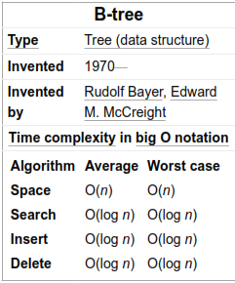
B-Trees: Applications
Database indexing
File systems
Domain Name System (DNS)
to quickly retrieve IP addresses
Web browsers to store bookmarks,
history, and other user data.
Encryption, computer networks,
and natural language processing

Slide 5
What is a B-Tree?
A B-tree of order m is an m-way tree (i.e., a tree where each node may have up to m children) in which:
The number of keys in each non-leaf node is one less than the number of its children and these keys partition the keys in the children in the fashion of a search tree
All leaves are on the same level
The tree is always balanced
All non-leaf (internal) nodes except
the root have between ⎡m / 2⎤ and m children.
The root is either a leaf node, or it has from 2 to m children
A leaf node contains no more than m – 1 keys
If a node has n children, it contains n – 1 keys

Slide 6
B-Tree Example

Slide 7
B-Trees: Capacity for degree m
Consider the root to be at level L = 0 and the tree levels are 1, 2,.. H
Maximum no. of keys in the root is m-1 and it has m children
The maximum no. of keys at level 1 , n(1) = (m – 1) m
The maximum no. of keys at level 2 , n(L) = (m – 1) m²
The maximum no. of keys at level L , n(L) = (m – 1) m^{L}
The maximum no. of keys in all the tree is:

Slide 8
B-Trees: Performance
Searching is similar to searching a binary search tree.
Since all leaves are on the same level and the tree is always balanced, the search cost is O(h)
n = 127 Keys, m = 5
Log(5) = 2.32
h = 2
______________________
n = 32 Gega keys =2³⁵
m = 128,
h = 4

Slide 9
B-Trees: Insertion Steps
In a B-Tree, a new element must be added only at the leaf node. That means, the new keyValue is always attached to the leaf node only. The insertion operation is performed as follows...
Step 1 - Check whether tree is Empty.
Step 2 - If tree is Empty, then create a new node with new key value and insert it into the tree as a root node.
Step 3 - If tree is Not Empty, then find the suitable leaf node to which the new key value is added using Binary Search Tree logic.
Step 4 - If that leaf node has empty position, add the new key value to that leaf node in ascending order of key value within the node.
Step 5 - If that leaf node is already full, split that leaf node by sending middle value to its parent node. Repeat the same until the sending value is fixed into a node.
Step 6 - If the splitting is performed at root node then the middle value becomes new root node for the tree and the height of the tree is increased by one.

Slide 10
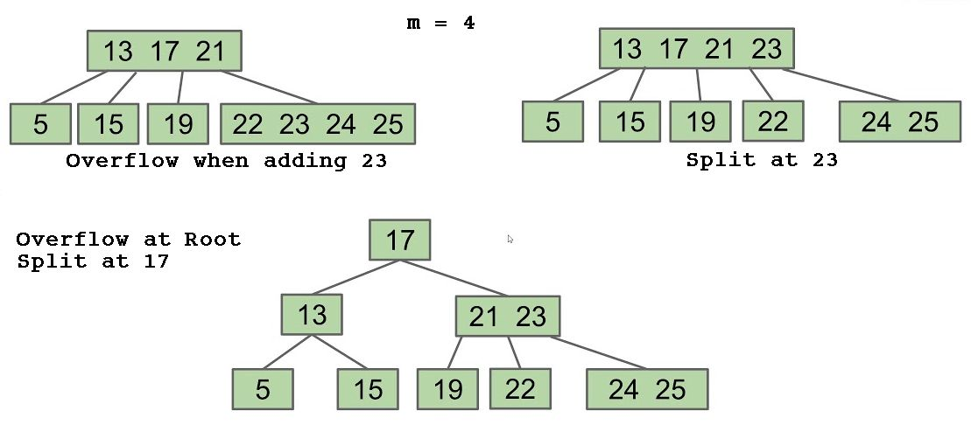
B-Trees: Splitting in Case of Overflow
A node contains no more than m – 1 keys
Adding a new key to a full node causes overflow
To repair this, we split the node into three parts:
Left: the first (M-1)/2 values, becomes the left child of the middle
Middle: the middle value (position 1+((M-1)/2)
Right: the last (M-1)/2 values, becomes the right child of the middle
The middle is added in the appropriate place in this node's parent.

Slide 11
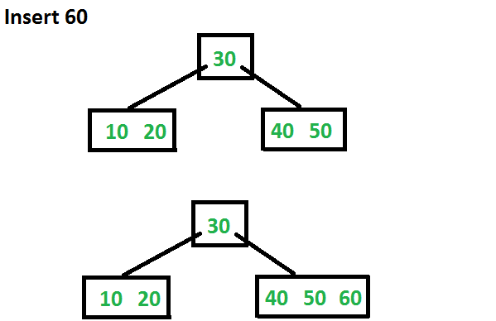
B-Trees: Insertion Example
Insert the sequence of integers 10, 20, 30, 40, 50, 60, 70, 80 and 90 in an initially empty B-Tree with m = 6
Let us now insert 60.
Since root node is full,
it will first split into two,
then 60 will be inserted into the appropriate child.

Slide 12
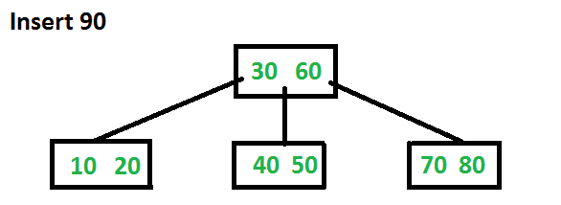
B-Trees: Insertion Example
Insert 70 and 80
Let us now insert 90.
This insertion will cause
a split. The middle key
will go up to the parent.

Slide 13
Deletion: Exercise for Exploring
Explore the steps for Deletion from a B-Tree

Slide 14
B-Trees: Visualization
See B-Tree visualization at:
https://www.cs.usfca.edu/~galles/visualization/BTree.html

