Slide 1
CSCE 2211
Applied Data Structures
Prof. Amr Goneid, AUC
Part 8. Heaps & Priority Queues

Slide 2

Heaps & Priority Queues
Definition of Priority Queue
The Binary Heap
Insertion and Removal
A Priority Queue Class
Analysis of PQ operations
Heapify Algorithm
Heap Sort
Merging Two Binary Heaps
Fibonacci Heaps

Slide 3
1. Definition of Priority Queue
Definition of Priority Queue
A Priority Queue (PQ) is a set with the operations:
• Insert an element
• Remove and return the smallest / largest element
Priority queues enable us to retrieve items not by the insertion time (as in a stack or queue), nor by a key match (as in a dictionary), but by which item has the highest priority of retrieval.

Slide 4
Some Applications
Priority queues are used to maintain schedules and calendars.
The Selection Problem
Event Simulation: They govern who goes next in simulations of airports, parking lots, and the like.
They serve in Bandwidth Management in network routers.
They are used in finding shortest paths in graphs.
One famous application is an efficient sorting method called Heap Sort.

Slide 5
2. The Binary Heap
The Binary Heap is a common way of implementing a PQ using an array.
The Heap is visualized as a binary tree with the following properties:
Property (1): Partially Balanced:
The heap is as close to a complete binary tree as
possible. If there are missing leaves, they will be
in the last level at the far right.

Slide 6
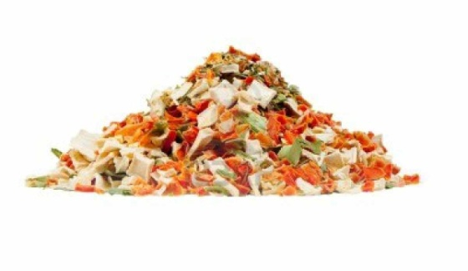
The Heap as a Complete Tree
1
2
3
4
5
6
7
8
9
10
Missing Leaves

Slide 7
The Heap as a Complete Tree
Property (2): Heap Condition (Minimum Heap):
The value in each parent is ≤ the values in its children.
1
1
2
3
3
7
4
5
6
7
5
7
18
9
8
9
10
16
7
8

Slide 8
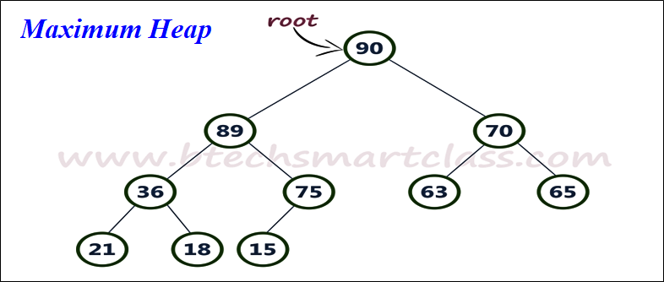
The Heap as a Complete Tree
Property (2): Heap Condition:
Maximum Heap: The value in each parent is ≥ the values in its children.
Minimum Heap: The value in each parent is ≤ the values in its children.

Slide 9
The Heap as a Complete Tree
Property (3): The Heap array
The Heap array contains the level order traversal of the tree
1
1
2
3
3
7
4
5
6
7
5
7
18
9
8
9
10
16
7
8

Slide 10
The Heap Array
1
3
7
5
7
18
9
16
7
8
Parent at location (i), children at locations (2i) and (2i + 1)
Parent of child at (i) is in location (i / 2)
The heap condition (Minimum Heap)is:
a_{i} ≤ a_{2i} && a_{i} ≤ a_{2i+1}
Condition is reversed for a Maximum Heap

Slide 11
The Heap Array
The binary heap data structure supports both insertion and extract-min in O(log n) time each.
The minimum key is always at the root of the heap.
New keys can be inserted by placing them at an open leaf and up-heaping the element upwards until it sits at its proper place in the partial order.

Slide 12
3. Insertion and Removal
Insert in a Minimum Heap (Algorithm)
ALGORITHM insert (v)
{
// Insert element v in heap array A, location of last element is N
  Increment heap size (i.e. N++)
  insert element (v) at end (first rightmost empty leaf)
  upheap element from location (N) if necessary
}
O(h) = O(log N)

Slide 13
UpHeap Algorithm
  Upheap element at location (k) in a minimum heap
  as long as it is less than or equal to its parent
  Assume a[0] = -∞
  ALGORITHM upheap (k)
  {
  copy a_{k} into v;
  while ( parent of a_{k} >= v)
  {
  move parent to child’s location;
  set k to point to old parent location (i.e. k ← k/2) ;
  }
  copy back v into a_{k};
  }
// Complexity = O(h) = O(log n) for one element
While loop
O(h) = O(log N)
h

Slide 14
Insert in a Minimum Heap
Insert array X[ ] = {2,4,6,5,3,1} into a heap
Resulting heap = {1,3,2,5,4,6}
2
2
2
2
1
4
4
6
3
6
3
2
5
3
5
4
1
5
4
6
insert 4
insert 1
insert 2
insert 6,5,3

Slide 15
Removal Algorithm
Remove and return top of the heap, then adjust heap.
ALGORITHM remove( )
{
copy top of heap (a₁) into v;
replace a₁ by last element (a_{N});
decrement heap size (i.e. N--);
downheap a₁ to its proper location if necessary;
return v;
}
O(h) = O(log N)

Slide 16
DownHeap Algorithm
Downheap element at (k) in the heap
ALGORITHM downheap(k)
{
copy element a_{k} to v;
find location (j) of its left child;
while (left child a_{j} exists) {
if ((there is a right child) && (left child > right child))
point j to right child (i.e j++);
if ( v <= a_{j} ) break;
copy child to parent;
move j down to new left child;
}
copy back v to parent;
}
// Complexity = O(h) = O(log n) for one element
While loop
O(h) = O(log N)
h

Slide 17
Remove from The Heap
1
1
6
2
2
4
3
2
3
2
3
6
3
6
5
4
6
5
4
5
4
5
3
4
5
6
3
5
4
6
5
6
4
6
4
6
5
6
5
6
5
Input heap = {1,3,2,5,4,6}, Output = {1,2,3,4,5,6}

Slide 18
Cost of Insertion & Deletion
One element insertion or deletion will cost O(h) = O(log n)
Insertion of n elements: O(n log n)
Deletion of n elements: O(n log n)

Slide 19
Heap Visualization
See Heap visualization at:
https://www.cs.usfca.edu/~galles/visualization/Heap.html

Slide 20
4. A Priority Queue Class
// File: PQ.h
// Priority Queue header file (Minimum Heap)
/* The PQ is implemented as a minimum Heap.
The elements of the heap are of type (E).
The top of the heap will contain the smallest element.
The heap condition is that a parent is always
less than or equal to the children.
The heap is implemented as a dynamic array a[ ] with a
size specified by the class constructor.
Location a[0] is reserved for a value "itemMin" smaller
than any possible value (e.g. a negative number)
*/

Slide 21
A Priority Queue Class
#ifndef PQ_H
#define PQ_H
template <class E>
class PQ
{
public:
// Class Constructor with input size parameter
PQ (int , E );
// Class Destructor
~PQ ( );
// Member Functions
void insert (E ); // insert element into heap
E remove ( ); // remove & return the top of the heap

Slide 22
A Priority Queue Class
private:
E *a; // Pointer to Storage Array
int MaxSize; // Maximum Size (not including a[0])
int N; // index of last element in the array
E itemMin; // itemMin to be stored in a[0]
// Heap Adjustment Functions
void upheap(int k);
void downheap(int k);
};
#endif // PQ_H
#include "PQ.cpp"

Slide 23
PQ Implementation File
// File:PQ.cpp
// PQ (min Heap) Class implementation
#include <iostream>
#include <cmath>
#include <iomanip>
using namespace std;
// Member Functions
// Constructor with argument. Max size is mVal elements
// not including a[0] which will receive -32767
// The constructor creates the heap array, initializes
// the end of the heap to N=0,and itmMin

Slide 24
PQ Implementation File
template <class E>
PQ<E>::PQ(int mVal) // Constructor
{
MaxSize = mVal;
a = new E[MaxSize+1]; N=0;
itemMin = -32767; // Minimum Heap
a[0] = itemMin ;
}
template <class E> // Class Destructor
PQ<E>::~PQ()
{ delete [ ] a;}

Slide 25
PQ Implementation File
// Insert element (v) in the heap and adjust heap
template <class E>
void PQ<E>::insert(E v)
{
a[++N] = v ; upheap(N) ;
}
// remove and return top of the heap, then adjust heap
template <class E>
E PQ<E>::remove()
{
E v = a[1] ;
a[1] = a[N--] ; downheap(1) ;
return v;
}

Slide 26
PQ Implementation File
// upheap element at location (k) in the heap
// as long as it is less than the parent
template <class E>
void PQ<E>::upheap(int k)
{
E v = a[k] ;
while ( a[k/2] >= v)
{ a[k] = a[k/2] ; k = k/2 ; }
a[k] = v ;
}

Slide 27
PQ Implementation File
// downheap element at (k) in the heap
template <class E>
void PQ<E>::downheap(int k)
{
int j = 2 * k ; E v = a[k] ;
while (j <= N) {
if ((j < N) && (a[j] > a[j+1])) j++ ;
if ( v <= a[j] ) break;
a[j/2] = a[j] ; j *= 2 ; }
a[j/2] = v ;
}

Slide 28
Implementation Files
  A dynamic-array based implementation of the Minimum Heap class is found at:
  http://www1.aucegypt.edu/faculty/cse/goneid/csce2211/codes.rar

Slide 29
5. Analysis of PQ Operations
Worst case cost of insertion:
This happens when the data are inserted in descending order in a minimum heap (ascending order in a maximum heap)
Consider inserting such sequence of (n) integers and take T(n) to be the number of comparisons used in the upheap process.
Let us find T(n) for each of the following sequences :
1. (1) (a complete tree of height h = 1)
2. (3,2,1) (a complete tree with h = 2)
3. (7,6,5,4,3,2,1) (a complete tree with h = 3)

Slide 30
Insert in a Minimum Heap
(Worst Case)
1
1
1
4
2
3
2
7
5
6
3
1 comp
1 + 2 + 2 comp
1 + 2 + 2 + 3 + 3 + 3 + 3 comp
insert 1
insert 3,2,1
Insert 7,6,5,4,3,2,1

Slide 31
Analysis of insertion
Notice that h = ⎡ log(n+1)⎤
There is always an extra comparison of root with itemMin
so that:
n | h | Levels | T(n)
1 | 1 | 1 | 1*1 = 1*2⁰ = 1
3 | 2 | 1,2 | T(1) + 2*2 = 5
7 | 3 | 1,2,3 | T(2) + 3*4 = 17

Slide 32
Analysis of insertion
The heap is now a full binary tree and the Worst case number of comparisons in insertion will be:

Slide 33
Analysis of PQ Operations
upheap O(h) = O(log n)
downheap O(h) = O(log n)
insert (n) items O(nlog n) or O(n)*
remove (n) items O(nlog n)
* see Heapify algorithm

Slide 34
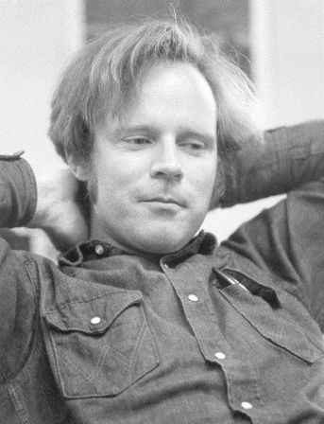
Heapify: A Modified Insertion Algorithm
A Modified Insertion algorithm
Robert Floyd (1964) found a better way to build the heap using a merge procedure called heapify
Consider a node (i) in the heap with children (L) and (R).
Consider (L) and (R) to be roots of proper heaps.
If tree rooted at (i) violates heap property, we let the parent node trickle down so subtree (i) satisfies the heap property.
Heapify algorithm rearranges the elements
of an array where the left and right sub-tree
of i^{th} element obeys the heap property.

Slide 35
Heapify Algorithm for a Maximum Heap
Adjust Heap for element (i)
Notice that in the worst case Heapify will take T(n) = O(log n), how?
ALGORITHM Heapify (A[1..n], n, i)
{ left = 2i right = 2i+1
if ((left ≤ n) and (A[left] > A[i])) then
max = left else max = i
if ((right ≤ n) and (A[right] > A[max])) then
max = right
if (max ≠ i) then
swap (A[i], A[max])
Heapify (A, n, max)
}
T(n)
i
T(n/2)
L
R
Adjust

Slide 36
Heapify Example
Consider the max heap rooted at (2) to have n nodes.
1
2
7
7
6
7
5
6
1
6
5
3
3
5
2
4
3
1
2
4
5
2
4
11
Heapify (A,n,2)
Heapify (A,n,5)
Heapify (A,n,11)
No Action

Slide 37
Complexity of Heapify
Consider the heap rooted at (i) to have n nodes.
In the worst case, the number of adjustments is:
Therefore, the worst-case complexity of Heapify will be T(n) = O(log n),

Slide 38
Building the Maximum Heap
Given an unsorted array A, we can make it a heap using the Heapify algorithm.
We know that the last internal node is at ⎣n/2⎦
All elements at ⎣n/2⎦+1 → n are already Heaps.
So, we apply Heapify only on elements at ⎣n/2⎦ → 1
Since heapify costs O(log n), so what is the advantage?
Assuming a full tree, the number of nodes on a level (L) is 2^{L-1} and the total number of nodes is n = 2^{h}-1. The worst-case number of heap adjustments is (h-L) at level (L).
ALGORITHM Build-MaxHeap (A[1..n], n)
for i = ⎣n/2⎦ downto 1 do Heapify (A, n, i)

Slide 39
Analysis
The worst-case cost of insertion will be:
Hence, using Heapify requires only O(n) operations instead of
O(n log n).
L
i
h
L
R

Slide 40
Explore
How to use Heapify in removing highest priority
How to make a heap act as a stack
How to make a heap act as a queue

Slide 41
7. Heap Sort Algorithm
The heap sort is a sorting algorithm based on Priority Queues.
The idea is to insert all array elements into a minimum heap, then remove the top of the heap one by one back into the array.

Slide 42
HeapSort Algorithm V1
//To sort an array X[ ] of n elements
heapsort( X[1..n ], n)
{
int i;
PQ <type> Heap(n);
for (i = 1 to n) Heap.insert(X[i]);
for (i = 1 to n) X[i] = Heap.remove();
}
O(n logn)
O(n logn)

Slide 43
Analysis of HeapSort V1
Worst case cost of insertion:
As we saw, every new insertion will have to take the element all the way up to the root, i.e. O(h) operations. Since a complete tree has a height of O(log n) , the worst case cost of inserting (n) elements into a heap is O(n log n)

Slide 44
Analysis of HeapSort V1
Worst case cost of removal:
It is now easy to see that the worst case cost of removal of an element is O(log n). Removing all elements from the heap will then cost O(n log n).
Worst Case cost of HeapSort
Therefore, the total worst case cost for heapsort is
O(n log n)

Slide 45
HeapSort Algorithm V2
//Sort an array X[ ] of n elements using Heapify Algorithm
heapsort (X[1..n ], n)
{ heap_size = n;
Build-MaxHeap (X[1..n], n)
for i = n downto 2 {
swap(X[1] , X[i])
heap_size = heap_size -1
Heapify ( X , heap_size , 1) }
}
O(n)
Loop O(n)
O(logn)

Slide 46
Analysis of HeapSort V2
Build-MaxHeap takes O(n) time
Each of (n-1) calls to Heapify takes O(log n)
Hence Heapsort takes:
T(n) = O(n) + (n-1) O(log n) = O(n log n)

Slide 47
Performance of Heap Sort
The complexity of the HeapSort is O(n log n)
In-Place Sort No (uses heap array)
Stable Algorithm No
This technique is satisfactory for medium to large data sets

Slide 48
Heap Sort Visualization
See Heap Sort visualization at:
https://www.cs.usfca.edu/~galles/visualization/HeapSort.html

Slide 49
8. Merging Two Binary Heaps (Union)
Merge two heaps H1 of size N and H2 of size M into one heap of size n = N + M.
The operation is Union(H1, H2) will cost O(n) where n is the total no. of elements in the two heaps.
Let A and B be the heap arrays of H1 and H2, respectively.
//To Merge two heaps
Union ( A[1..N ], B[1..M], N , M, C[1..N+M])
{
n = N + M;
Copy array A to C [1..N];
Copy array B to C[N+1 .. n];
Build-MaxHeap (C[1..n], n)
}
O(n)
O(n)
O(n)

Slide 50
9. Fibonacci Heaps: Motivation
Binary min-heaps/max-heaps can support creating a heap, insert, finding/extracting the min (max) efficiently.
Not good for merging two heaps H₁ and H₂ . Union(H₁, H₂) will cost O(n) where n is the total no. of elements in the two heaps.
Binary Heaps can also support decrease-key operation which allows us to decrease the value of a certain key inside the data structure.
Mainly, the decrease-key operation is used in Dijkstra’s algorithm when we discover a new path to a certain node at a lower cost. Cost is O(log n)
Fibonacci Heaps overcome these difficulties

Slide 51
Fibonacci Heaps
Introduced by Fredman and Tarjan, 1986
The primary advantages of a Fibonacci heap are the UNION and DECREASEKEY operations, which each take O(1) amortized time.
Operation | Binary Heap (worst case) | Fibonacci Heap (Average Case)
Insert (H,k) | O(log n) | Θ(1)
Minimum (H) | O(1) | Θ(1)
ExtractMinimum (H) | O(log n) | Θ(log n)
Union (H1, H2) | O(n) | Θ(1)
Decreasekey (H, x, k) | O(log n) | Θ(1)
Delete (H, x) | O(log n) | Θ(log n)

Slide 52
Fibonacci Heap: Properties
A Fibonacci Heap is a collection of trees and follows either min-heap or max-heap properties.
When a new element is inserted, it is added as a singleton tree.
When two heaps are merged, the root list of one heap is simply appended to the root list of the other heap.
When the extract-min operation is performed, the tree with the minimum root node is removed from the root list and its children are added to the root list.

Slide 53
Fibonacci Heap: why the name?
In a Fibonacci Heap, a tree of degree/order n has exactly n children.
The minimum number of nodes in a tree with a given degree is:
N(0) = 1
N(1) = 2
N(2) = N(0) + N(0) + 1 = 3
N(3) = N(1) + N(0) + N(0) + 1 = 5
N(4) = N(2) + N(1) + N(0) + N(0) + 1 = 8
So, it follows the Fibonacci sequence.

Slide 54
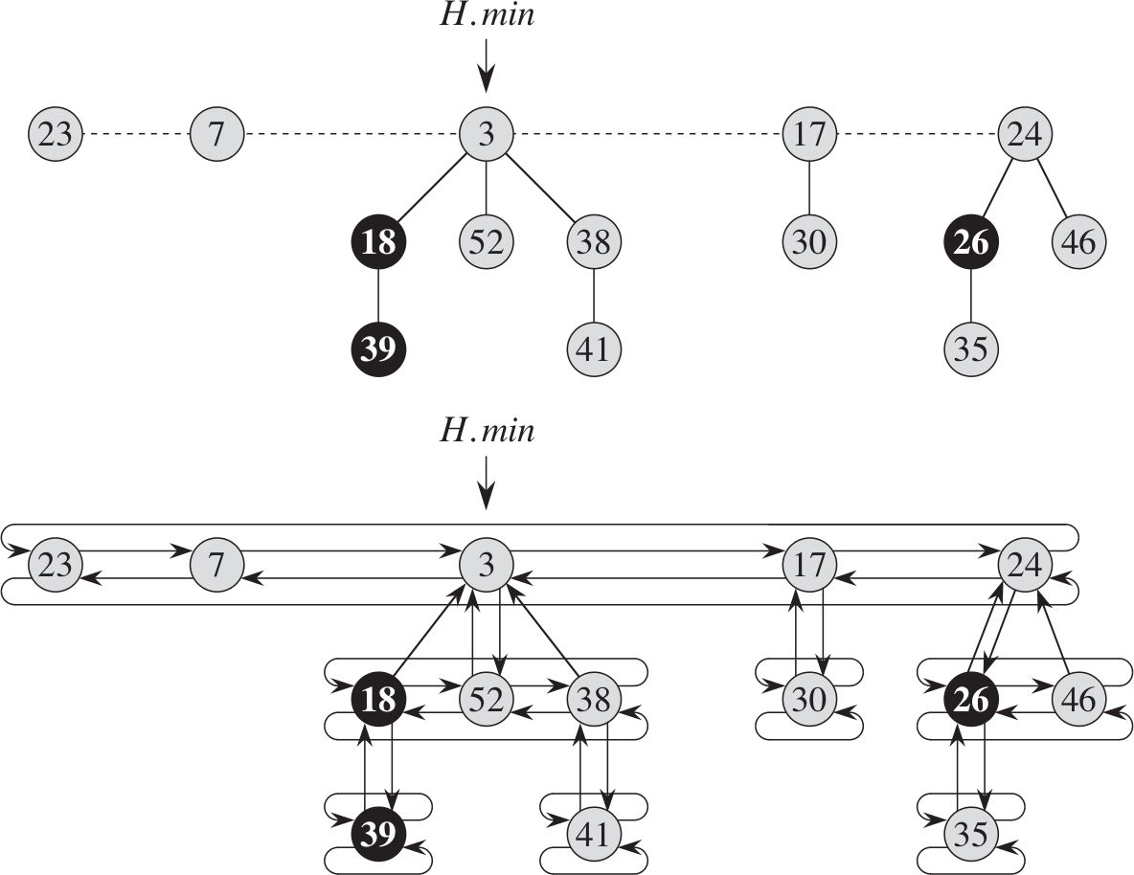
Fibonacci Heaps
Example:
Consists of 5 heaps with 14 nodes
All roots and siblings are stored in separated circular doubly linked lists
Marked nodes indicate nodes that have lost children
The degree of a node is the number of its children.

Slide 55
Fibonacci Heap: Potential Function
In analyzing the cost of operations in Fibonacci heaps, we use amortized cost which is calculated using a potential function.
For a heap (H):
t(H) = No. of trees in H
m(h) = No. of marked nodes in H
Potential function Φ (H) = t(H) + 2m(H)
If an operation changes a heap (H1) into (H2), the cost will be:
Cost = 1 + (Φ (H2) - Φ (H1))

Slide 56
Fibonacci Heap: Insertion of item x
If H is empty, create a new root list and adds x to it and the newly added x becomes the minimum node
else
Inserts the x in the root list
Checks whether the x -> key is smaller than the H -> min
If yes, then make x the minimum node of the H by updating the H -> min = x
Increase the number of nodes of in H by 1

Slide 57
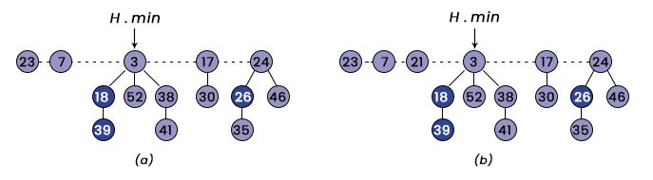
Example: Insertion of item 21
Cost = 1 + (Φ (H2) - Φ (H1)) = 1 + 1 = O(1)

Slide 58
Fibonacci Heap: Union of two Heaps
Creates a new Root List H.
Set H.min=H1.min;
Join (Concatenate) the root list of H2 with the root list of H
Check whether the H1.min is null, H2.min is null, and whether the H2.min is smaller than the H1.min or not
If yes, it set the H.min = H2.min6.
Number of nodes in H = sum of the number of nodes in H1 and H27.
Return H

Slide 59
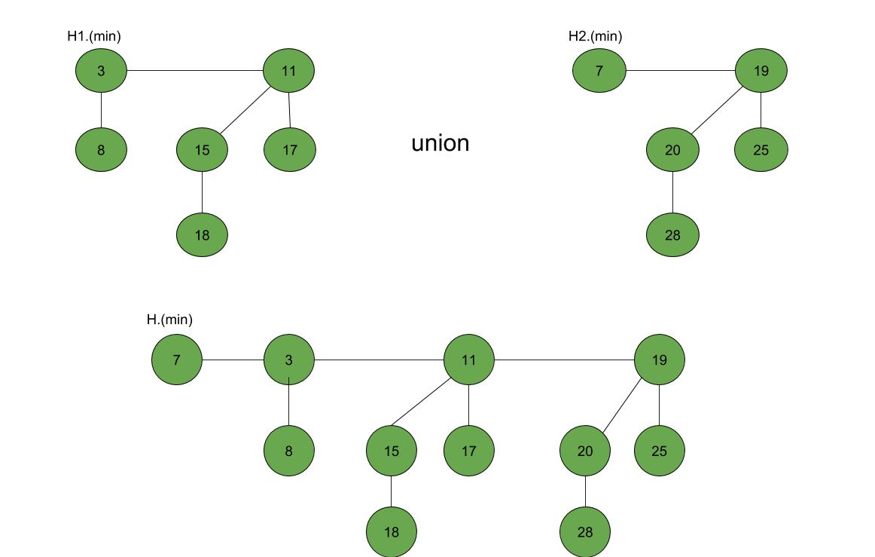
Example: Union of two Heaps
Cost = 1 + Φ (H) - (Φ (H1) + Φ (H2))
= 1 + 0 = O(1)

Slide 60
Explore
Explore other operations on Fibonacci Heaps
Operation | Binary Heap (worst case) | Fibonacci Heap (Average Case)
Insert (H,k) | O(log n) | Θ(1)
Minimum (H) | O(1) | Θ(1)
ExtractMinimum (H) | O(log n) | Θ(log n)
Union (H1, H2) | O(n) | Θ(1)
Decreasekey (H, x, k) | O(log n) | Θ(1)
Delete (H, x) | O(log n) | Θ(log n)

