Slide 1
CSCE 2211 Applied Data Structures
Prof. Amr Goneid, AUC
Part 9. Disjoint Sets

Slide 2
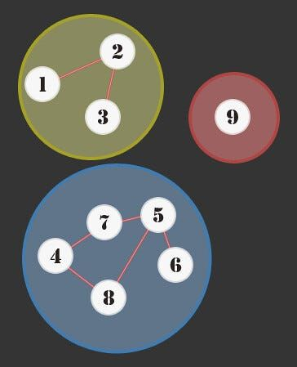
Disjoint Sets
What are Disjoint Sets?
Tree Representation
Parent Array Representation
Simple Find and Simple Union
Disjoint Sets Class

Slide 3
1. What are Disjoint Sets?
A set S is a collection of elements of the same type
A disjoint-set data structure keeps track of a set of elements partitioned into a number of disjoint (non-overlapping) subsets.
Disjoint sets:
If S_{i} and S_{j}, i ≠ j are two sets, then S_{i} ∩ S_{j} = Ø
Therefore, the intersection is always NULL
Examples:
S1 = {1,7,8,9}, S2 = {5,2,10}, S3 = {3,4,6}

Slide 4
What are Disjoint Sets?
Disjoint sets have a Union-Find structure.
Two useful operations on such a data structure are:
Find: Given an element, determine to which set it belongs. This can determine if two elements are in the same set.
Union: Join two sets into a single set.

Slide 5
Some Applications
Representation of disjoint collections of data (Clusters)
Representation of Trees, Forests and Graphs
Kruskal’s Minimum Spanning Tree Algorithm.
Job Sequencing Problem.
Cycle Detection in graphs.
Keeping track of connected component in an undirected graph.
Finding mutual friends.

Slide 6
2. Union-Find Data Structure: Tree Representation
One possible representation is a tree where a set can be identified by a parent node and children nodes.
In this representation, children point to their parents, rather than the reverse. The representative of the subset is the ancestor of all elements in that subset (e.g. 1 , 5 , 3)
S1 = {1,7,8,9} S2 = {5,2,10} S3 = {3,4,6}
1
5
3
7
8
9
2
10
4
6

Slide 7
3. Parent Array Representation
n disjoint sets can be represented as n disjoint nodes where each node is its own parent, i.e. p[i] = -1:
1
2
3
n
i
1 | 2 | 3 |  |  |  | n
-1 | -1 | -1 |  |  |  | -1
p[i]

Slide 8
4. Basic Operations
Find(i):
Given the element (i), find the set containing (i), i.e. find the representative of (i) = the root of the tree.
Algorithm for Simple find:
Keep traversing up the parent pointers until we hit the root.
int find(int i)
{ while (p_{i} >= 0) i = p_{i}
return i;
}

Slide 9
Simple Find
9
The value in p[i] represents the parent of node (i). For the sets S1,S2,S3 shown before, we have:
i
1 | 2 | 3 | 4 | 5 | 6 | 7 | 8 | 9 | 10
-1 | 5 | -1 | 3 | -1 | 3 | 1 | 1 | 1 | 5
p[i]
1
5
3
find (1) → 1
find (4) → 3
find (10)→ 5
7
8
9
2
10
4
6

Slide 10
Basic Operations
Union(i,j):
Given two disjoint sets S_{i} and S_{j}, obtain a set containing the elements in both sets, i.e.,
S_{i} ∪ S_{j}
Algorithm for Simple union:
Make the root of one of two trees point to the other, so now all elements have the same root and thus the same subset name.
void union (int i, int j)
{ p_{i} = j ; }

Slide 11
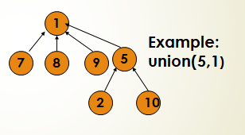
Simple Union
Before
Example: Union(i,j) = Make set (i) the child of set (j)
After union(5,1)
i
p[i]
i
1 | 2 | 3 | 4 | 5 | 6 | 7 | 8 | 9 | 10
-1 | 5 | -1 | 3 | 1 | 3 | 1 | 1 | 1 | 5
p[i]

Slide 12
5. Disjoint sets class
class Sets
{
private:
int *p, n;
public:
Sets(int Size): n(Size) // Constructor
{
p = new int[n+1];
for (int i=0; i<=n; i++) p[i] = -1;
}

Slide 13
Disjoint sets class
~Sets() // Destructor
{ delete [ ] p; }
void SimpleUnion(int i, int j);
int SimpleFind(int i);
};

Slide 14
Disjoint sets class
// Make set(i) the child of set(j)
void Sets::SimpleUnion(int i, int j)
{ p[i] = j; }
// Find the parent set of subset(i)
int Sets::SimpleFind(int i)
{ while (p[i]>=0) i = p[i];
return i;
}

Slide 15
Analysis
Union: takes constant time, i.e., O(1)
Find: Suppose we do the following sequence of unions:
union(1,2) , union(2,3),...., union(n-1,n)
The time of find parent of node (i) will be i.
To process all finds, we need
(1+2+....+n) steps = O(n²)
Hence, the average find cost per node is O(n)
n
n-1
2
1

Slide 16
Improvement: Union by Size
We can improve the find cost by modifying the simple union algorithm to be Union by Size:
“make the root of the smaller tree point to the root of the bigger tree”
In this case, the cost of find is O(log n)
Implementation:
We need a new array of integers called C[ ]. The size of this array is the same as the parent array p[ ]. If (i) is a representative of a set, C[i] is the number of the elements in the tree representing the set. Store the node count (size) in each root. Modify the count when making a union.

Slide 17
Modified Disjoint sets class
class Sets
{
private:
int *p, *c, n;
public:
Sets(int Size): n(Size) // Constructor
{
c = new int[n+1]; // Array of sizes
p = new int[n+1]; // Parent Array
for (int i=0; i<=n; i++) {p[i] = -1; c[i] = 1}
}

Slide 18
Disjoint sets class
~Sets() // Destructor
{ delete [ ] p; delete [ ] c;}
void UnionbySize(int i, int j);
int Find(int i);
};

Slide 19
Disjoint sets class
// Make a union between set(i) and set(j)
void Sets::UnionbySize(int i, int j)
{
int sum = c[i] + c[j];
if (c[i] > c[j]) {p[j] = i; c[i] = sum; }
else { p[i] = j; c[j] = sum;}
}
// Find the parent set of subset(i)
int Sets::Find(int i)
{ while (p[i]>=0) i = p[i];
return i;
}

Slide 20
Explore
Union by Height (Rank)
The C++ STL set container
Multisets in C++ STL

