Slide 1
Refugee Livelihood Adaptability: The Role of Adult Education in the Development of a Community’s Livelihood in Forced Migration Context in Uganda Salome J. Awidi. University of South Africa, Pretoria

Slide 2
Extract of a thesis entitled “Livelihood sustainability in forced migration context: the case of refugees in Kyaka II refugee settlement in south western Uganda”.
Focus: Factors of Influence: The 2006 refugee policy & adult education programs
Methodology: qualitative group case study
- 8 FGD with CIG (grass root collectives), 68 individual
interview, key documentation review

Slide 3
Main question: Sustainability of livelihoods of refugees in Kyaka II refugee settlement?
Objectives /research questions:
livelihood strategies of refugees in Kyaka II?
Factors influencing livelihood sustainability
How refugees perceive their livelihood
How refugees adapt ?

Slide 4
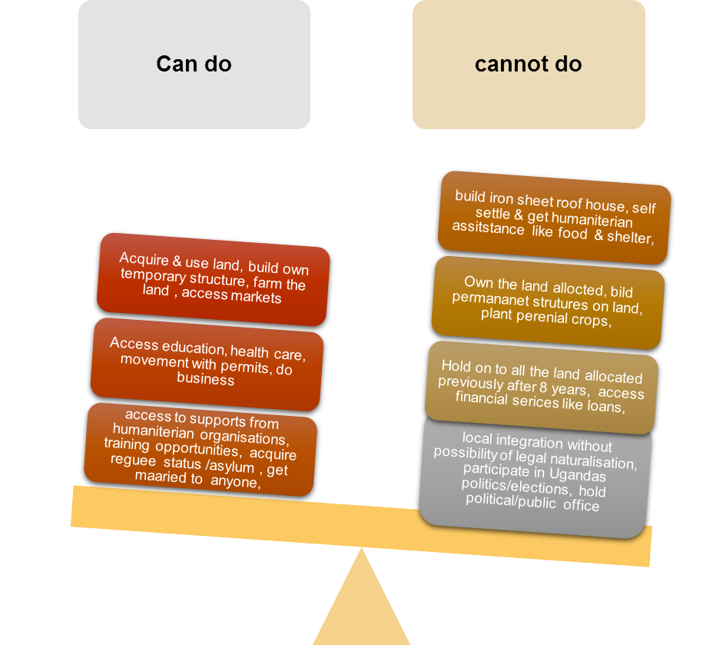
Findings: The 2006 Ugandan refugee policy

Slide 5
64% of the respondents thought a refugee status had certain limitations.
“…something was missing……..you can’t do big things and businesses like the nationals……………..…I feel useless and hopeless in the settlement….”
(Voices of refugee in a focus group discussion, Kyaka II)

Slide 6
The 2006 Ugandan refugee policy enigma

Slide 7
Findings: adult learning & education

Slide 9
Livelihood adaptation strategies
Embedded literacies in Farming activities and agriculture extension services (47% of study participants rely on the new sets of skills and knowledge acquired)
Language learning: English as a second/ native language (Ethnic similarity with boarder communities in the country of asylum was facilitate integration and adaptation of refugees)

Slide 10
Grass root collectives: Village Saving and loans associations/thematic livelihood groups dual purpose; social –economic roles (improving access to fast affordable credit & Psychosocial support for members)

Slide 12
Main livelihood strategies in Kyaka II refugee settlement
livelihood strategies in Kyaka II
Farming
Business/skills acquired
Microfinancing
Humaniterian assistance/aid
Social Networks

Slide 13
“I take my children to school so that they don’t live like refugees in future….”
(Francine, Kyaka II)

Slide 14
Procession of adult education graduates (Adjumani settlement, northern Uganda)

Slide 17
Conclusion
Adult Education facilitates acquisition of relevant sets of skills and knowledge, for local integration & adaptation of refugees

