Slide 1
Leveraging food systems for jobs, nutrition and poverty reduction in Africa – the case of Egypt Agricultural Value Chain Development: An economywide approach applied to Egypt
Clemens Breisinger, Mariam Raouf, James Thurlow and Manfred Wiebelt
IFPRI
ICRAC Conference
5/12/2019
Cairo, Egypt

Slide 2
Broadening the scope: from Agriculture to the Agri-Food System
We know that the (relative) role of agriculture in the economy declines as countries become richer, both in terms of the sector’s contribution to GDP and employment.
But agriculture is an important part of the larger agri-food system, which constitutes a sizeable part of all economies.
Food systems include the entire range of actors and their interlinked value added activities involving: the production, the aggregation, processing, distribution, consumption and disposal of food products
This presentation will address few important questions:
Agriculture serves multiple purposes – what are the trade-offs among different goals and between different value chains?
How to quantitively assess the different characteristics of agricultural value chains?
Which policies and investments can help reaching a country’s objectives?
An innovative tools exist for prioritizing agricultural investments: AIDA.
Agri-Food System (AFS)
Farmers
Input suppliers
Aggregators
Processors
Traders
Consumers
Exporters
Food Services

Slide 3
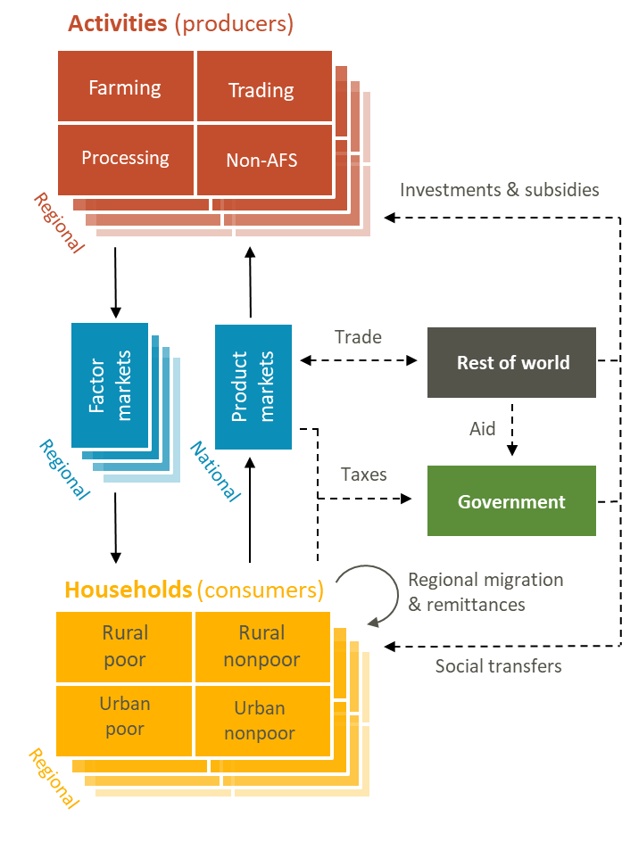
Adding the “Development” Case to the “Business” Case
“Traditional” value-chain analysis provides the “business case” for investment
When at scale, value-chains have economy-wide implications:
Contribute to (regional) economic growth
Resource competition: labor, capital, land etc.
Impact on other (food) prices
Need to establish the “development case” for a value chain strategy by considering economy-wide benefits and costs, using the IFPRI Dynamic CGE modelling
Why does this matter?
Better capture the role of agri-food in the economy
Sub-national regional approach
Show trade-offs between different goals such as growth, poverty and nutrition
Forward-looking estimates of expected economy-wide impacts of policies and interventions
Source: IFPRI

Slide 4
CGE: A Planning and Strategy Development Tool
Economy-wide, regionalized DCGE Model developed by IFPRI in collaboration with IFAD and CGIAR-PIM (RIAPA and AIDA projects)
One tool in the toolbox that can serve as a policy laboratory
Detailed economic structure
68 productive sectors in each of 3 regions (Lower Egypt, Upper Egypt, Suez Canal) of which 23 agriculture
9 factors (land, labor, capital)
15 representative households (rural farm, rural non-farm, and urban each by quintiles) per region
Resource constraints
Crop land and skilled labor is fully-employed (wages adjust)
Wage elastic supply of uneducated and primary educated labor
Recursive dynamic
Saving → Investment → Capital stock
Model is calibrated to 2015 CAPMAS-IFPRI SAM, Baseline scenario from 2015-2022
Captures details of the food system and its linkages to the broader economy
23 Agricultural Sectors & Products
Maize | Sorghum + millet | Rice | Wheat + barley | Other cereals | Pulses | Groundnuts | Other oilseeds | Roots | Vegetables | Sugarcane | Tobacco | Cotton + fibers | Fruits + tree crops | Tea | Other crops | Cattle | Raw milk | Poultry | Sheep + goats | Other livestock | Forestry | Fisheries
17 Agro-Processing Sectors & Products
Meat | Fish + seafood | Dairy | Fruits + vegetables | Fats + oils | Maize milling | Sorghum + millet milling | Rice milling | Wheat + barley milling | Other grain milling | Sugar refining | Other foods | Animal feed | Beverages | Tobacco | Cotton yarn | Wood products
20 Other Industrial Sectors & Products
Coal | Crude oil | Natural gas | Other mining | Textiles | Clothing | Leather + footwear | Paper | Petroleum | Fertilizers | Other chemicals | Non-metal minerals | Metals + metal products | Machinery | Equipment | Vehicles | Other manufacturing | Electricity + gas | Water supply + sewage | Construction
12 Services Sectors & Products
Wholesale + retail trade | Transportation + storage | Accommodation | Food services | Information + communication | Finance + insurance | Real estate activities | Business services | Public administration | Education | Health + social work | Other services

Slide 5
Questions asked:
Which agricultural value-chains, if scaled-up, are most effective at…
Accelerating agricultural and national economic growth
Reducing poverty
Creating jobs on and off the farm
Improving nutrition by diversifying diets
Category
Maize
Rice
Wheat
Vegetables
Sugar cane
Cotton
Fruits and nuts
Cattle
Milk
Poultry and eggs
Small ruminants
Fishing
Simulation Shocks
Total factor productivity (TFP) growth in each group of agricultural products and regions is accelerated beyond baseline growth rates, such that, in each value-chain scenario, total agricultural GDP or regional agricultural GDP is one percent higher in 2022 than it is in the baseline scenario

Slide 6
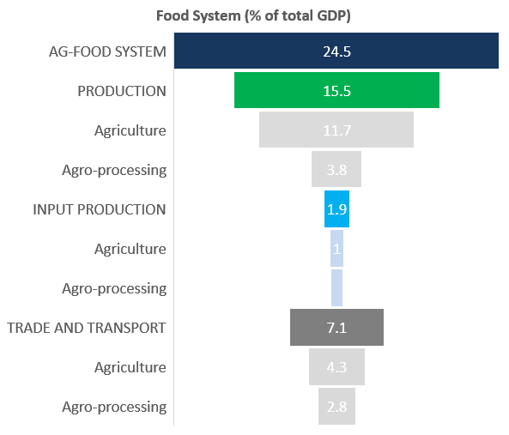
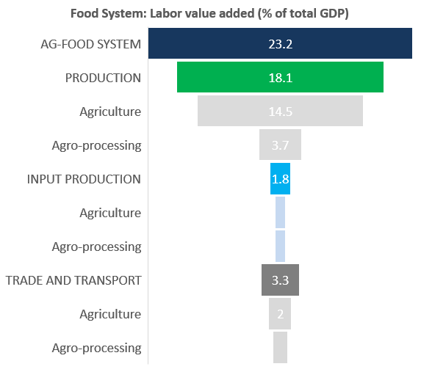
Agri-food System in Egypt
(GDP and Labor Value Added)
Source: AIDA-RIAPA model

Slide 7
Agri-food System in Egypt
(Example: Vegetable Supply Chain)
Trade and retail make up more than half of value added in the vegetable supply chain
Value added on the farm (production) is 22.5% and from vegetable processing is 6.6%
Value added created by the production of intermediate inputs is a combined 20.6%
Compared to higher income countries, the production share is relatively high and the processing and retail shares are low
Source: AIDA-RIAPA model

Slide 8
Agri-food System in Egypt
(Regional GDP, AgGDP, Ag Processing GDP)
The majority of economic activity is in Lower Egypt (71.6% of GDP)
The large majority of agro-processing activity is in Lower Egypt (78.3% of GDP)
Upper Egypt plays an important role in primary agriculture, contributing 30.2 percent to AgGDP
Source: AIDA-RIAPA model

Slide 9
Agri-food System in Egypt
(Import and export intensities)
Trade intensities matter for impacts on prices when scaling up value chains
4.9% of crop commodities and 4.2% agro-processing products are exported
13.9% of crop commodities and 12.0% of agro-processing products consumed in Egypt are imported
Source: AIDA-RIAPA model

Slide 10
Agri-food System in Egypt
(Household food consumption)
Estimated household expenditure is $1,975 (national average); $1,423 (rural); $2,714 (urban)
Rural households spend 32.6 of expenditures on food compared to 26.7 for urban households
Income elasticities of demand are lower for inferior goods (cereals, roots) and higher for meats and fruits
Source: AIDA-RIAPA model

Slide 11
Impacts on economy-wide growth
Agricultural growth is good for economy-wide growth for all value chains
Size of the positive impact is largely determined by inter-sectoral linkages and market demand (domestic and international)
Impacts on regional growth vary by region and crops
Source: AIDA-RIAPA model

Slide 12
Impacts on poverty
Agricultural growth is pro-poor for all value chains and all regions (the real income of the poor grows faster than average household incomes)
Regional agricultural growth has positive impacts on rural and urban households (mainly through lowering prices)
Source: AIDA-RIAPA model

Slide 13
Impacts on labor value added (employment)
Productivity-driven agricultural growth often leads to net job losses in agricultural sector (as usually observed during transformation)
Agriculture-led growth can create new and better jobs in and beyond the agro-food system
But for comprehensive and job-creating economic transformation additional growth in non-food system sectors is needed
Source: AIDA-RIAPA model

Slide 14
Impacts on dietary diversity
Agricultural growth is good for dietary diversity for all crops (mainly through lowering prices)
Fruits are particularly good for dietary diversity
But, the example of livestock-led growth shows that growth acceleration in single sectors can have negative effects (mainly through increasing staple prices)
International trade can help mitigating large domestic price effects
Source: AIDA-RIAPA model

Slide 15
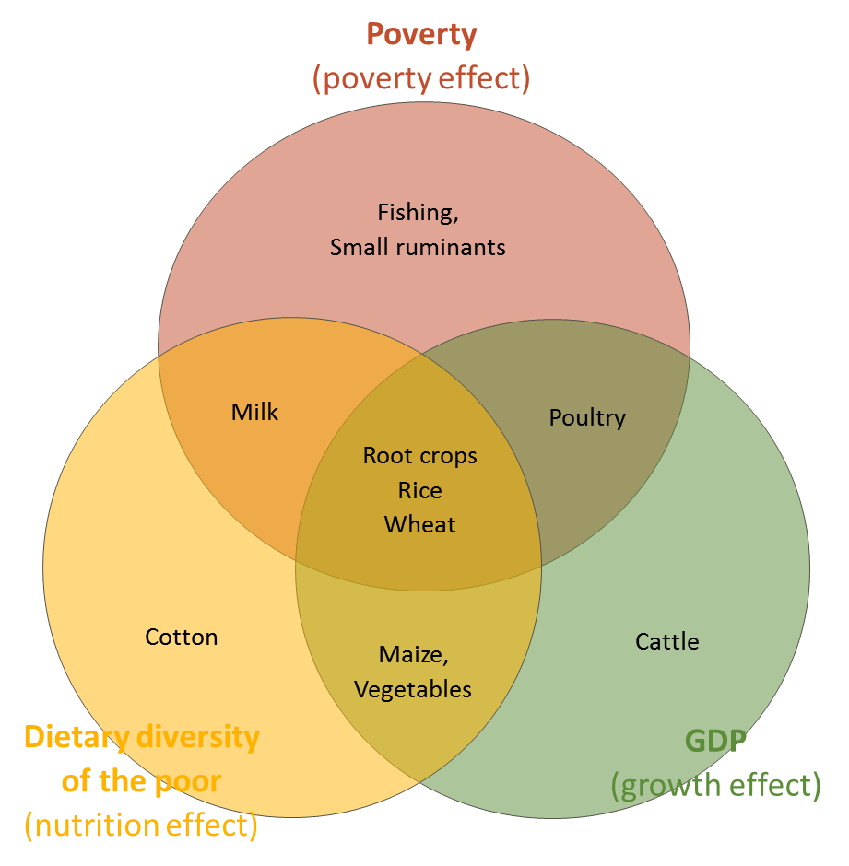
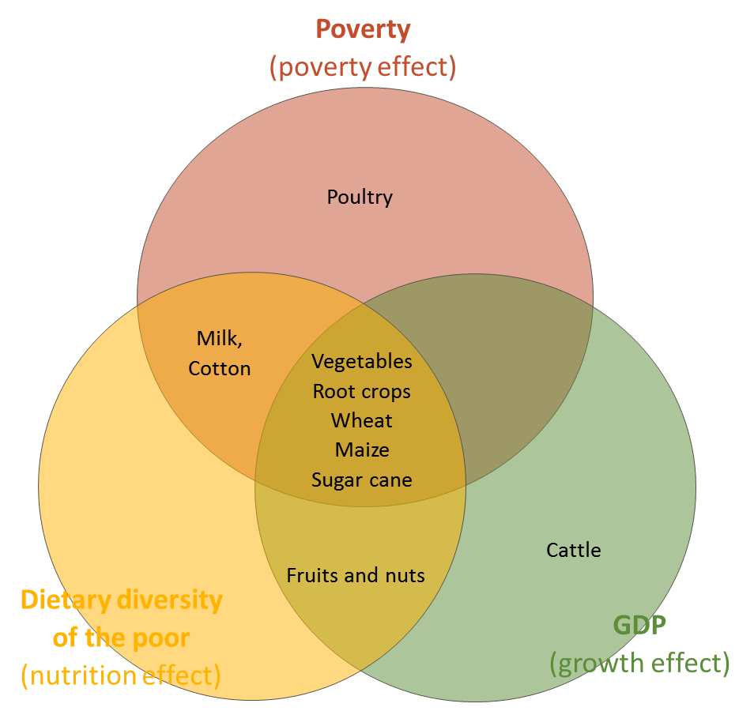
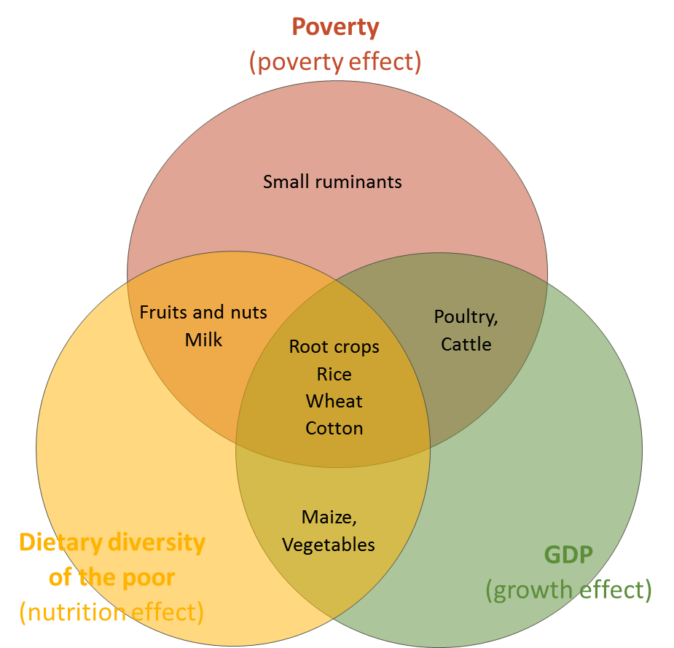
Top 8 priority value chains (Lower Egypt)
Lower Egypt
Upper Egypt
Suez Canal
Source: AIDA-RIAPA model

Slide 16
Conclusions
The food system will remain a substantial part of the Egyptian economy
The relative importance of primary production is likely to decrease and the role of agro-processing and food-related services is bound to increase
Food system development is likely to create better jobs but not necessarily many more jobs
For comprehensive economic transformation and job creation, parallel growth acceleration in non-agricultural sectors is necessary (for absorbing farm labor and increasing agri-food demand)
Most value chain development generates growth, is pro-poor, and improves nutrition
No single VC is best at achieving growth, employment, poverty reduction and nutrition
Impacts across regions vary substantially
Size of the impact mainly depends on economic linkages, employment and price effects
Economy-wide value chain/food system modeling (like AIDA) can help (agricultural) strategy development, policy planning and large-scale project design
The impact of value chain development critically depends on the policy and business environment (e.g. agricultural and food policies, infrastructure, business climate )
In a few months an online version of AIDA will be available for Egypt, followed by Tunisia

