Slide 1
Are Micro-Loans Too Small? November 2019
Gharad Bryan (LSE)
Dean Karlan (NWU)
Adam Osman (UIUC)
Presented by: Sarah Wahby (J-PAL/AUC)
Notes:
Alternative Title: Are Micro-Loans Too Small To Promote Business Growth?

Slide 2
Enterprises Growth
Returns to capital are high among microenterprises (De Mel, McKenzie and Woodruff, 2008)
Firms are credit constrained (WB Enterprise surveys)
The microcredit literature shows that the returns to microloans are often modest Angelucci et al (2015), Attanasio et al (2015), Augsburg et al (2015), Banerjee et al (2015a,b), Crepon et al (2015), Karlan and Zinman (2011), Tarozzi et al (2015),Kaboski & Townsend(2012)

Slide 3
Are Micro-Loans too Small?
Larger loans could be the answer
There could be returns to scale that are being missed due to capital constraints
Even if returns are high, doubling a small loan may not be enough to really make a difference
However, there may be decreasing marginal returns to capital: Meager (2018)
Overall the effects of larger loans are ambiguous:
Research Question 1: What is the impact of providing larger loans to microenterprises?
Notes:
Look at poor economics and see their discussion of the s shaped
Baseline business plan, and look at what type of business they actually did? Differences in sectors?
Heterogeniety in returns in the capital papers?
Fafchamps? Mckenzie? Roth? Gazellles? Business Plan competition?
Equipment, machinery, land,
Looking at riskiness of investments:
-assets bought
-type of business
-variation in profits
-likelihood of failed business
-Quantile regressions
-racheal meger- read the paper.
-distributions
-prob that profits is below a threshold, and change the threshold, and iterate and generate a graph
- Who are the people who benefit most from the different types of capital? ML… lasso

Slide 4
How Important is Heterogeneity?
It’s intuitive that some people will use capital better than others
Ex-ante targeting of high-return individuals is the “holy grail” in business, finance and development
But predicting the future is hard!
Earlier literature has some suggestions, e.g. prior business performance, risk preferences, etc
Can Machine Learning techniques do a better job? (McKenzie & Sansone 2018)
Research Question 2: How important is heterogeneity in explaining the impacts of larger loans for microenterprises?
Notes:
Maybe remove the last point? It’s nice but doesn’t fit.

Slide 5
What we do
We run a Randomized Experiment to identify high-potential borrowers at an MFI
Treatment borrowers are provided a loan 4x larger than their previous loan, while control borrowers are provided a loan at most 2x larger than their previous loan
We collect three types of data about borrowers:
“Hard” data: age, education, revenues, expenses, etc
“Soft” data: loan officer assessments of borrower potential
“Psychometric” data: questions aimed at assessing borrower’s personality

Slide 6
“Psychometric” Data
150 statements that respondents assess on a 5 point likert scale (1=Strongly Agree; 5=Strongly Disagree)
Examples:
I will do anything to get what I want
I am a natural risk taker
I don't like following rules
I see patterns and connections where other's don't
I always know when to give up, and move on to something else
I can't wait to get out of bed in the morning - there is always so much to do

Slide 7
Partner and Context
Alexandria Business Association (ABA)
The largest MFI in Egypt and the MENA region
Around 500k clients
2 billion EGP portfolio
66 branches across 7 Governorates
Average loan around 3000EGP
Only 0.5% of clients have loans greater than 20000 EGP
Clients only allowed gradual increase in borrowing
This is typical for many lenders

Slide 8
Intervention Details
Researchers approached loan officers and informed them of opportunity to suggest borrowers for new program called “Tomouh” (i.e. Ambition)
Loan Officers approached current borrowers in good standing and offered them the opportunity to apply for the program
Eligibility Criteria included having successfully completed a prior loan in the 5k-15k range (~$280- $840)
Loan Committee at MFI HQ would further screen the applicants for suitability
Borrowers would be randomized into T/C at individual level, stratified by Loan Officer
1004 borrowers (501T/503C). This gives us a relatively high powered study
Enrollment took place between June 2016-June 2017

Slide 9
Sample Characteristics & Balance
Notes:
6820EGP is about $383, so between $350-$400 a month. So the treatment loan is about 3 times the size of monthly profits

Slide 10
Take Up & Disbursement of Funds

Slide 11
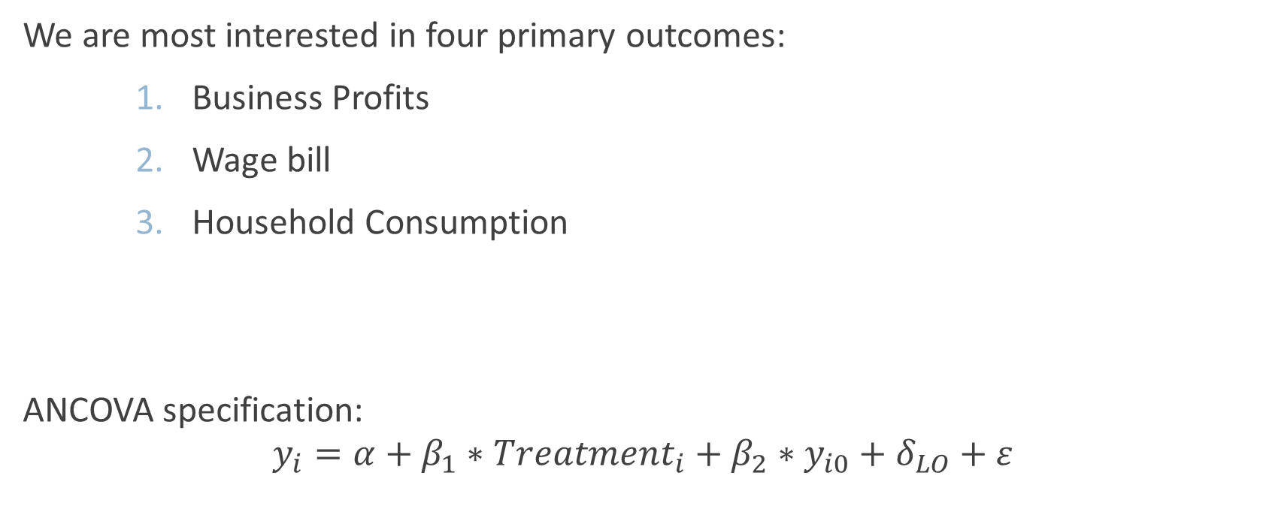
Primary Outcomes
We are most interested in four primary outcomes:
Business Profits
Wage bill
Household Consumption
ANCOVA specification:
$$y_{i}=α+β_{1}∗Treatment_{i}+β_{2}∗y_{i0}+δ_{LO}+ε$$

Slide 12
1 Year Follow Up

Slide 13
Heterogeneity: Business Characteristics

Slide 14
Heterogeneity: Loan Officer Info

Slide 15
Heterogeneity: Borrower Demographics

Slide 16
Heterogeneity: Psychometrics

Slide 17
Conclusion
We randomized the provision of SME-level loans to microenterprises in Egypt
We find large but imprecise positive effects on profits & total wages, and a 10% increase in household consumption. Still analyzing results.
Hard, Soft and Psychometric data hint at heterogeneity, pursuing machine learning strategies to provide more structured tests
Thank You!

