Slide 1


AUC Formula Competition Team
The American University In Cairo
Mechanical Engineering Department
Notes:
1

Slide 2
Forces and Calculations

Slide 3
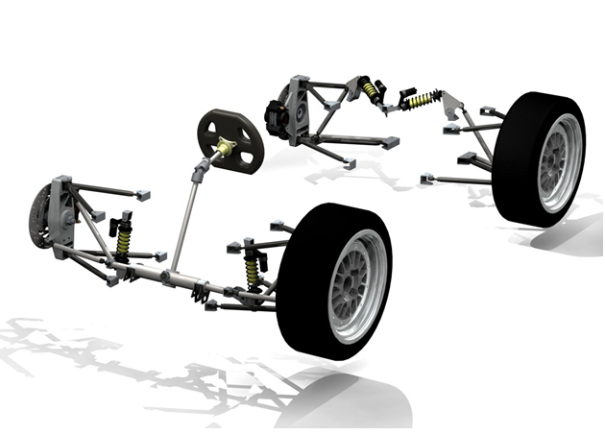
Outline
Overview
Different Systems
Design Phase
Manufacturing Phase
Assembly Phase
Static Testing
Test Drive
Disassembly and shipping
Competition

Slide 4
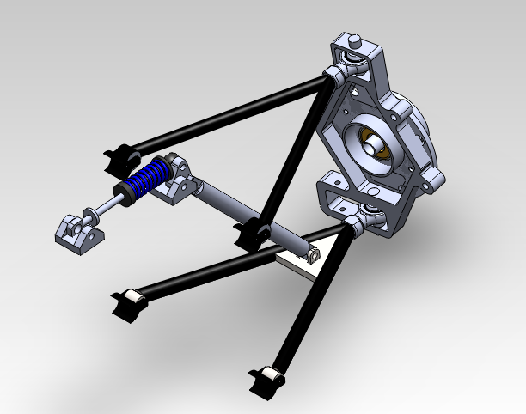
Suspension Components
Wishbone
Push rod
upright
spring
Crank bell

Slide 5
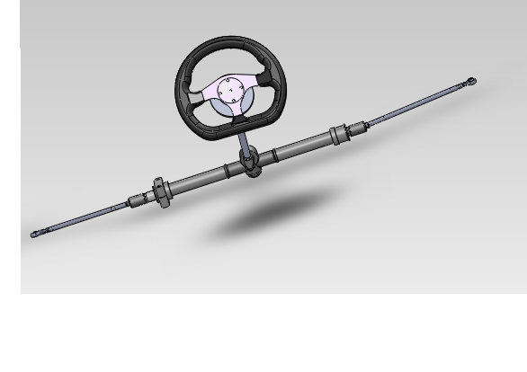
Steering Components
Quick release
Steering wheel
Column rod
Tie rod
Ball joint
Rack and pinion

Slide 6
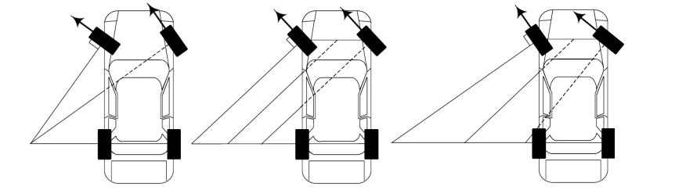
Steering Theories
Ackerman
Parallel
Reverse Ackerman

Slide 7
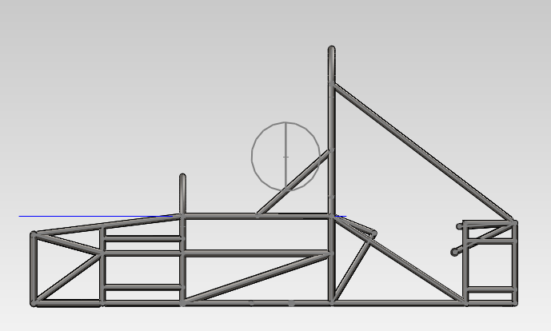
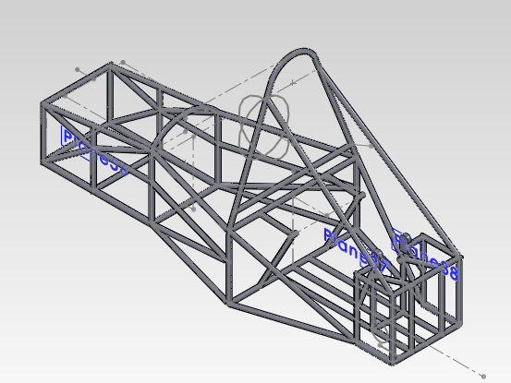
Main components of chassis

Slide 8
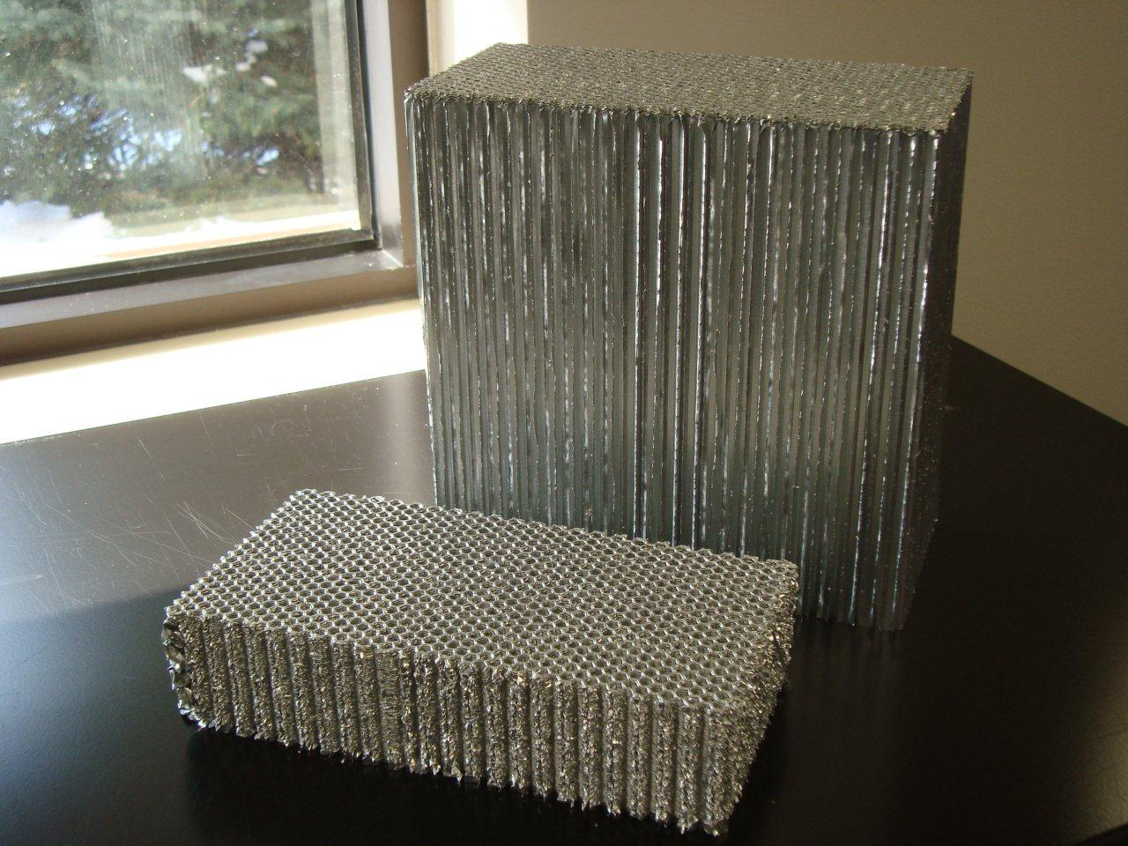
Impact Attenuator Design

Slide 9
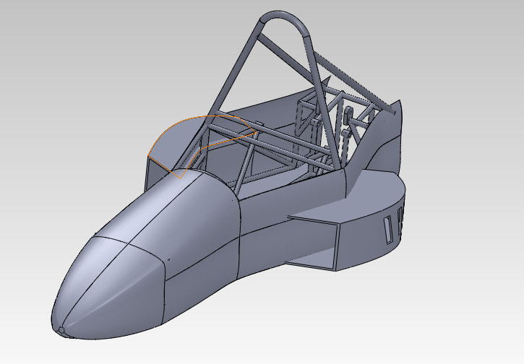
PRELIMINARY DESIGNS
The proposed Design
Near final dimensions
All Solidworks sketches are fully defined.
The dimensions are nearly finalized.
The design looks more aerodynamic than design two.
C_{d}=0.36

Slide 10
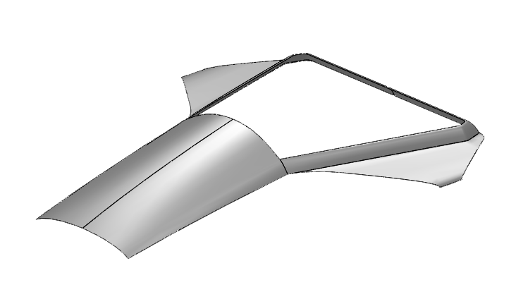
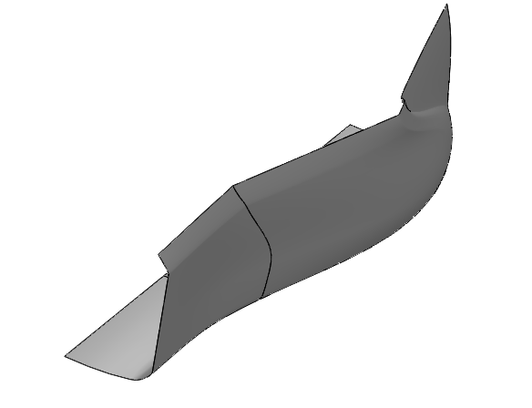
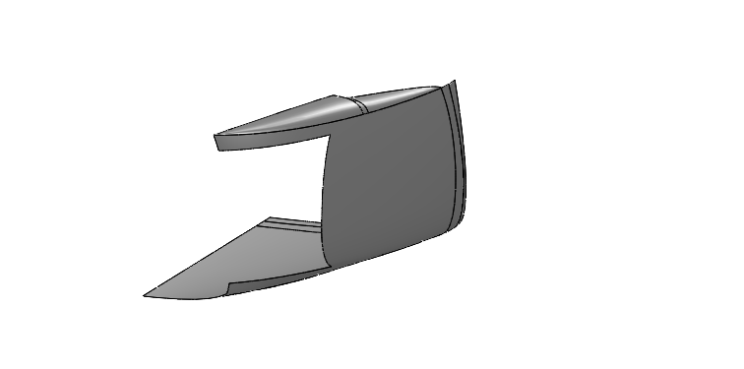
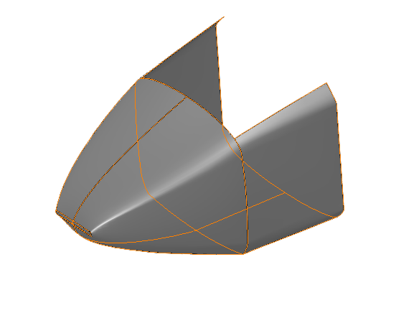
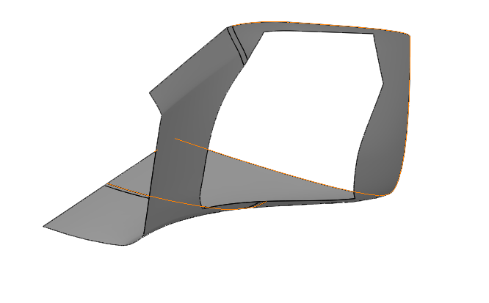
THE Proposed DESIGN

Slide 11
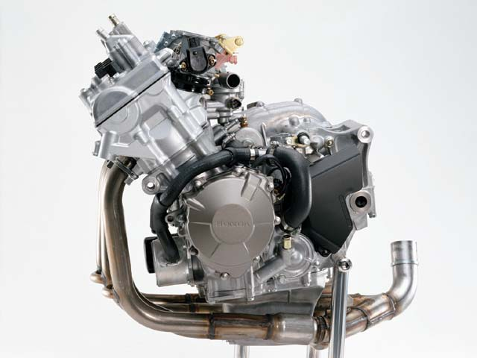
Selected Engine
Selected Engine
HONDA CBR600RR

Slide 12
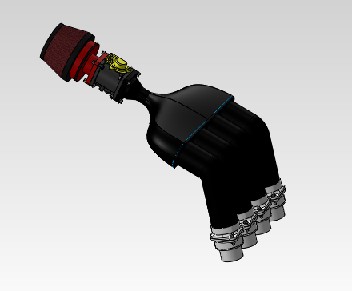
Air Intake Final Design
Air Intake Design

Slide 13
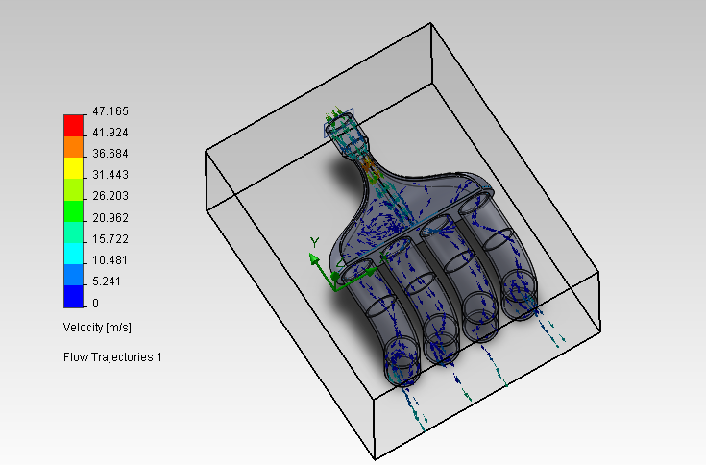
Air Intake System Flow Simulation
Air Intake System Flow Simulation

Slide 14
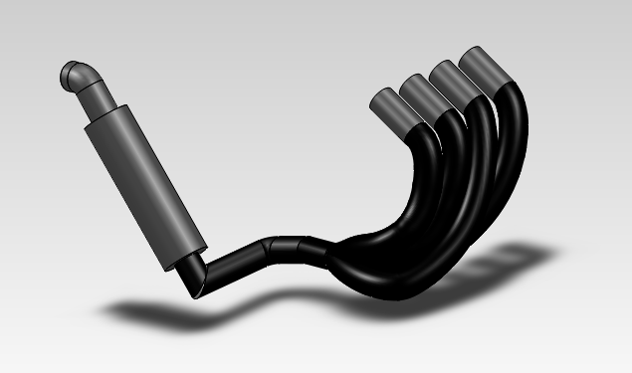
Exhaust System Final Design
Exhaust System Design

Slide 15
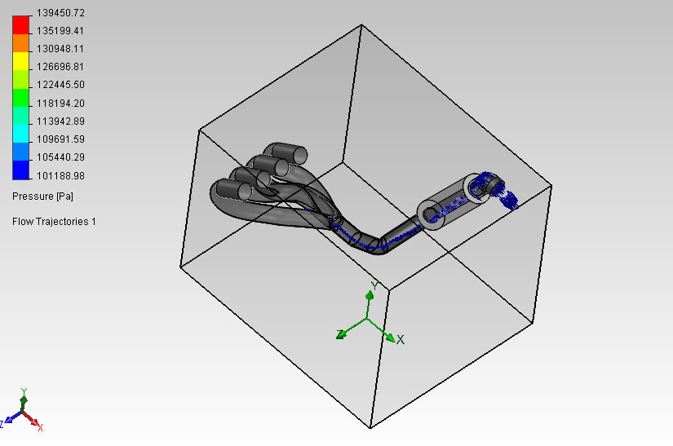
Exhaust System Final Design
Exhaust System Design Analysis
Material Selection Criteria
-High Temperatures, Cost & Availability
Material: Cast Iron
Manufacturing
Items to be Purchased:
-Catalytic Converter
Further Modifications

Slide 16
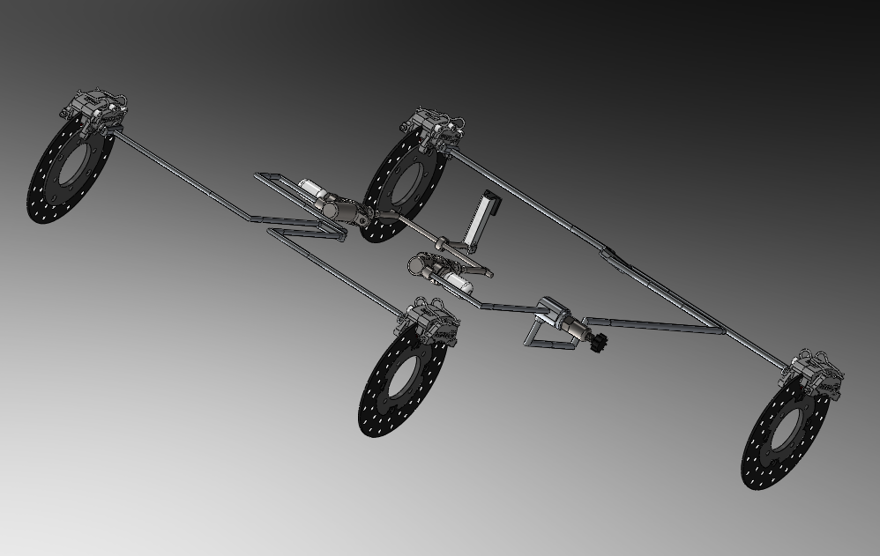
Brake System Design

Slide 17
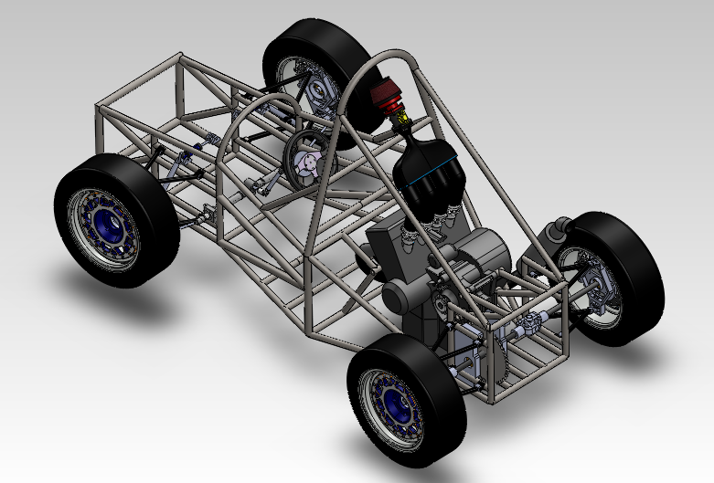
Powertrain Assembly

Slide 18
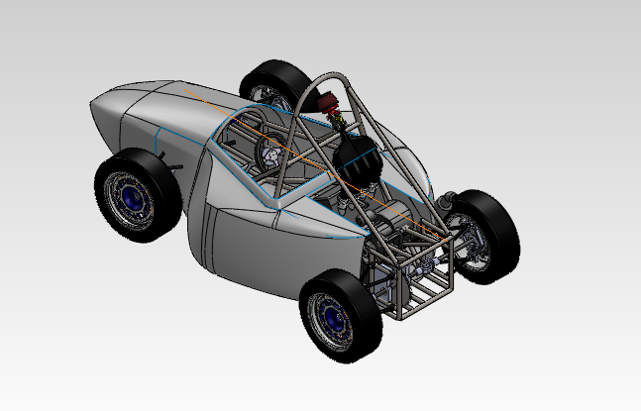
Final assembly

